Slide 1
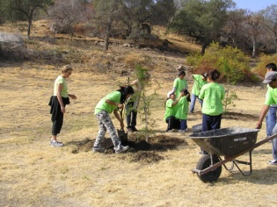
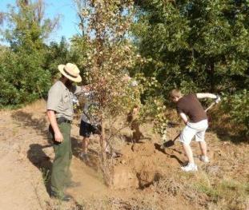
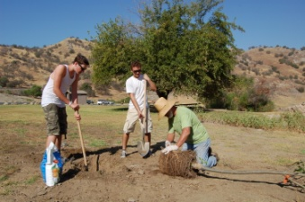
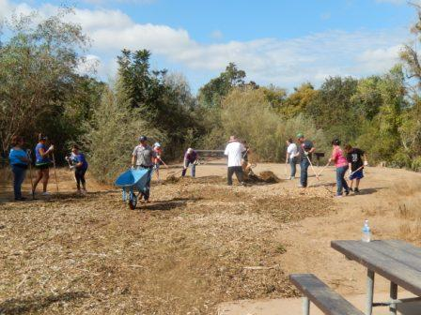
Who’s involved?
National Public Lands Day is a unique public-private partnership involving many federal, state, and local land agencies. These Agencies work closely with business partnerships such as Toyota, Outdoor Life Network, Coleman and numerous non-profit organizations. The National Environmental Education & Training Foundation manages, coordinates and generates financial support for the program.
Stanislaus River Parks
Sacramento District
United States Army Corps of Engineers
Sacramento District
Stanislaus River Parks
17968 Covered Bridge rd
Oakdale Ca. 95361
Helping hands for
public lands!
September 25th
2021

Slide 2
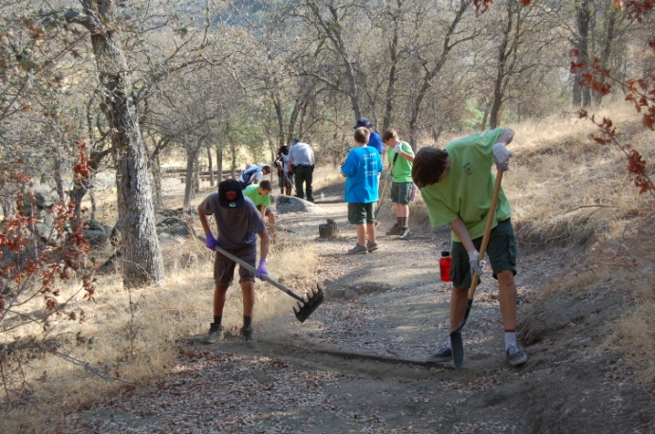
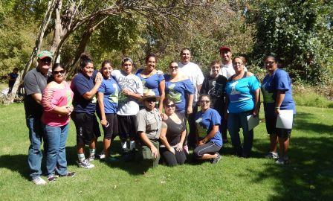
What Is National Public Lands Day?
National Public Lands Day (NPLD) provides Americans with a dramatic and productive opportunity to pitch in and help improve their public lands. One-third of the land area of the United States is in public ownership. These 700 million acres are used and protected for water supply, flood damage reduction, recreation, timber, scenic beauty, education and much more.
National Public Lands Day is an event that occurs once a year when hundreds-of-thousands of volunteers come together to improve the country’s largest natural resource– our public lands. These volunteers gather on the last Saturday every September to help improve the areas they enjoy.
Volunteer your helping hands
Volunteers are needed to help maintain landscape, refurbish campsites, plant trees, collect litter, and have fun. They will also learn about the importance of public lands to our nation.
Volunteer Recognition
All volunteers will receive a free day pass into any public lands across the nation. Stanislaus River Parks will offer free day passes to any federal park for all pre-registered volunteers. Lunch and refreshments will be served after a morning of hard work. If you would like to participate, call (209)881-3517 and ask for Frankie.
National Public Lands Day
Please call us and confirm your participation. We will contact you one to two weeks prior to September 25th, 2021 with all the details surrounding the event. Please R.S.V.P. @ 209-881-3517
Please meet us at Knights Ferry Recreation Area at 8:00 a.m. to get signed in and choose your project
Name
Address
Phone
Will you be participating?
Yes, how many people ______
No
Stanislaus River Parks
17968 Covered Bridge rd
Oakdale CA 95361
Phone: 209-881-3517
Fax: 209881-3203
Email: Frankie.L.Bowers@usace.army.mil

