Slide 1
Port of Stockton
July 13, 2020

Slide 2
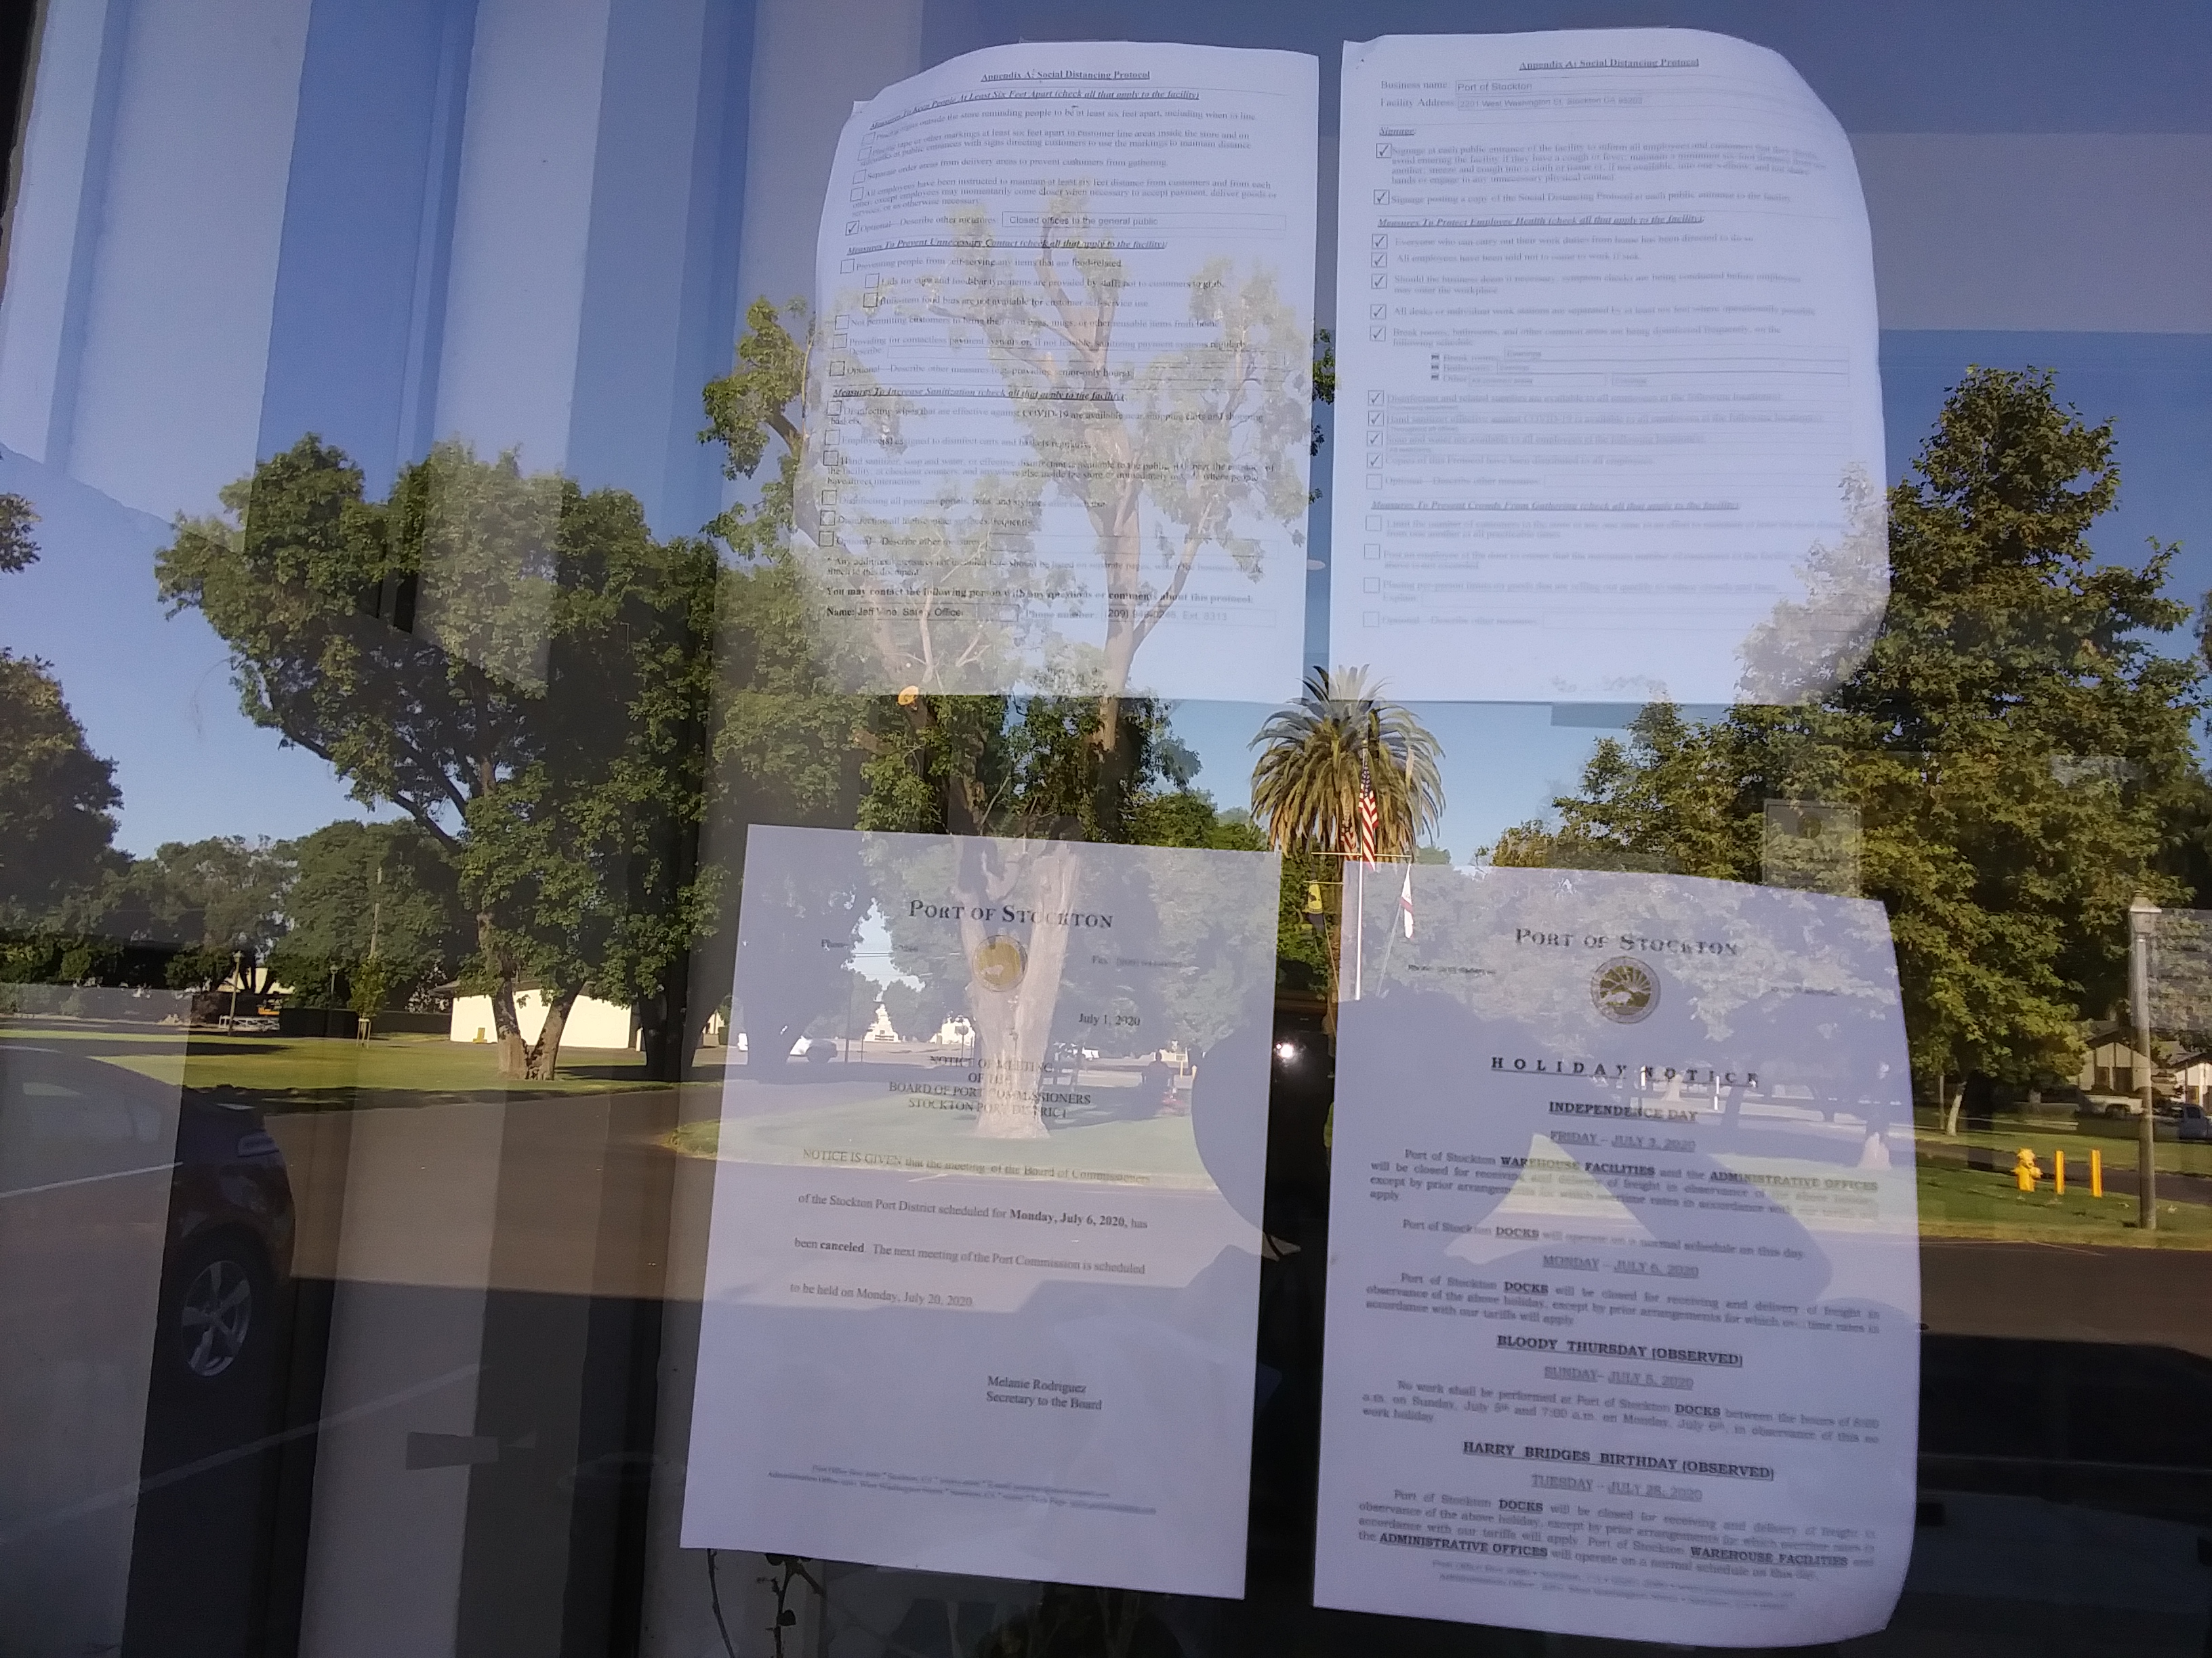
Notice to the Public w/o Internet

Slide 3
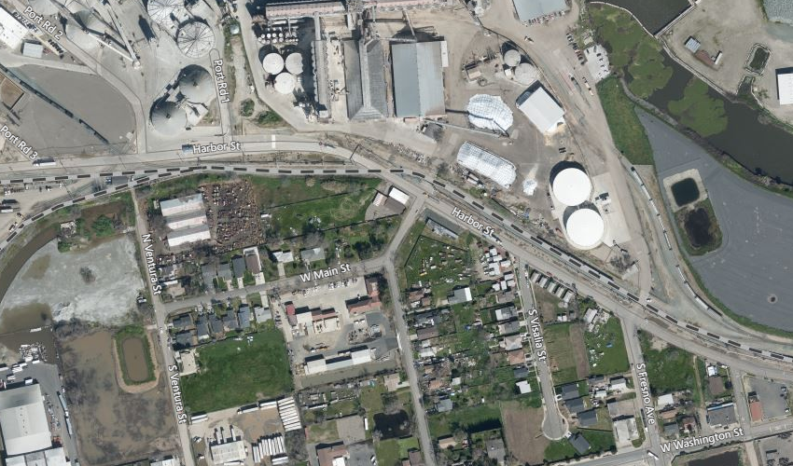
New Housing South Visalia

Slide 4
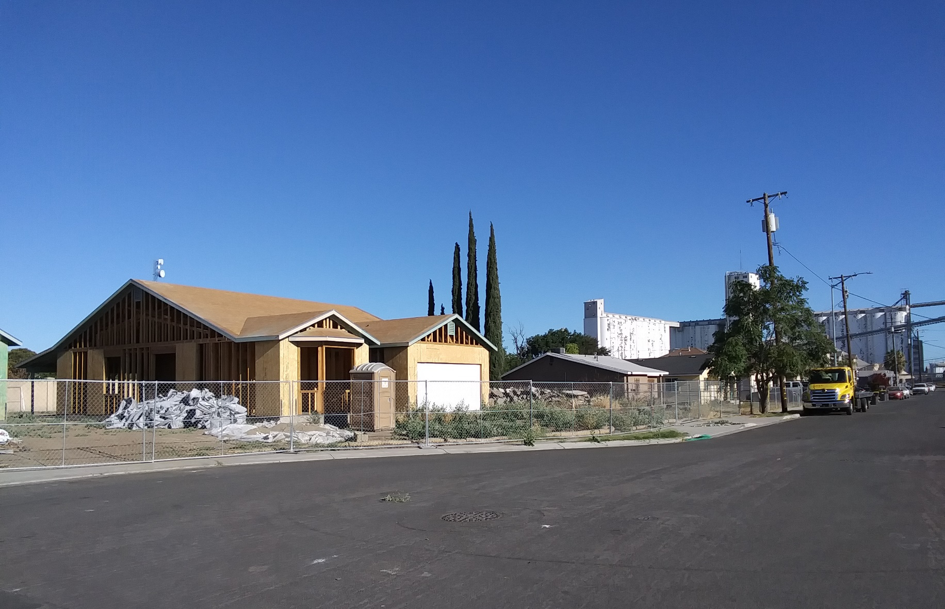
New South Visalia Street Housing

Slide 5
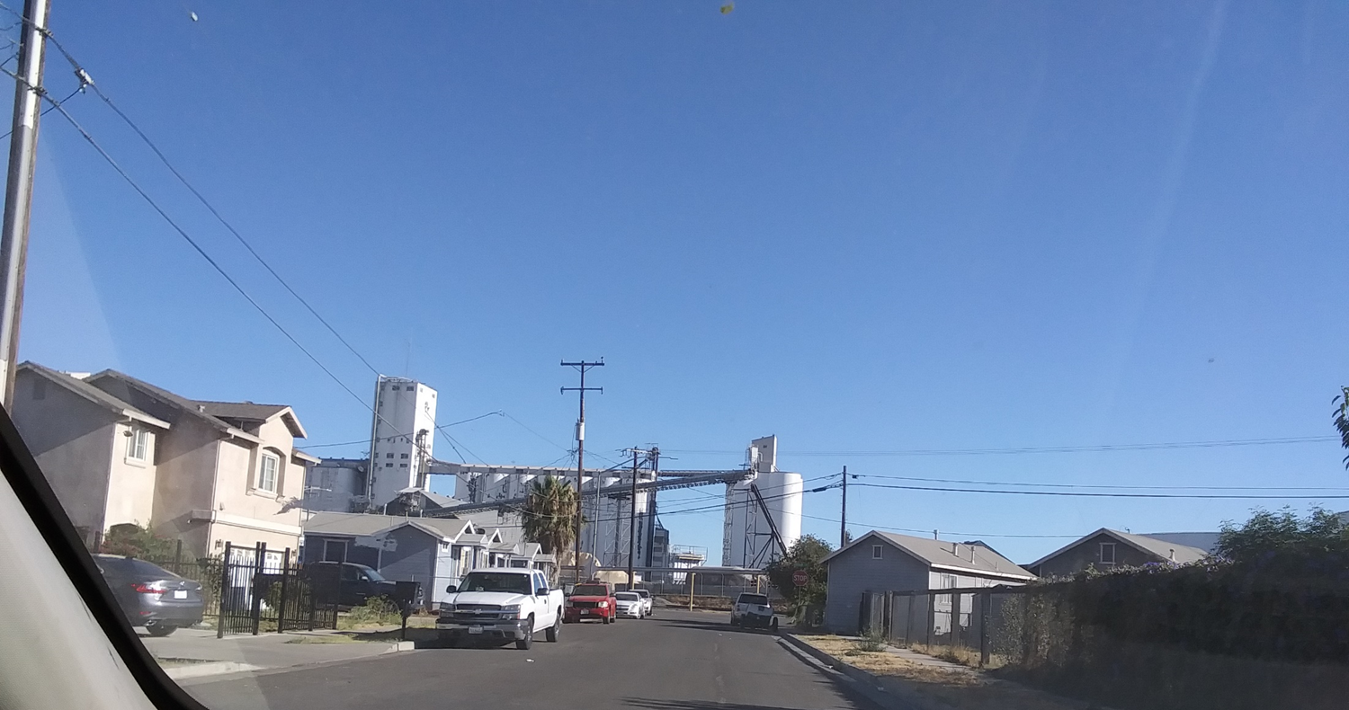
End of South Visalia Street Facing North

Slide 6
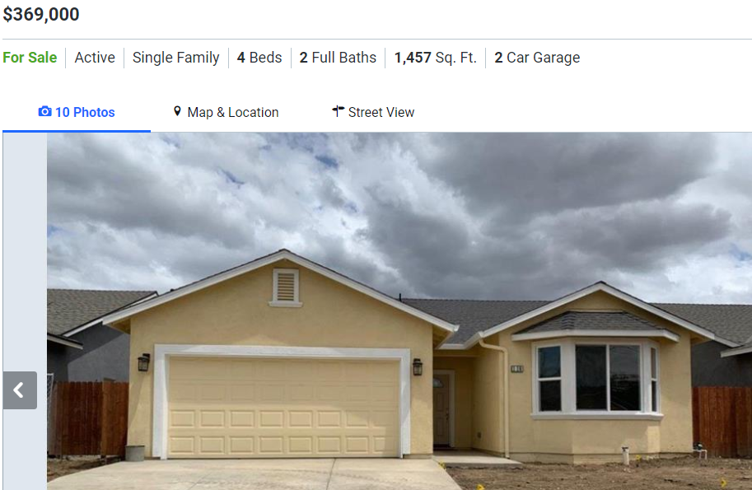
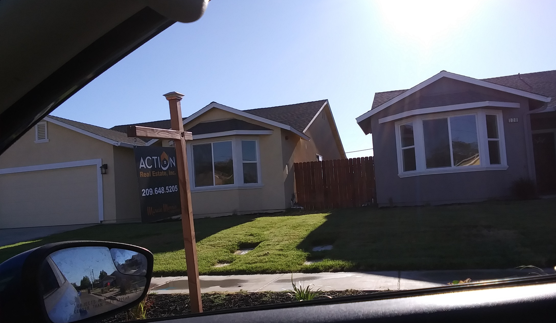
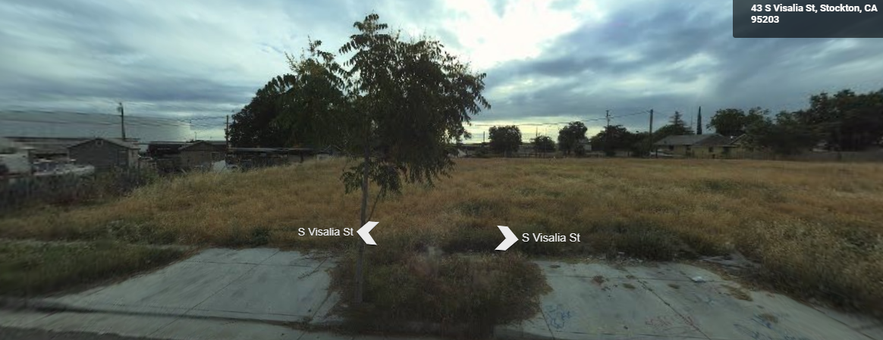
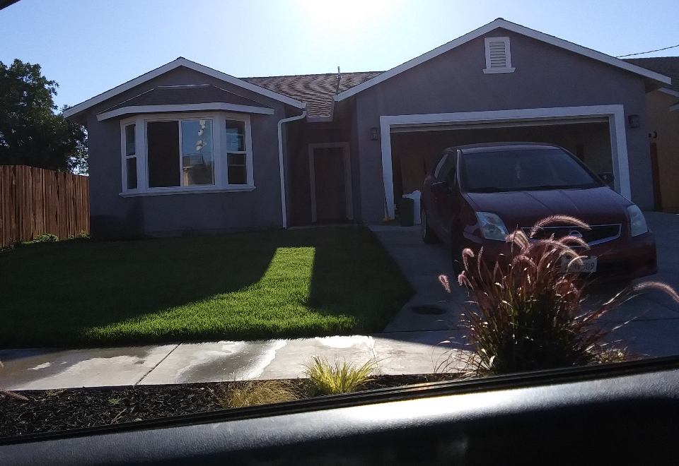
New South Visalia housing on East Side of Street

Slide 7
Stockpiled Material visible from Harbor Street

Slide 8
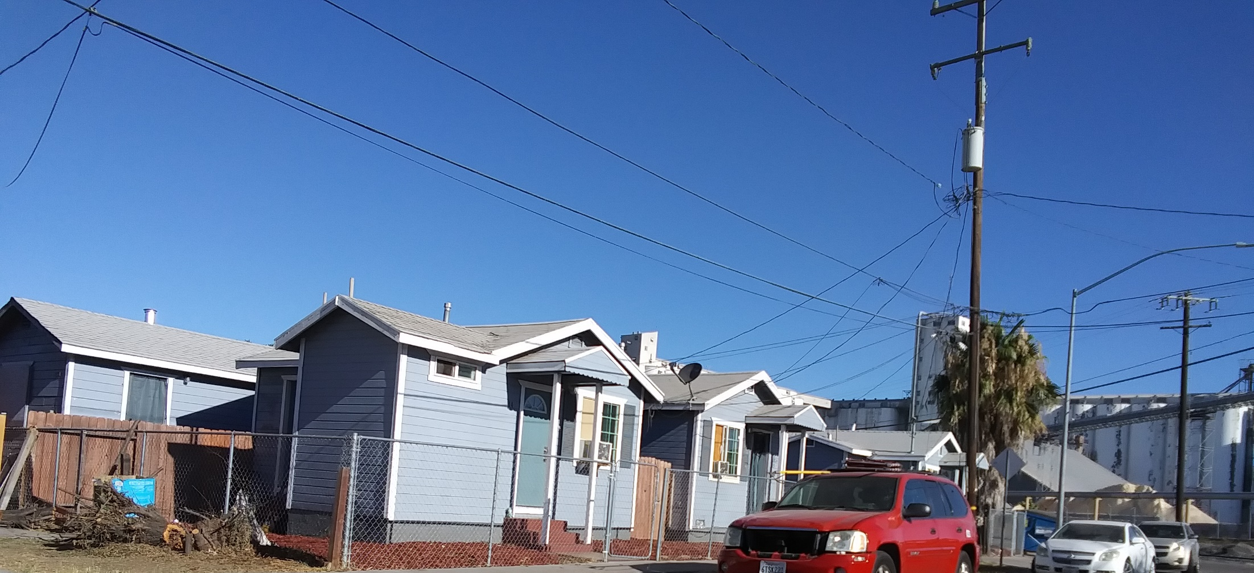
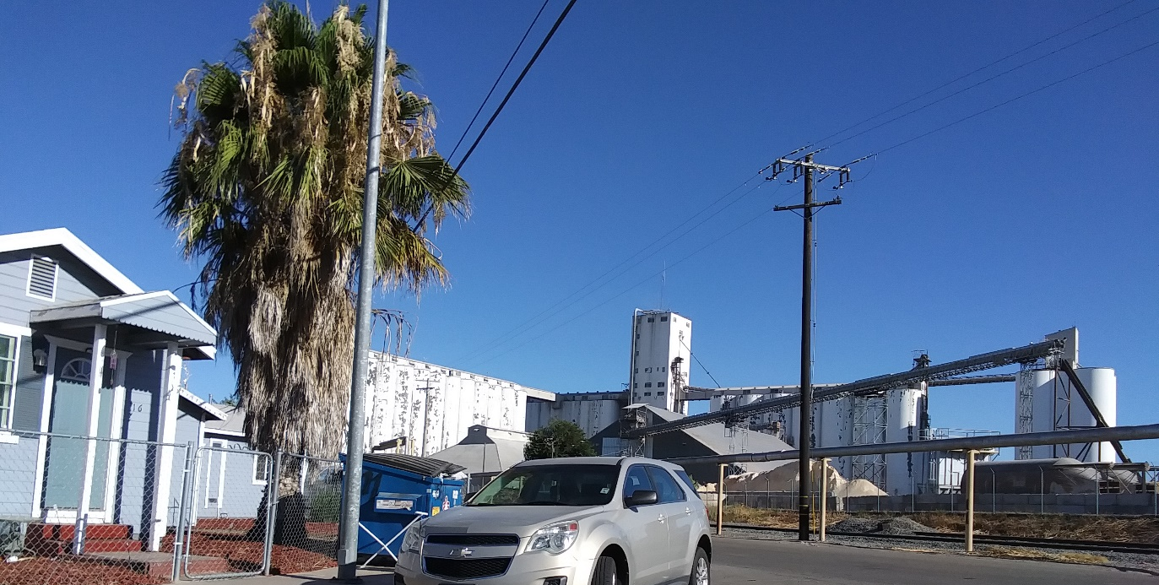
Port Neighbors

Slide 9
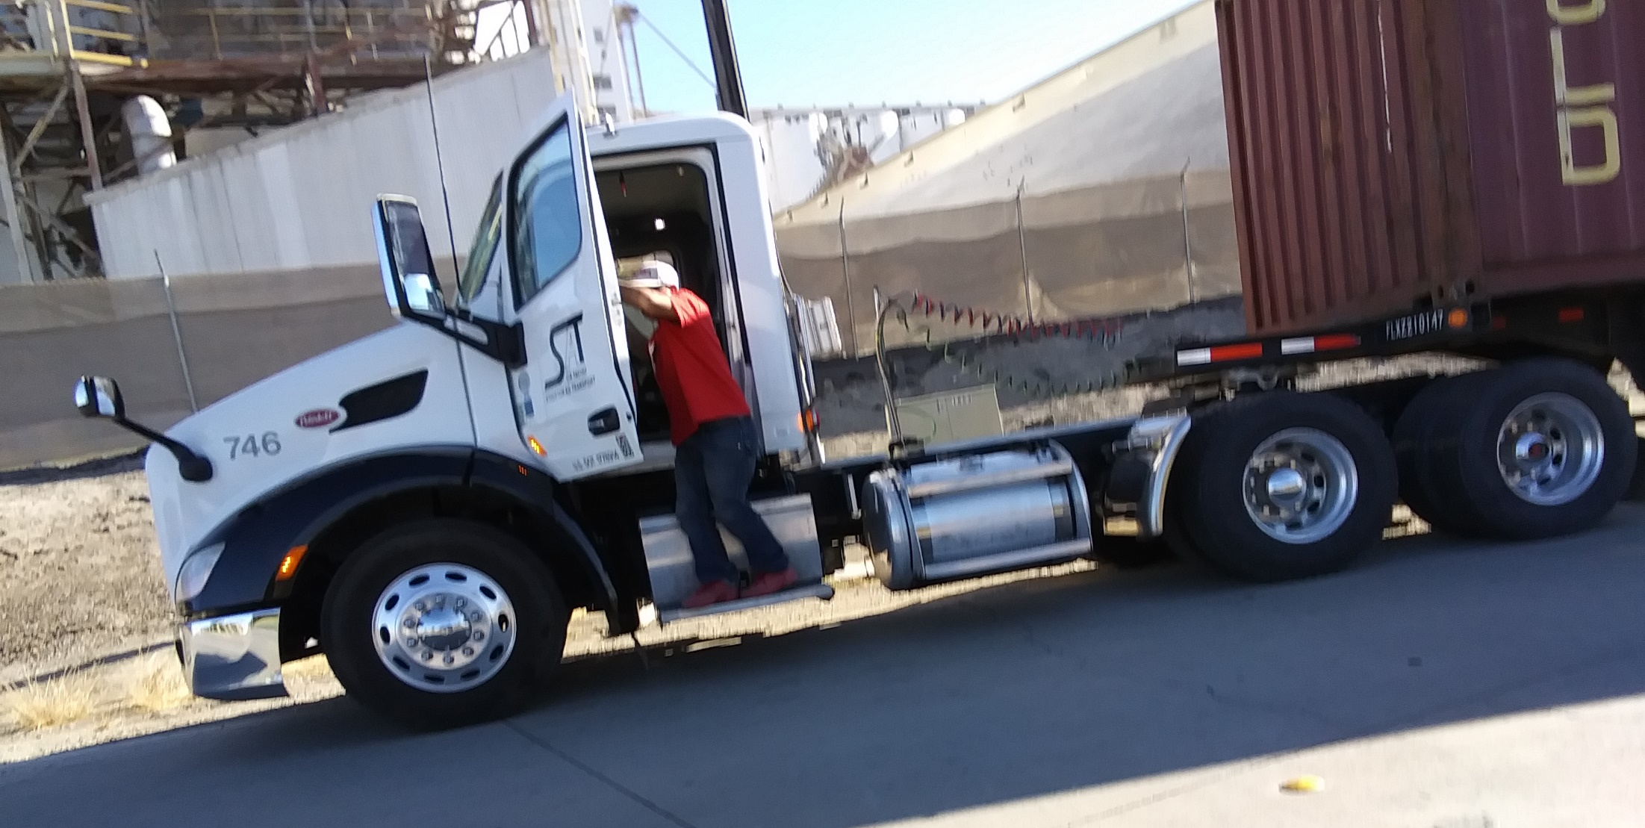
Truck queued

Slide 10
Residential and Truck Parking Queued Port Operations

Slide 11
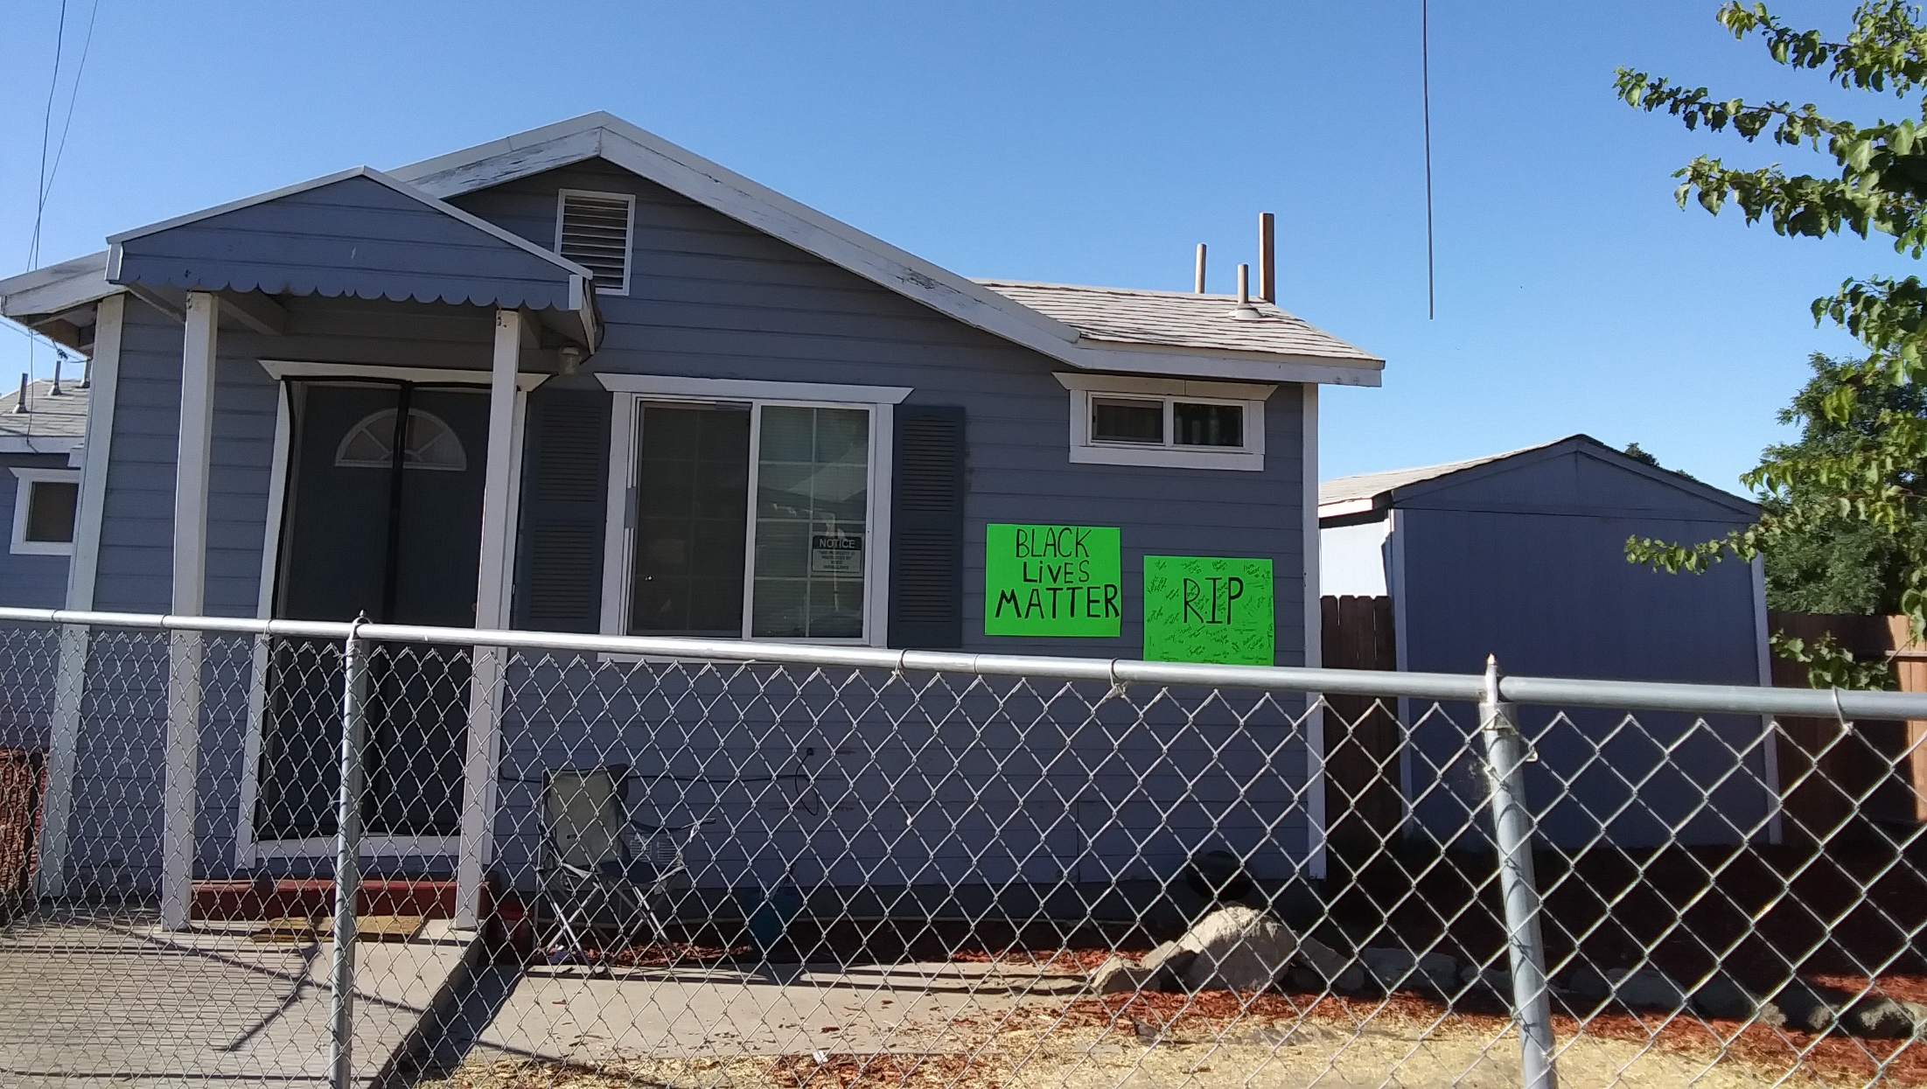
Black Lives Matter Across the Street from Port Operations

