Slide 1
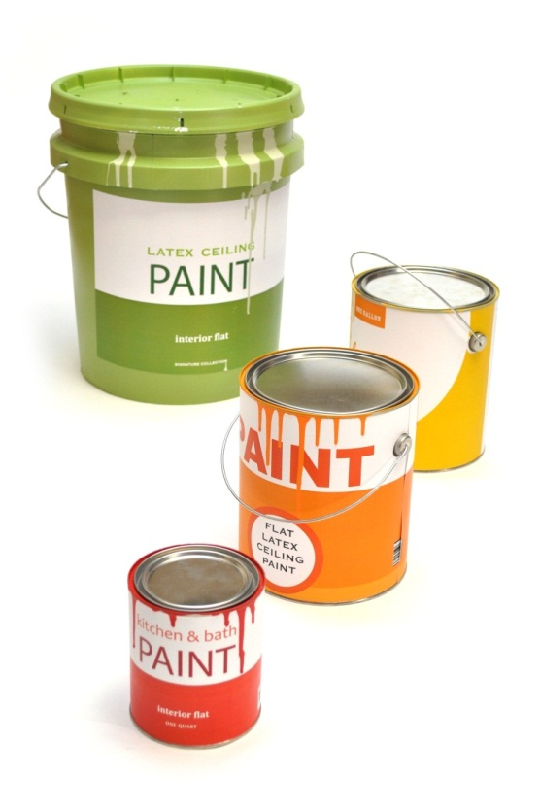
PaintCare Paint
Stewardship Program

Slide 2
Development of Program
PSI Research and reports (2002, 2003)
National dialogue (since 2003)
1st MOU (April 2005) – 4 meetings/9 months
8 projects ($2M public, private funding)
2nd MOU (October 2007)
detailed work plan, elements of legislation
Notes:
Discuss the signatories of the MOU – MD signed; get list
50% of household hazardous waste is paint
Studies show that approximately 10% of paint is leftover/unused
70 millions gallons leftover annually in the US
Cost and burden falls on municipal governments and government resources are limited, resulting in minimal opportunity to recycle or properly dispose of paint (in most states)

Slide 3
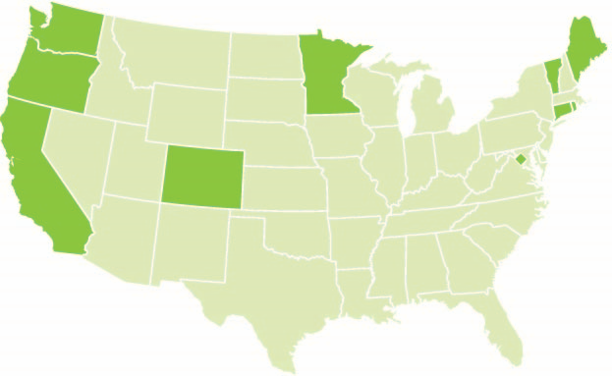
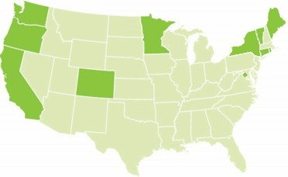
Model Paint Stewardship Legislation
State-wide legislation required to provide a level-playing field with sustainable financing and consistency across states (“nationally coordinated approach)
11 jurisdictions have passed the legislation:
2010: Oregon
2012: California
2013: Connecticut
2014: Rhode Island Vermont Minnesota
2015: Maine, Colorado
2016: Washington, DC
2019: Washington
New York
*

Slide 4
About the Paint Stewardship Law
Manufacturers selling paint into the state must operate a paint management system
Provide system for recycling and proper disposal of leftover paint; reduce the generation of postconsumer paint and, promote reuse;
Requires a program plan to be approved by state environmental agency
Convenient paint collection locations
Environmentally responsible paint management
Goals for reuse, recycling and proper disposal
Education and outreach plan
Budget and assessment rate to fund the program

Slide 5
About the Paint Stewardship Law
Requires an annual report to the state
Total volume of paint collected by type
Method of disposition (reuse, recycling, proper disposal) for all paint collected
Independent financial audit
Education and Outreach Evaluation
Reporting and Evaluation of program goals
Requires annual fee to state agency for plan and annual report review and for oversight and enforcement

Slide 6
PaintCare Funding
Financing through a per can assessment fee added to the product price of each container sold.
No fee for half pint or smaller
$0.35 for larger than half pint up to smaller than 1 gallon
$0.75 for 1 gallon
$0.95 for 1 gallon up to 2 gallons
$1.60 for larger than 1 gallon up to 5 gallons
Manufacturers pay the fees to PaintCare, on a monthly basis based on sales in the state and pass them through to distributors and retailers who add them to the final purchase price of new paint to make themselves whole.

Slide 7
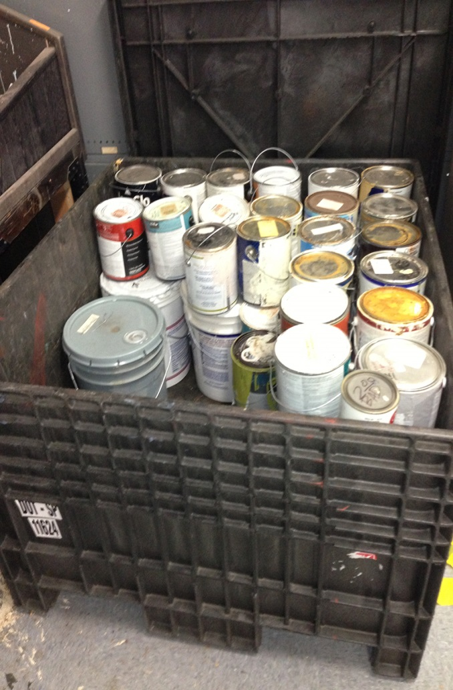
How Funds Are Used
Paint transportation and processing
Site supplies and assistance (paint collection containers, spill kits)
Multilingual outreach
In-state (and national) staff
State agency fees
Insurance, legal fees, consulting services

Slide 8
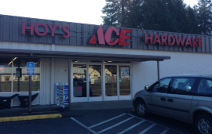
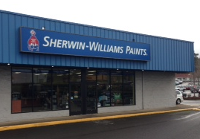
Drop-Off Site System
Retailers – paint, hardware, home improvement, reuse
Household hazardous waste facilities and events
Solid waste transfer station, recycling centers, landfills
Paint collection events
Direct pick-up service

Slide 9
Program Results
Active states: CA, CO, CT, DC, OR, ME, MN, RI, VT
97.7% of population in active states have convenient drop off location
Program population is (61M – 54M in active states)
Over 200 manufacturers participating
Collection sites and events:
1796 year round collection sites
4,800+ HHW events
339 PaintCare or paint-only events
4,130+ large volume direct pick-ups
Collected over 42 million gallons of paint
Washington and New York laws passed – program in development
2020 Bills: New Jersey, New Hampshire, Massachusetts, Maryland
Notes:
Add statistics on disposition here [from Paul]

Slide 10
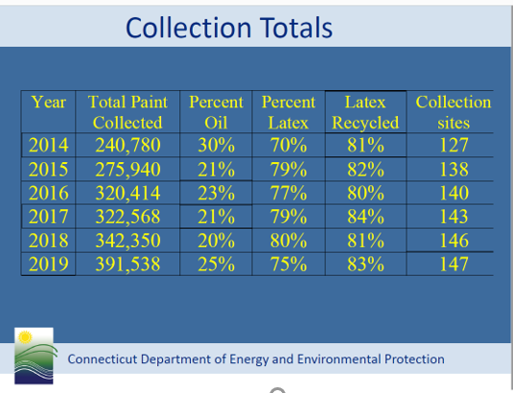
Notes:
Disposition of collected paint:
Latex

Slide 11
Contact Information
Heidi K. McAuliffe
Vice President, Government Affairs
(202)719-3686
Hmcauliffe@paint.org

