Slide 1
Pizza Palooza!
Old Town Pizza
Roseville, CA
Thursday, March 21
Placer Group

Slide 2
Harry White Placer Group - Executive Committee Chair
Placer Group
Introductions
Our shared goals
Projects and activities

Slide 3
Harry White Placer Group - Executive Committee Chair
My Role:
To help environmental activists in Placer County achieve our shared goals

Slide 4
Sierra Club Founded 1892
Oldest, Largest & Most Influential Grassroots Environmental Organization in the U.S.
Involved in: Climate Crisis, Wildlife, Rivers, Forests, Sane Urban Development . . . . .
National: 3.8 million Members & Supporters.
Mother Lode Chapter: 12,000+ Members.
Placer Group: 1,500+ Members.

Slide 5
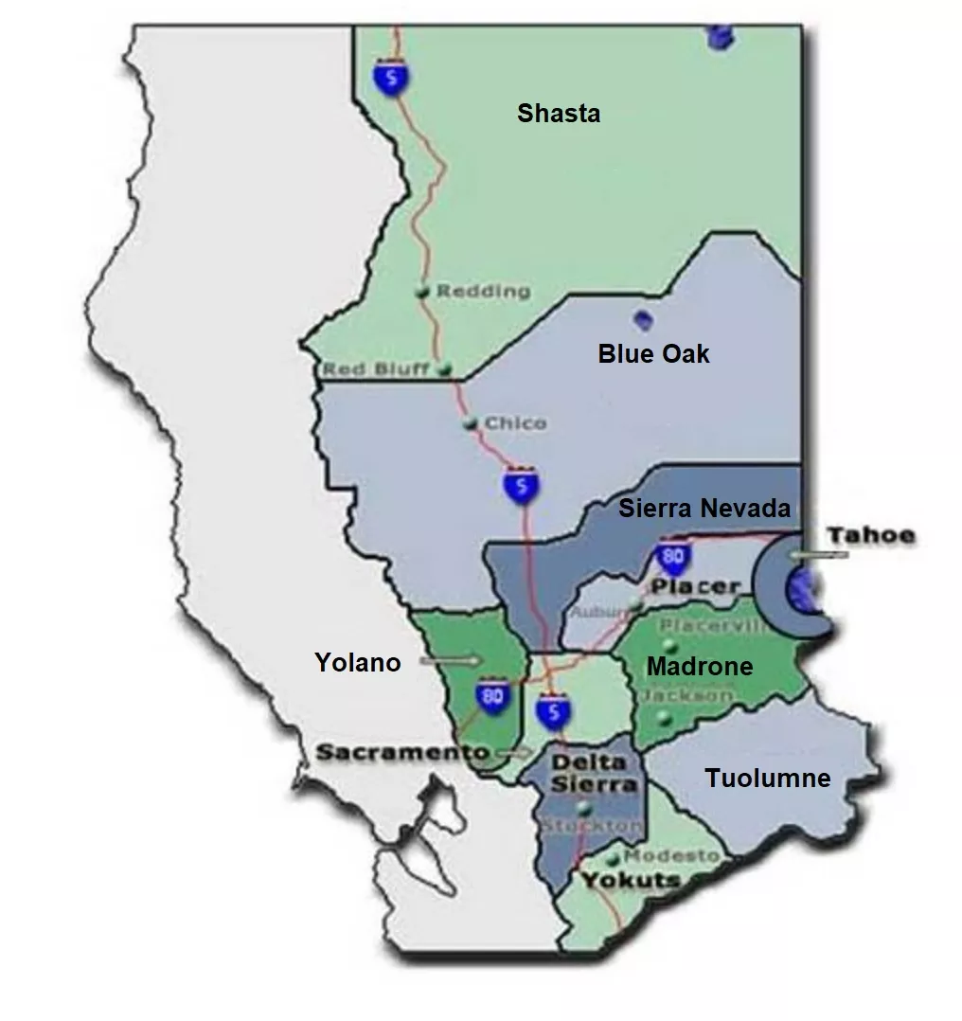
Mother Lode Chapter of the Sierra Club
11 regional groups

Slide 6
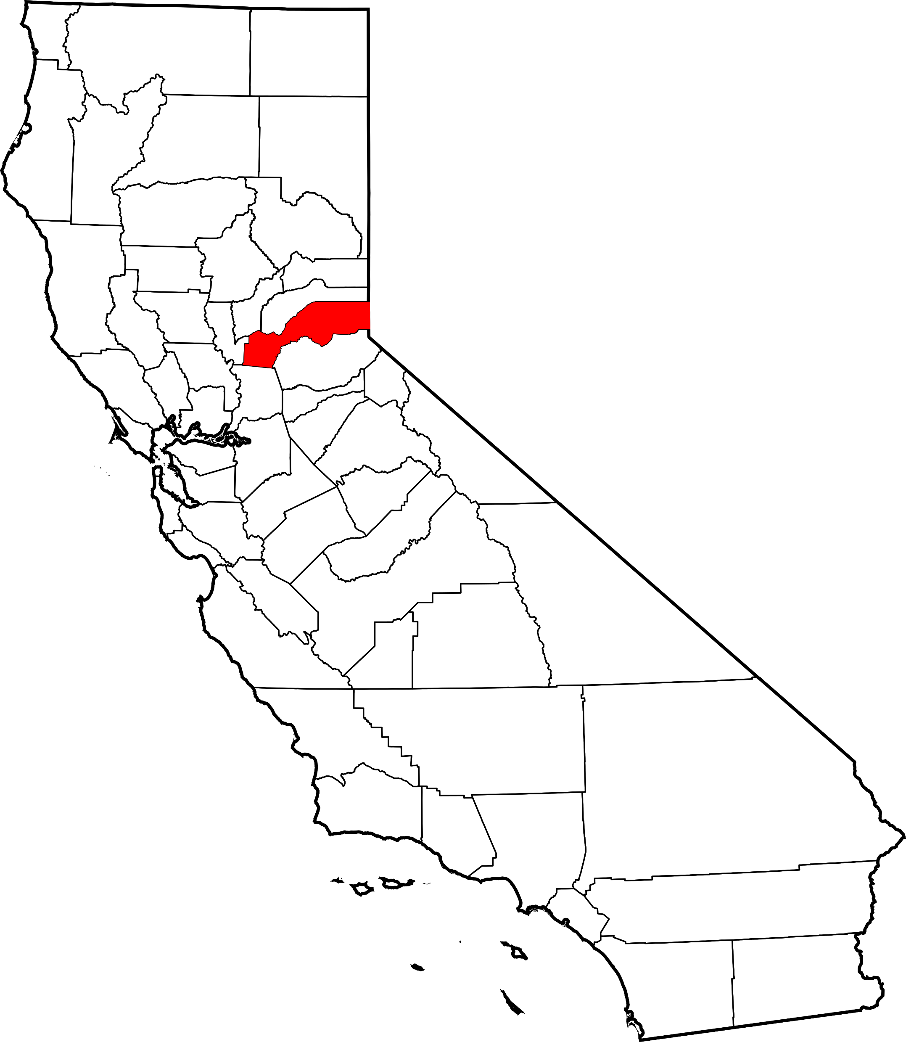
In Placer County strong numbers of conservationists reside in these cities and town:
City of Auburn
City of Colfax
City of Lincoln
City of Roseville
City of Rocklin
Town of Loomis

Slide 7
Placer County, California

Slide 8
Barry Grimm - Executive Committee - Membership Chair
Placer Group
My Role:
Keep Our Membership Growing.
Help Identify Members That Want the Next Level of Involvement.

Slide 9
What’s The Membership Plan?
1st Up – Tonight we Enjoy Pizza Together!!
More Pizza/Programs – Need Speaker Ideas.
Earth Day Booth at Sierra College (April 25) – Need a Volunteer.
Booths at Local Farmer’s Markets Year-Round – Need Volunteers.
. . . . More.

Slide 10
What’s The Plan?
Collect Non-Member Email Info. From:
Sierra Club Hike Leader’s.
Other Environmental Groups.
Send Invitations to Non-Members (Programs, Hikes, Meetings). . . . . More.

Slide 11
What’s The Plan?
Outreach to “Ecology Clubs”– Sierra College (March 23 at Effie Yeaw Nature Center).
Assist Hike Leaders in Tailoring Hikes to Novices & Newcomers.
Assist Conservation Leaders in Maximizing Media Attention.
What Else Might Work – Any Ideas??

Slide 12
Placer Group Outings
Local environmentally friendly outdoor adventures

Slide 13
OUTINGS PROGRAM
See the beauty of Northern California with one of our day hikes!
Restarted in 2022, we target scheduling one group day hike per month.
Hikes are typically around 5 miles in length and no more than a moderate level of difficulty.
Most hikes are within a 1-hour drive of Sacramento and often within Placer County.
Specialty hikes include wildflower photography hikes and migratory bird watching hikes.

Slide 14
OUTINGS CO-CHAIRS
Meet our volunteer Co-Chairs
Kathy Verrue-Slater
Trish Kness
Outdoor enthusiast, I enjoy biking, hiking and other outdoor activities. Strong supporter of wildlife and wildlife habitat protection.
Inspired to become an Outings Leader to meet others interested in exploring some of the great hiking opportunities in this area.
Favorite local hike: Training Hill
Other favorite hiking destinations: Pt. Reyes, Desolation Wilderness, many National Parks.
Recently retired from career focused on wildlife habitat restoration,.. Keeping busy with home remodel projects and planning future travel adventures with friends and family.
Avid hiker with a passion for wilderness preservation and wildlife conservation.
Inspired to become an Outings Leader to engage with the community and share some of her favorite day hikes with others.
Favorite local hike: Avery’s Pond
Most epic hike: Colca Canyon, Peru
When not enjoying the outdoors, can be found working for an international software company.

Slide 15
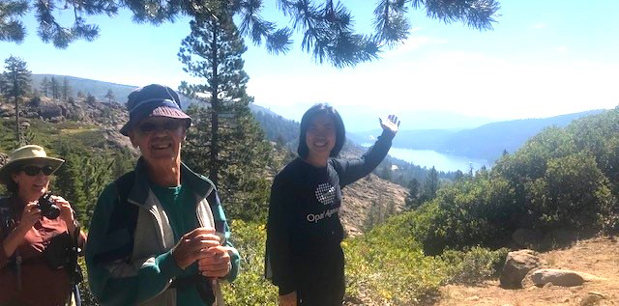
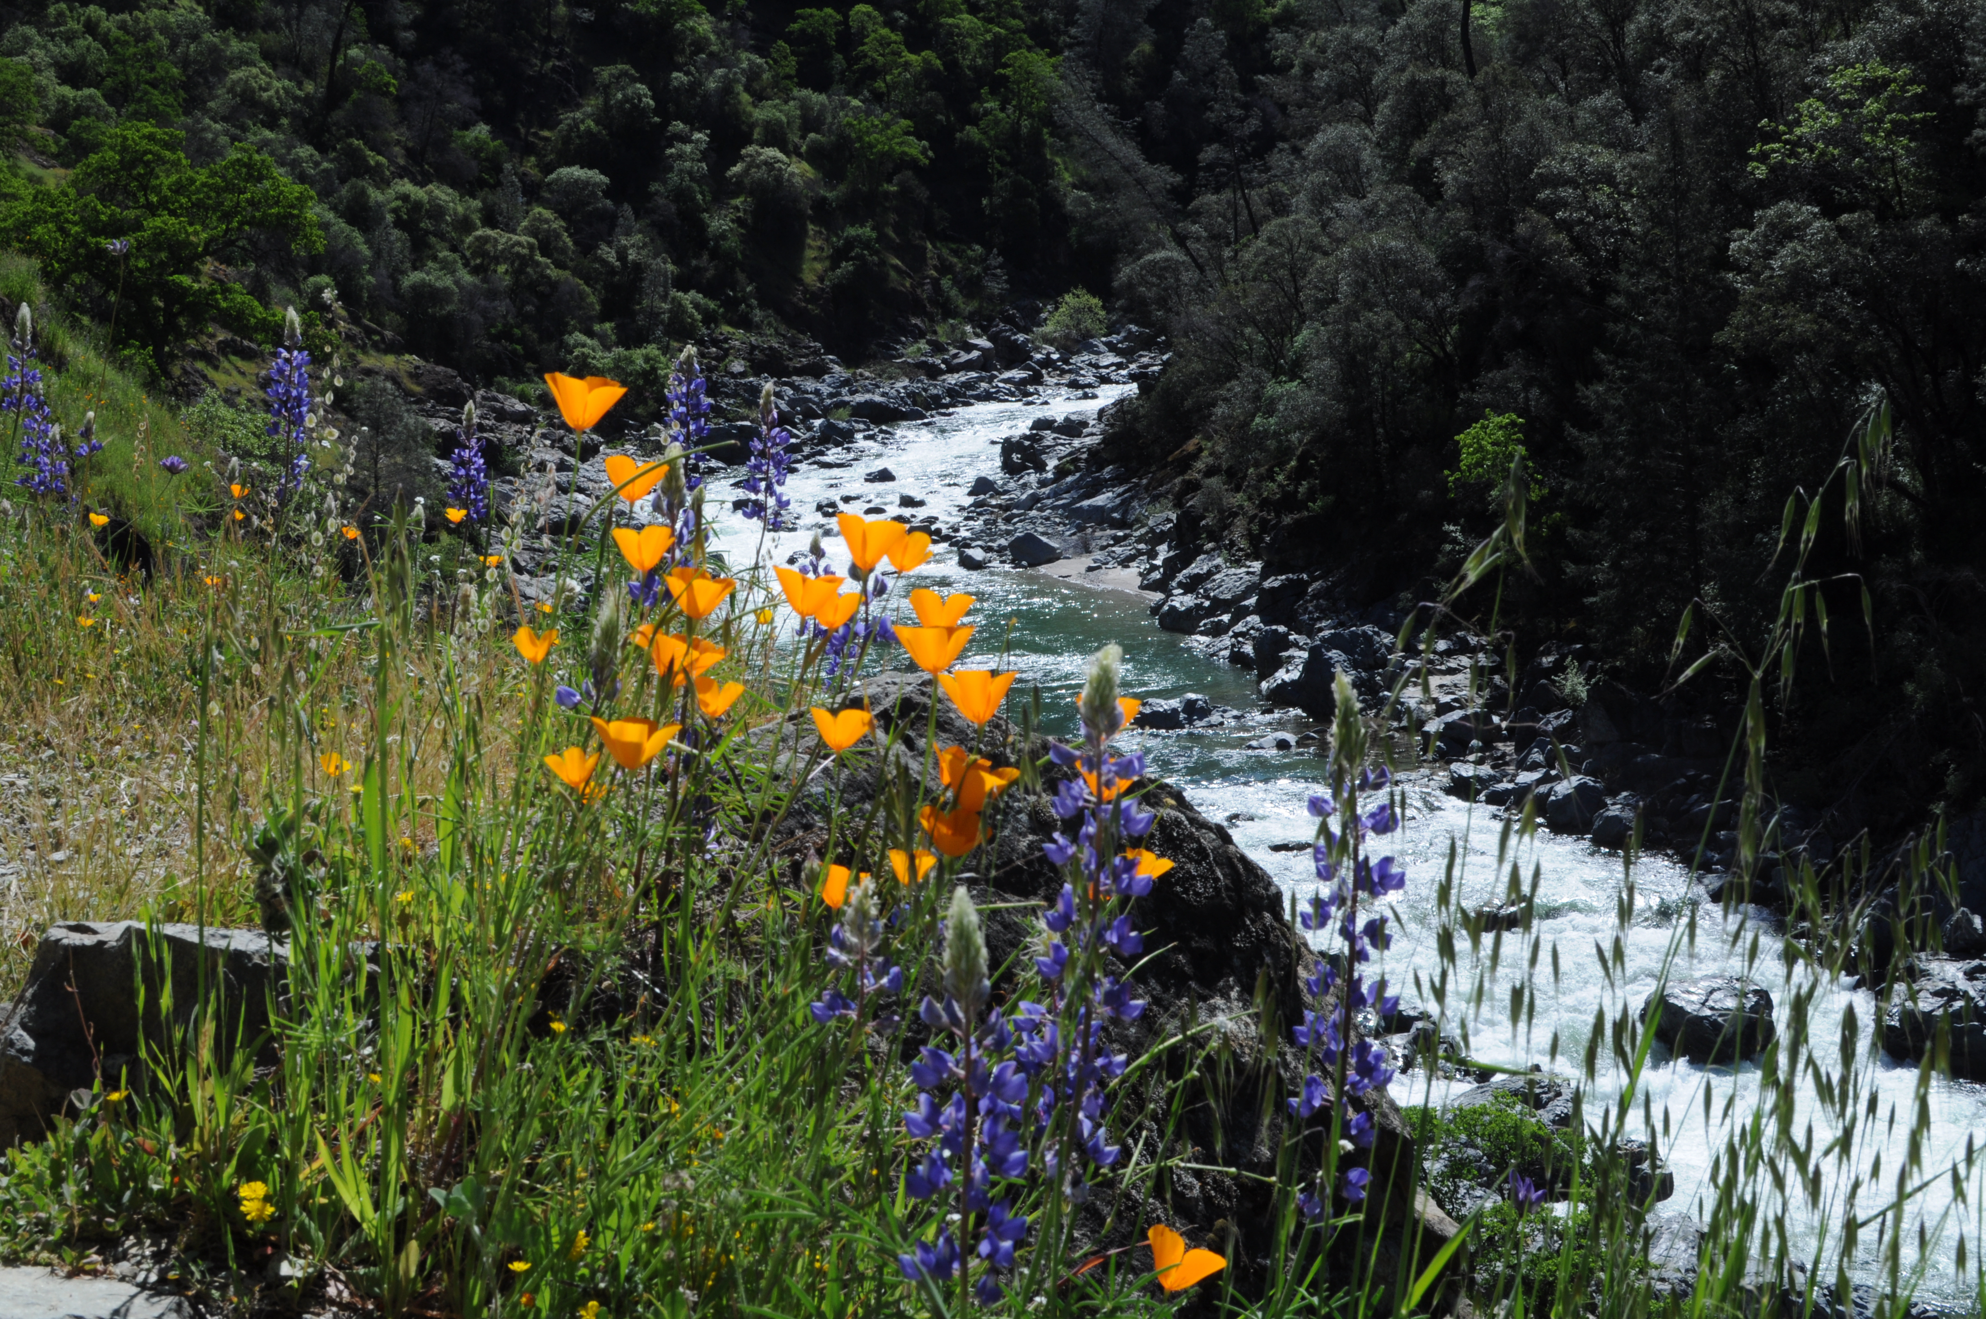
Fairy Falls
Angela, Flora & Azalea Lakes
Buttermilk Bend
Cronan Ranch

Slide 16
Want to join us?
Interested in becoming a leader? For more information email:
placersierraclub@gmail.com
Next hike: Saturday March 23, 2024
Knickerbocker Creek Trail, Auburn SRA

Slide 17
Potential Projects
What are your interests? Please let us know!
Email: placersierraclub@gmail.com
Ensure robust environmental protections in the new Placer County General Plan.
Push for mitigations in the Pleasant Grove Stormwater Retention Basins. Native plants, hiking trails, nature center. Address concerns about the Phillip Road site.
Protect and enhance open spaces, parks. Native trees, shrubs, annuals. Improve habitat for birds, mammals, fish. Reduce feral cat populations in a humane manner. Work with Audubon, Placer SPCA.
Mitigate developments. Monitor EIRs. Reduce footprints, use native plants. Pollinator gardens on public and private properties.

Slide 18
Potential Projects
What are your interests? Please let us know!
Email: placersierraclub@gmail.com
Letters, petitions, and verbal input to city and county commissions and councils.
Replace lawns with native plants. Government, commercial, residential. Work with RCONA, developers, LSAs.
Articles in local media. Outreach to schools, churches, and other community groups.
Hikes, including wildflowers and birdwatching, including in areas threatened by development.
Promote forestry practices that reduce wildfire risk while preserving forest ecology.
Environmental equity. Involve under-represented groups.
Pursue state and national advocacy as needed.

Slide 19
Marcus Ledergerber - Executive Committee - Technology Chair
Placer Group
My Role:
Support technology to enhance environmental advocacy efforts and engage communities in conservation initiatives.
Communicate about Sierra Club mission, activities, and events.
Attract and activate conservationists to support environmental causes.

Slide 20
Save Reason Farms https://savereasonfarms.org
Q: What motivated me to become involved with Save Reason Farms? A: Major concern shared by fellow residents in West Roseville about potential industrial development near the Pleasant Grove Creek watershed on the Reason Farms territory, a conservation easement, and residential housing.
Doing nothing is not an option. The risk of doing nothing is that the City of Roseville would likely rezone the Reason Farms Panhandle (the Phillip Road Site) to permit industrial use. If that were to occur, then we could all be subjected to diesel emissions from hordes of semi trucks roaming the surface streets of Roseville. Increased semi truck traffic on Roseville surface streets could pose safety risks to passenger vehicles, pedestrians, cyclists, and kids on scooters.

Slide 21
Context and Current Topics Dovetailing with Reason Farms
When will Placer Parkway traverse the Reason Farms Territory?
California HCD’s notice to City of Roseville regarding City’s alleged violation of the California Surplus Land Act.
Ideas for Ecological Development of Reason Farms, including the Phillip Road Site (aka Reason Farms Panhandle)
Pleasant Grove Stormwater Retention Basins in Reason Farms

Slide 22
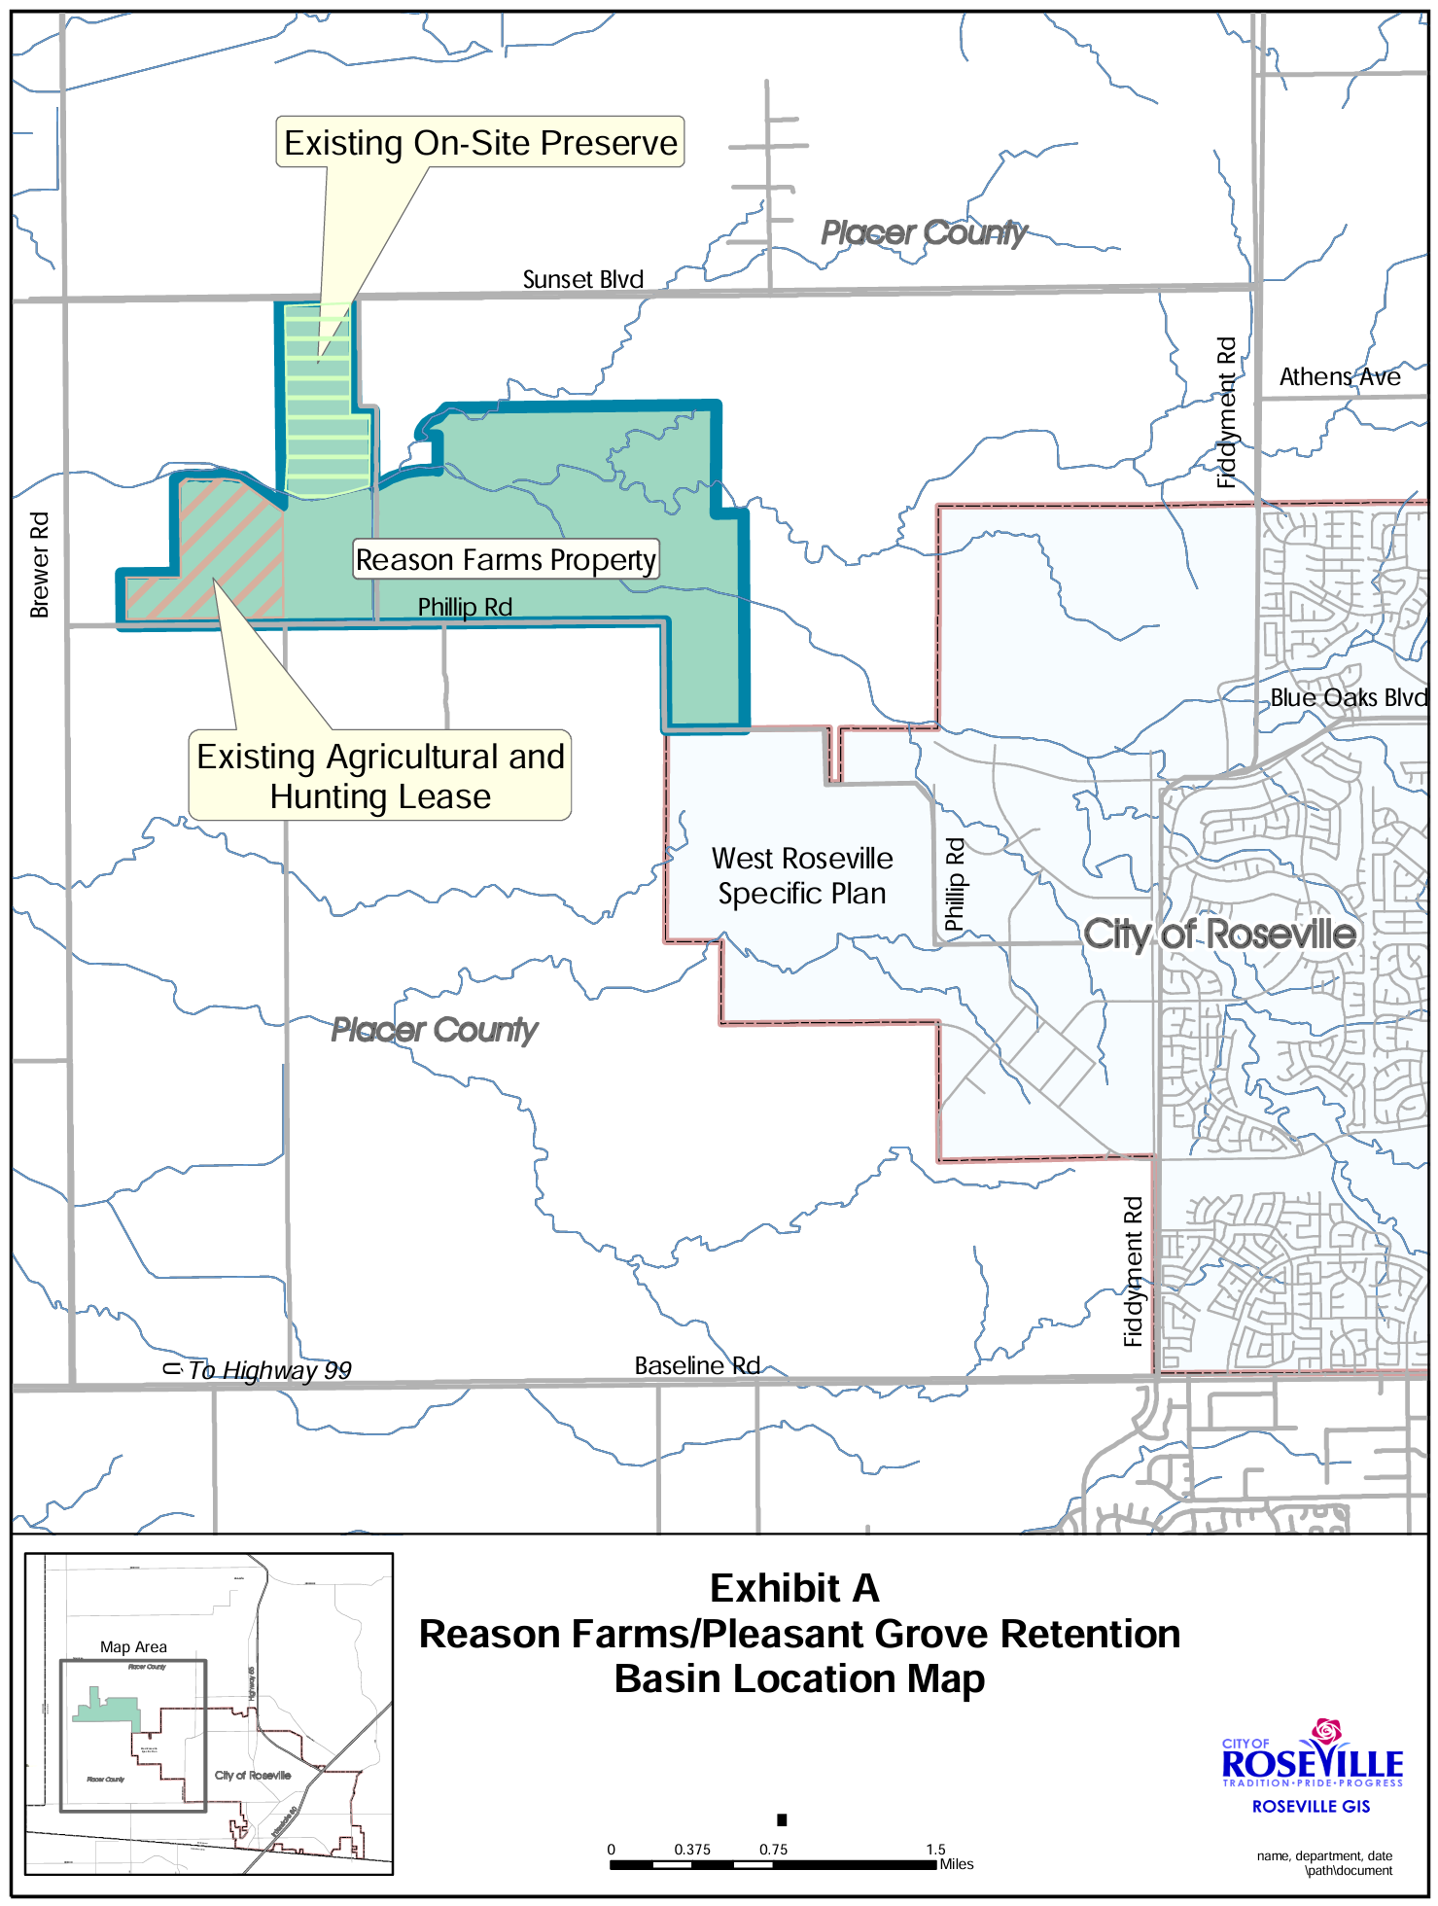

Slide 23
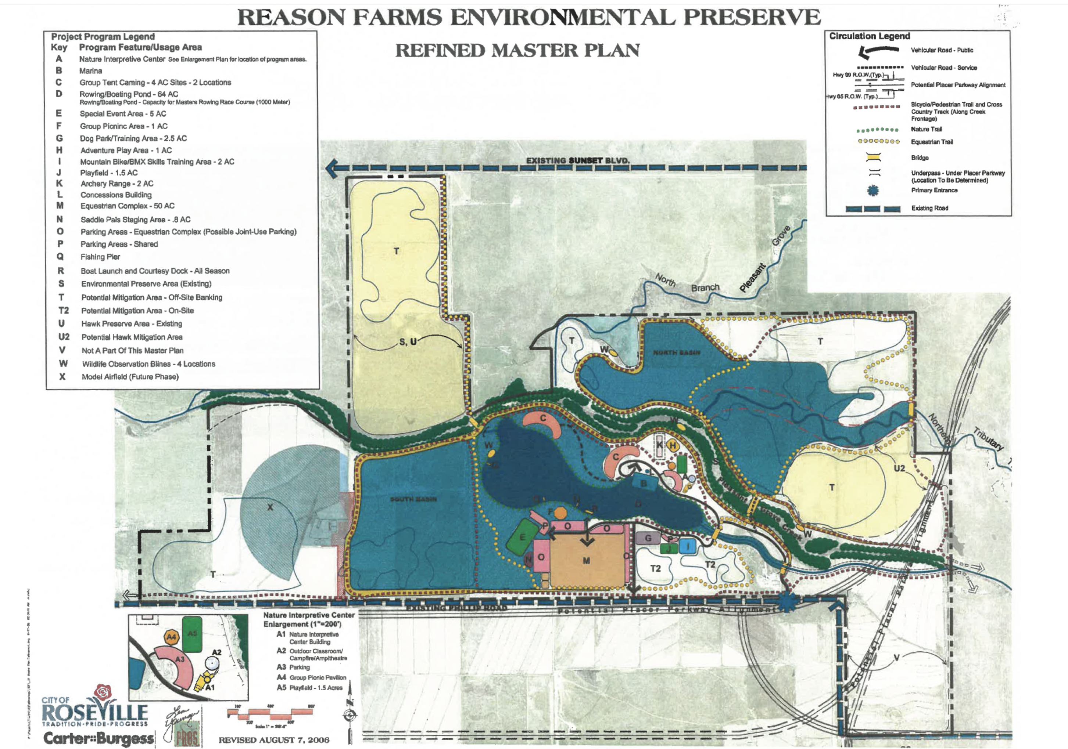

Slide 24
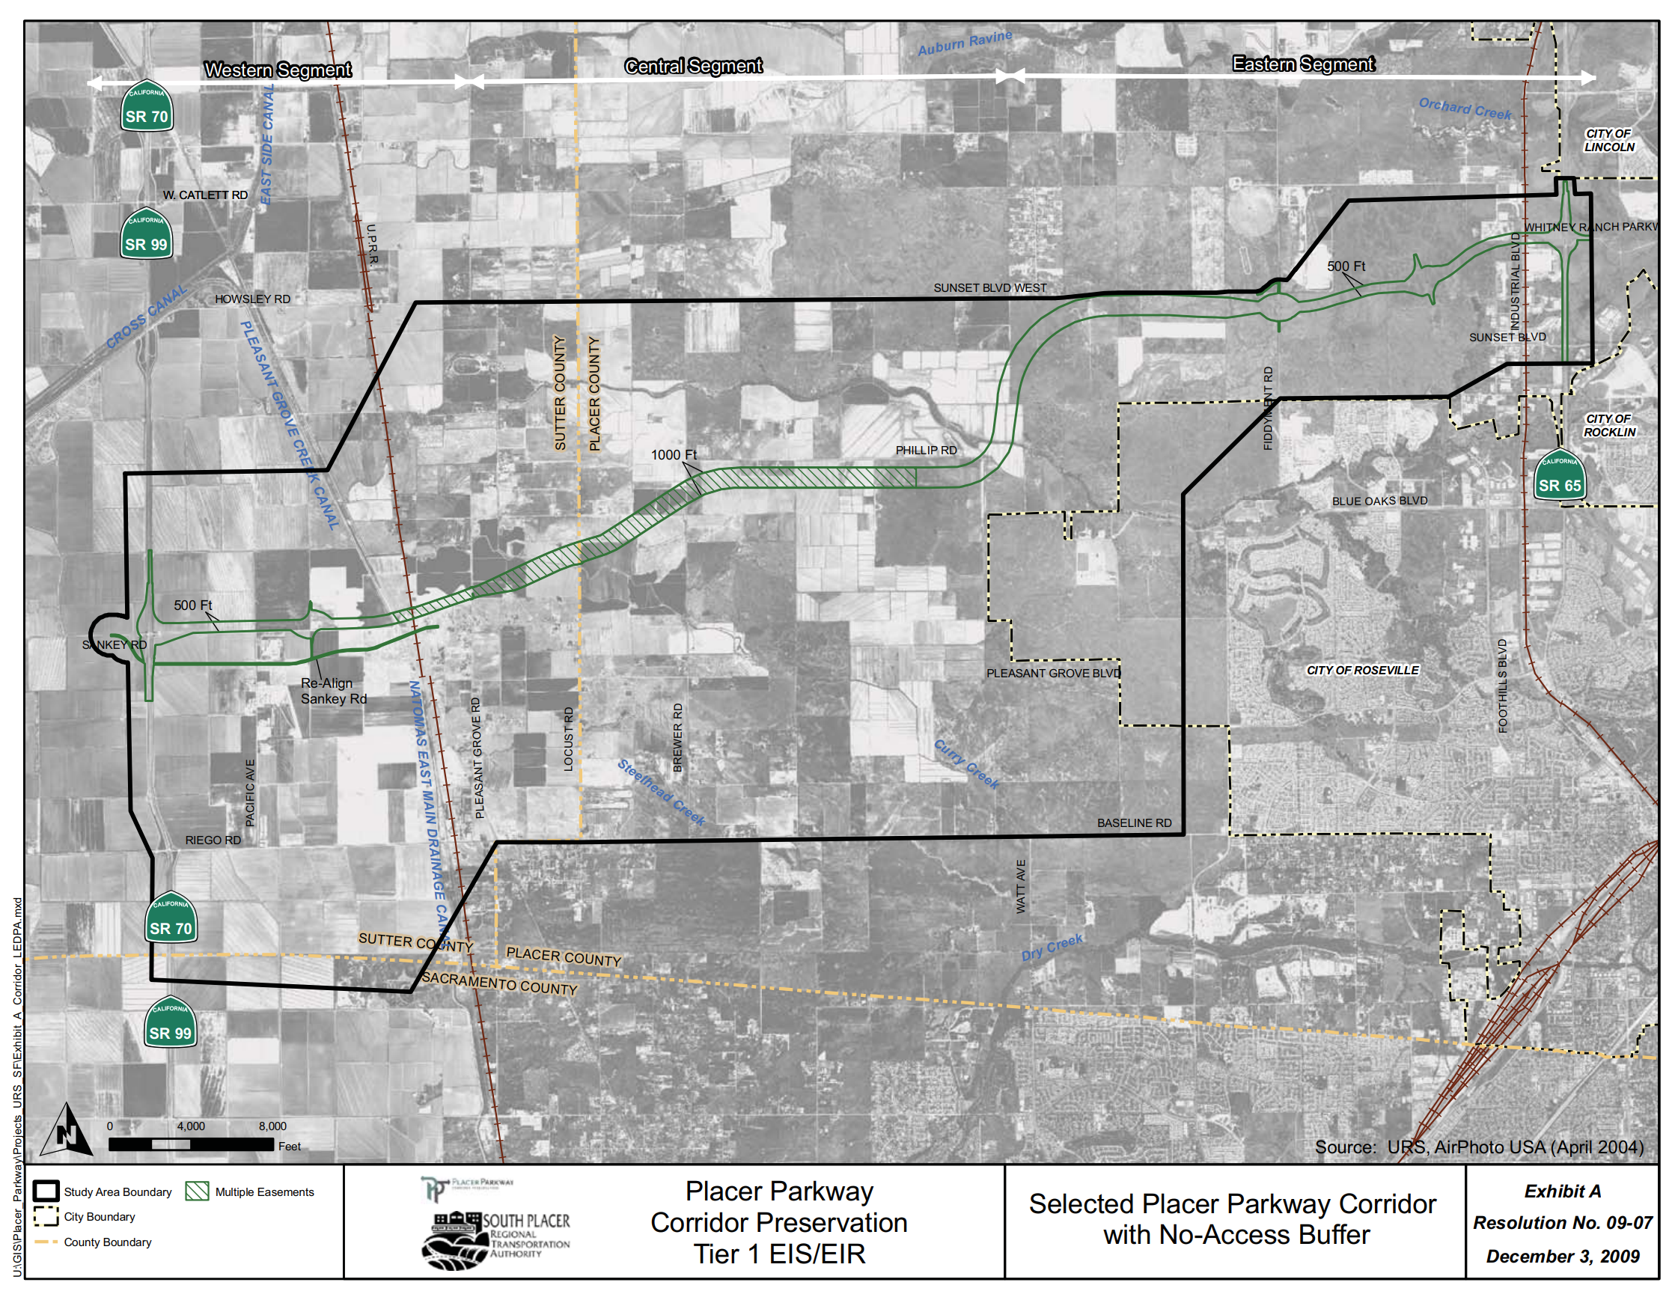

Slide 25
1. When will Placer Parkway be fully constructed and traverse through Reason Farms Territory?
Answer: Unknown, indefinite.
Placer Parkway Corridor Preservation Project
Has precise alignment of Placer Parkway been specified and fully evaluated in CEQA review? Not yet.
Insufficient project funding? Yes.
Construction Timeline: Indefinite (10-30 years, perhaps never)

Slide 26
Preservation Project: Placer Parkway Corridor
Resolution No. 09-07 approving selection of the Placer Parkway Corridor (December 3, 2009)
Proposed Placer Parkway involves a conservation easement (Exhibit B).
Interchanges would be precluded along proposed alternative 5.
Even if constructed, Placer Parkway would not be a major "highway" accessible to droves of diesel semi trucks frequenting the Phillip Road Site.
Diesel semi truck traffic -- attributable to hypothetical warehousing and distribution operations on the City-owned Phillip Road Site property -- could be prohibited on Roseville surface streets, if the City were to pass such Ordinance.

Slide 27
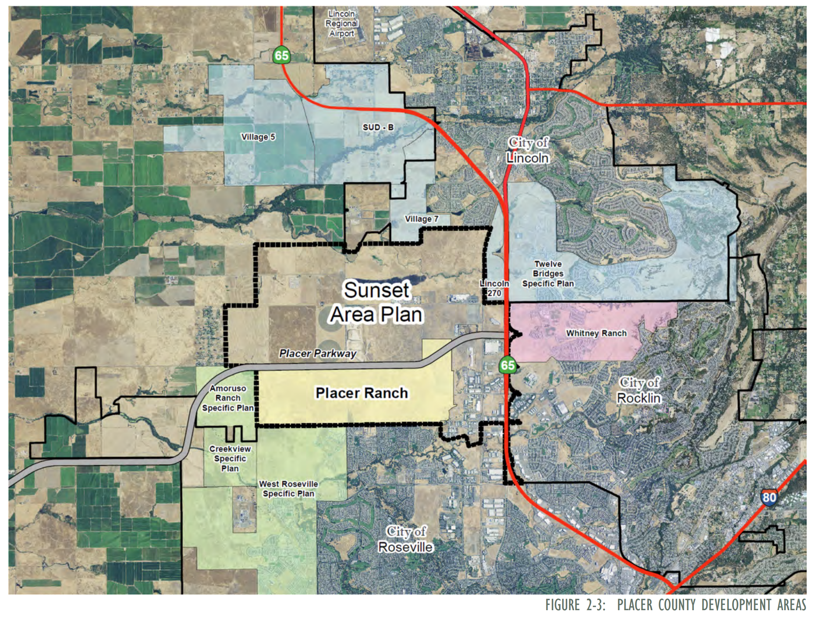

Slide 28
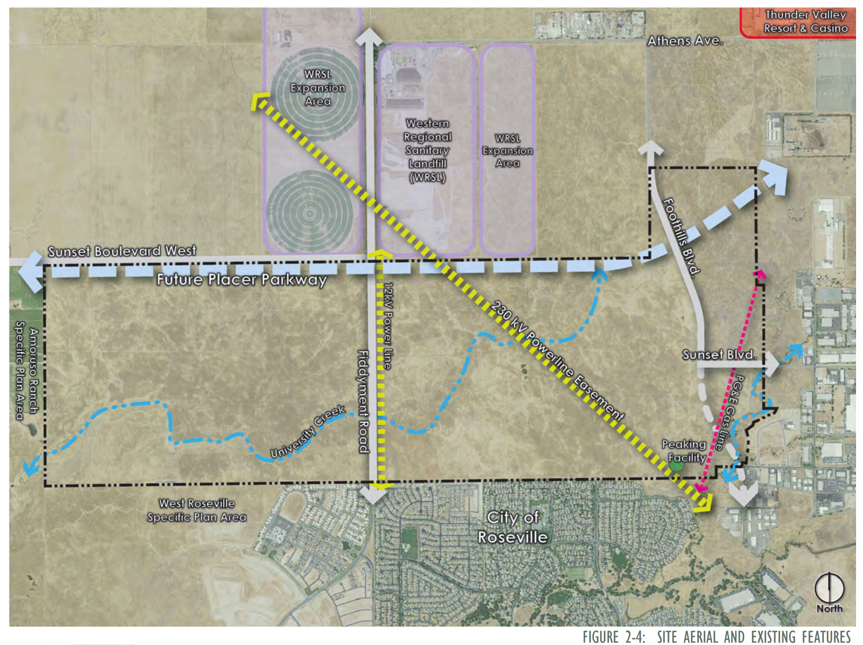

Slide 29
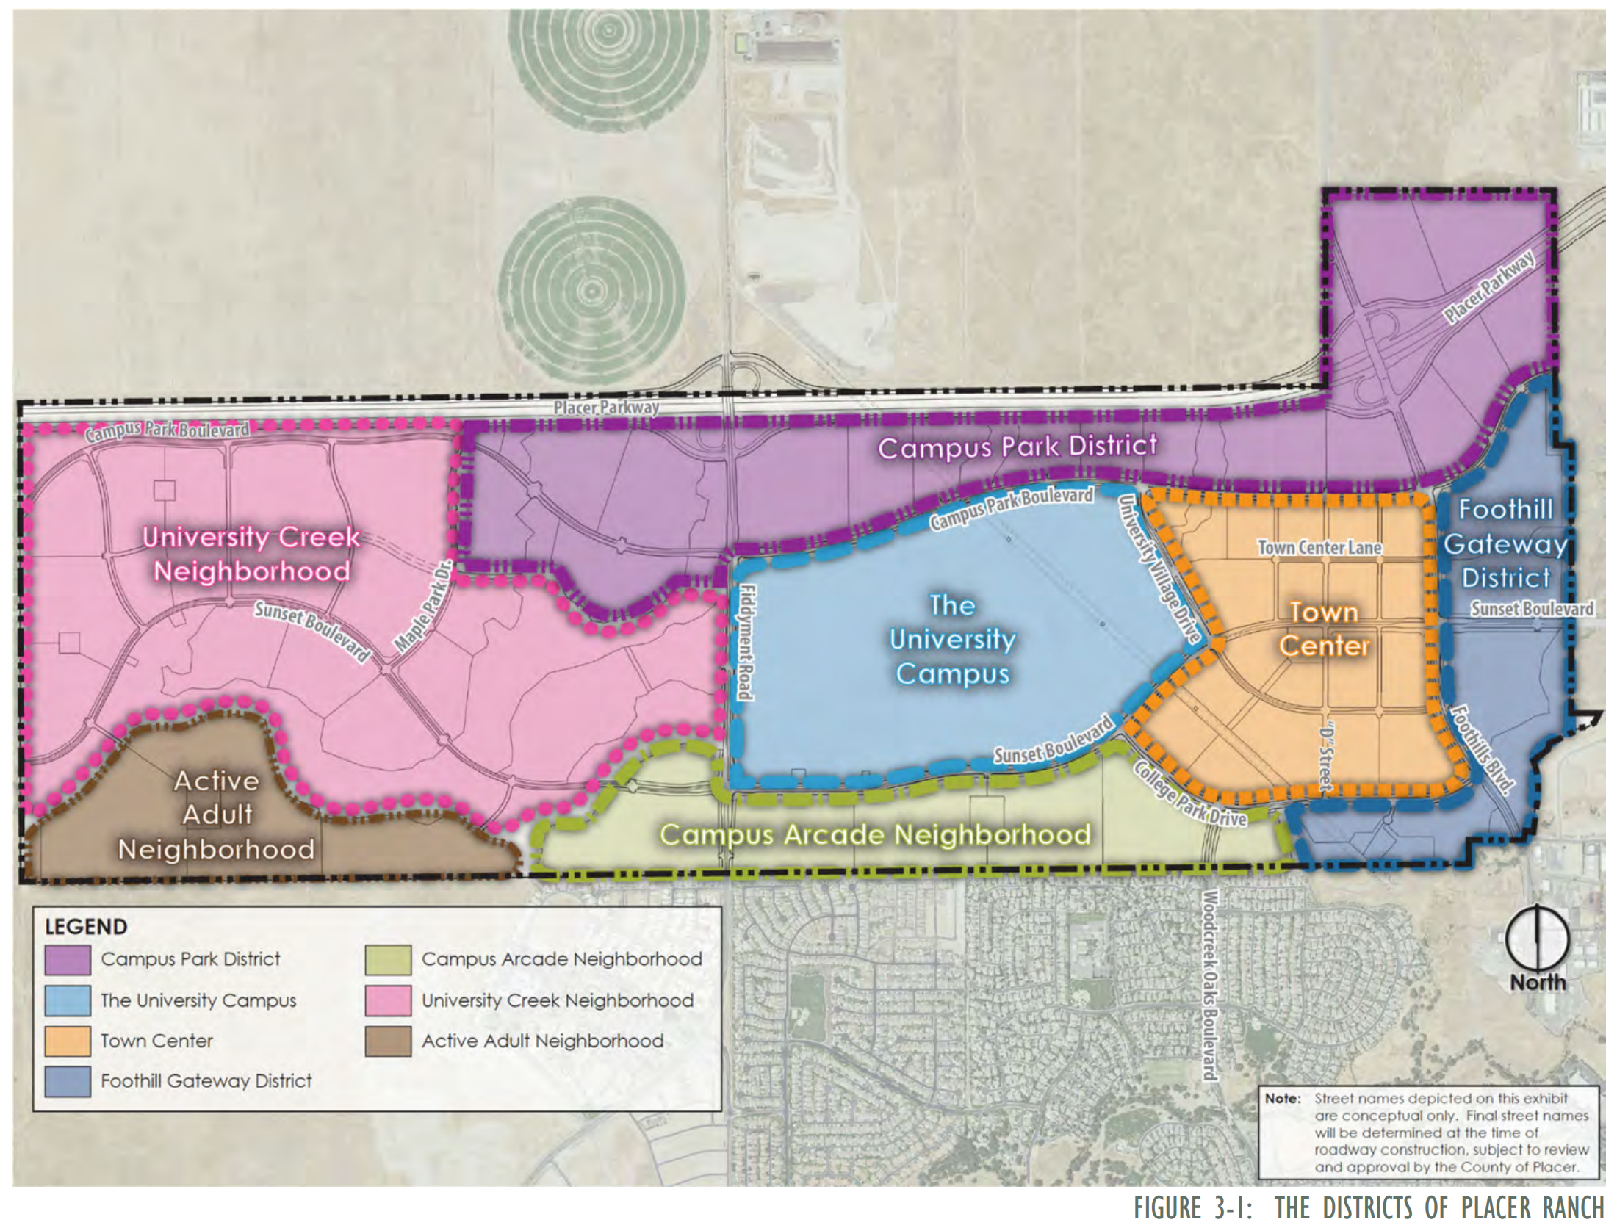

Slide 30
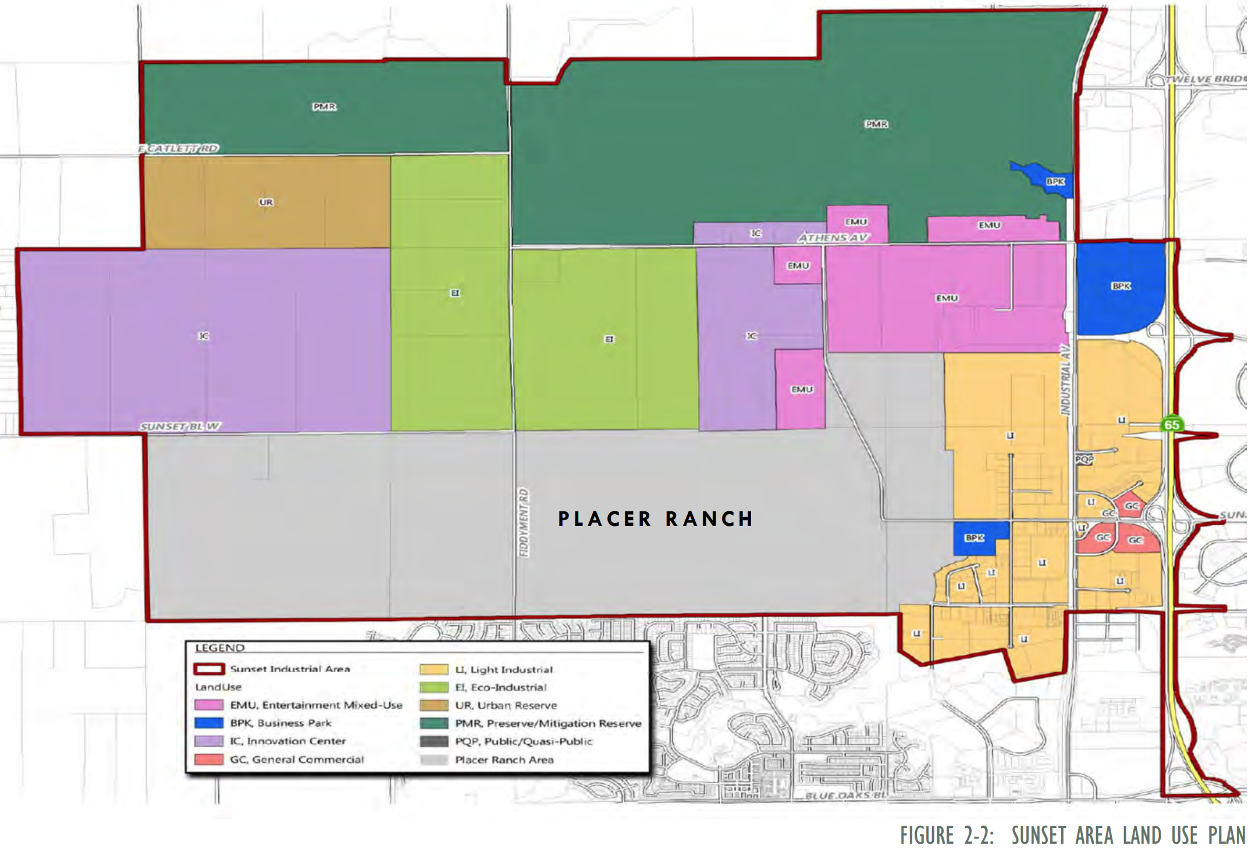

Slide 31
City of Roseville’s alleged violation of the California Surplus Land Act (SLA)
On December 4, 2024, HCD sent to City of Roseville a Notice of Violation regarding the Phillip Road Site (aka Reason Farms Panhandle) alleging that the City violated the SLA.
City could incur a 30% penalty, plus other potential penalties, if City does not cure or correct SLA violation by February 4, 2024
City Manager reported: “Given the potential of a revised project, the City is in discussions with HCD to identify options to cure or correct the alleged violation.” … “Staff is not expecting to receive a resubmittal of a revised project until at least late Spring/early Summer 2024.”

Slide 32
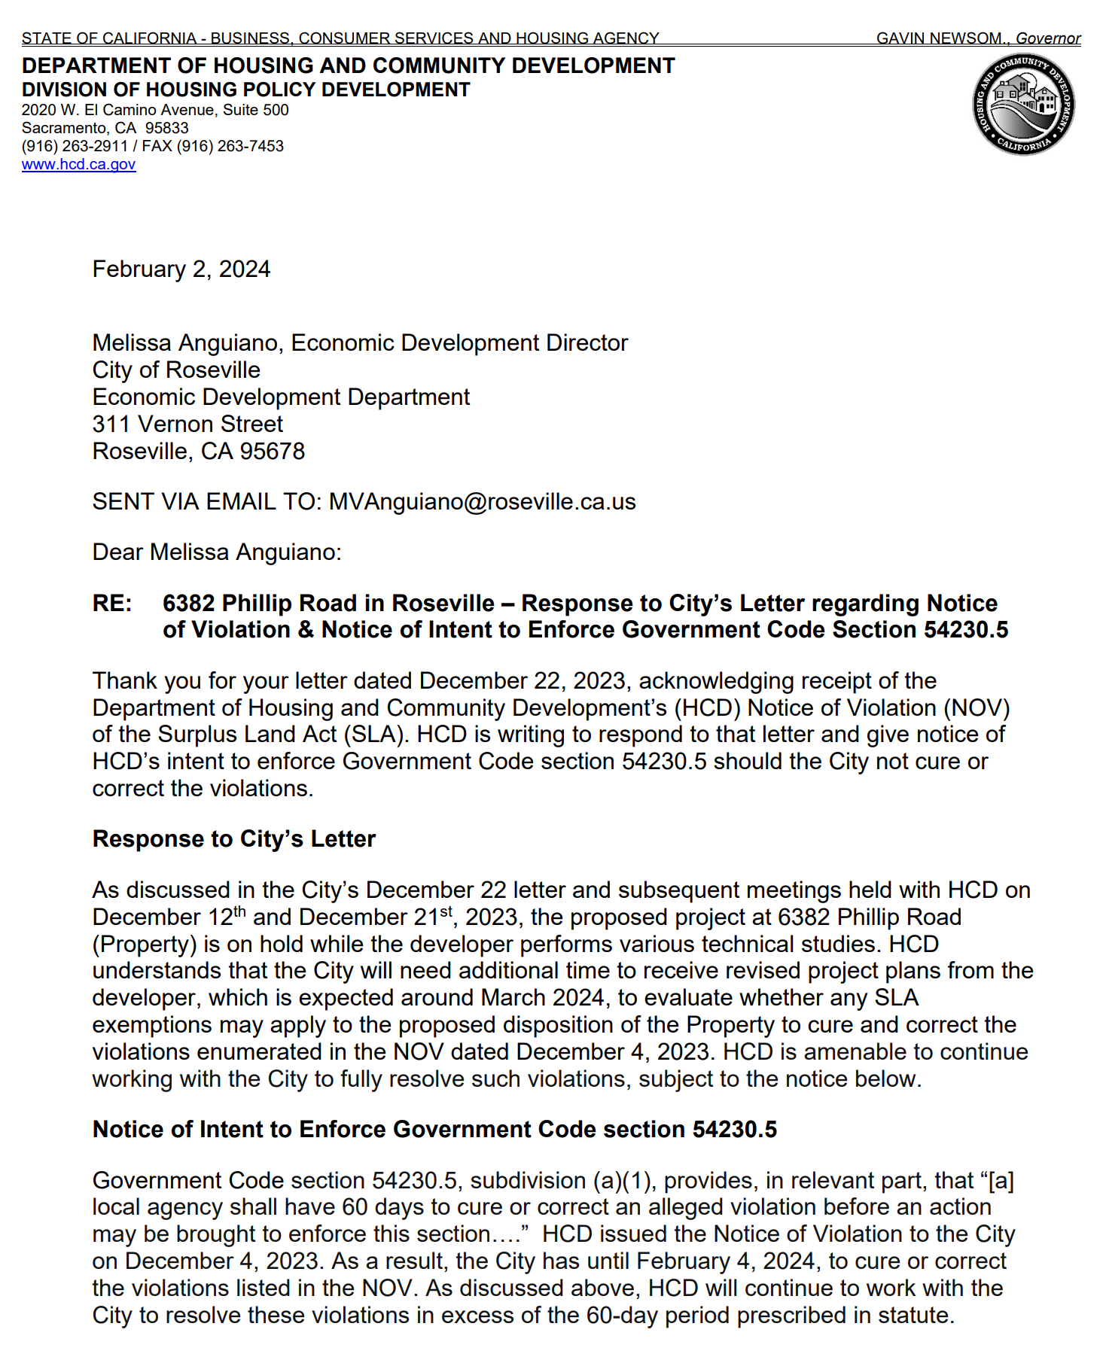
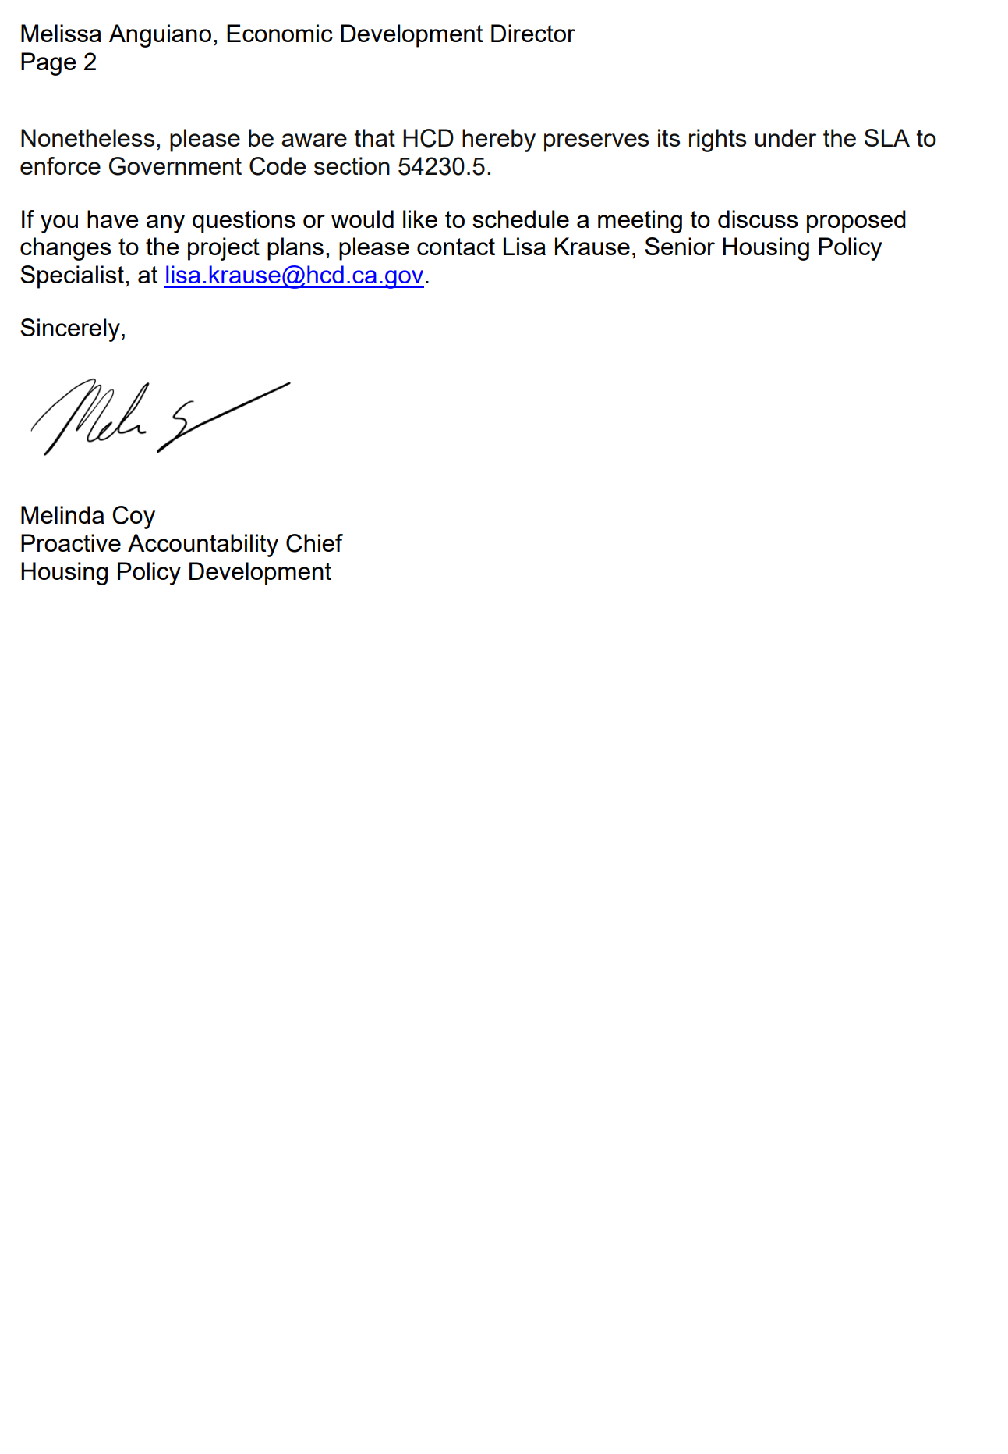

Slide 33
City of Roseville’s alleged violation of the California Surplus Land Act (SLA)
HCD’s Response to City’s Letter
“HCD is amenable to continue working with the City to fully resolve such violations, subject to the notice below.
…proposed project at 6382 Phillip Road (Property) is on hold while the developer performs various technical studies.
HCD understands that the City will need additional time to receive revised project plans from the developer, which is expected around March 2024, to evaluate whether any SLA exemptions may apply to the proposed disposition of the Property to cure and correct the violations enumerated in the NOV dated December 4, 2023.”

Slide 34
Ideas for Ecological Development of Reason Farms, including the Phillip Road Site (aka Reason Farms Panhandle)
Stormwater Retention Basins (South Basin/North Basin)
Open space for recreation.
Trails for walking/hiking and cycling.
Native trees and plants.
Surf park.
For additional ideas, see “Refined Master Plan” (Revised August 7, 2006)

Slide 35
Pleasant Grove Stormwater Retention Basins in Reason Farms
$17M is total amount of funding required by City to start.
Spring 2024 is estimated project start.
3-5 years is timeline for completion of Pleasant Grove Stormwater Retention Basins in Reason Farms.
Source: https://www.roseville.ca.us/government/departments/public_works/ floodplain_management/stormwater_retention_basins

Slide 37
Pleasant Grove Stormwater Retention Basins in Reason Farms
Since 1991, the City has been collecting fees on building permits within the watershed to help fund construction.
* Should the basin become a regional facility, Placer County will collect fees from County-issued building permits to fund increased stormwater capacity.
City of Roseville investment to-date on property acquisition and planning: $12.8M
Current mitigation fee fund balance: $16.1M
Design and environmental cost: $8M
Estimated construction cost: $25M
Funding still needed: $17M

Slide 38
Harry White Placer Group - Executive Committee Chair
Thanks for participating!
Let’s follow-up on shared goals and projects
By working together, we can coordinate coverage of Placer cities and the county

Slide 39
Resources
Sierra Club, national website (membership) https://www.sierraclub.org/
Placer Group, Sierra Club https://www.sierraclub.org/mother-lode/placer
Sierra Club hikes, Sacramento and Placer Groups Send request to placersierraclub@gmail.com
California Native Plant Society, Redbud Chapter https://chapters.cnps.org/redbud/
Audubon Society, Foothills Chapter https://sierrafoothillsaudubon.org/
Alliance for Environmental Leadership https://enviroalliance.org/
Save Reason Farms https://savereasonfarms.org/

