Slide 1

Data Center Town Hall
Southern Maryland Sierra Club

Slide 2
AGENDA
6 pm: Introduction and a little bit about the Sierra Club – Sandra Gwynn
6:05 pm Dr. Wysocki – Environmental and Health Impact of Data Centers (including AWS’ Lusby campus information)
6:25 pm Judy Pedersen - Communications failures of the data center industry and local process
6:35 pm Chuck Borges – AI and Federal government data usage
6:45 pm Ethan Cox
6:55 pm Sandra Gwynn – Quality of Life issues with Data Centers
7:05 pm – 8 pm Q&A and Discussion about Next Steps

Slide 3
Southern Maryland Sierra Club Group
All Volunteer
Supporting Members in:
Calvert
Charles
St. Mary’s

Slide 4
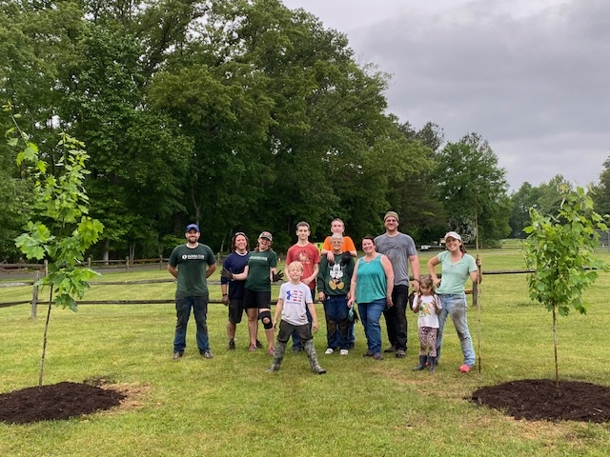
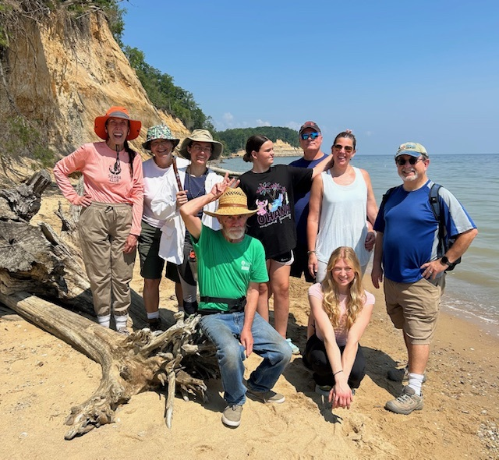
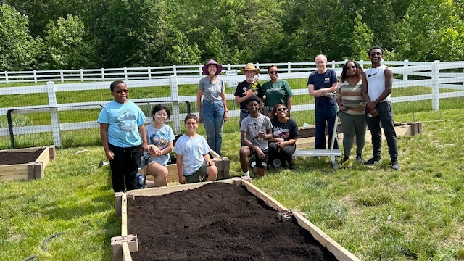
Our Local Work
Garden
Builds
Tree Plantings
Hikes and Outings

Slide 5


Contact/Follow Us!
https://www.sierraclub.org/maryland/southern-maryland-group
southernmaryland@mdsierra.org
Facebook: https://www.facebook.com/somdsierraclub/
Instagram: https://www.instagram.com/sierraclubmd/

