Slide 1

Data Centers and the Failure to Communicate
Judy Pedersen, At-large, Candidate for BOCC
Sierra Club Information Session

Slide 2

Why Listen To Me?
30 years in Public Communications
  Public engagement
  Community outreach
  Municipal bond campaigns
  Parks and land acquisitions
  First Amendment rights
  Crisis Communications
  Endorsed by Sierra Club

Slide 3


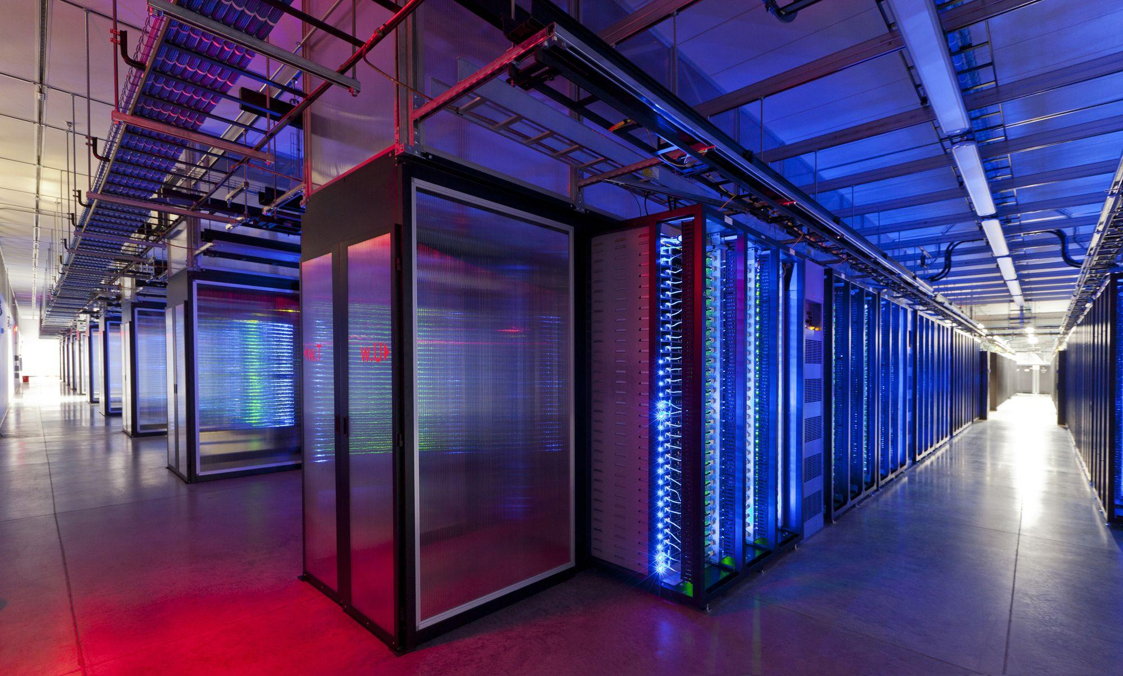

Industry’s Communication Failure
The Core Problem
Developers emphasize :
  Tax revenue
  Eco Benefits
  Technology
Communities worry about:
  Water
  Electricity
  Noise
  Environment
  Quality of life
  Transparency
DATA CENTERS
VERSUS
COMMUNITY

Slide 4

The World Has Changed
Social Media Changed Everything
  Facebook
  LinkedIn
  X/Twitter
  TikTok
“Citizens are no longer passive participants. They drive the conversation.”

Slide 5
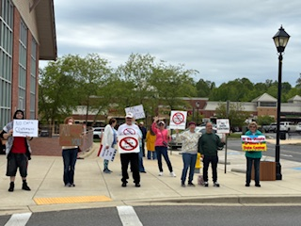
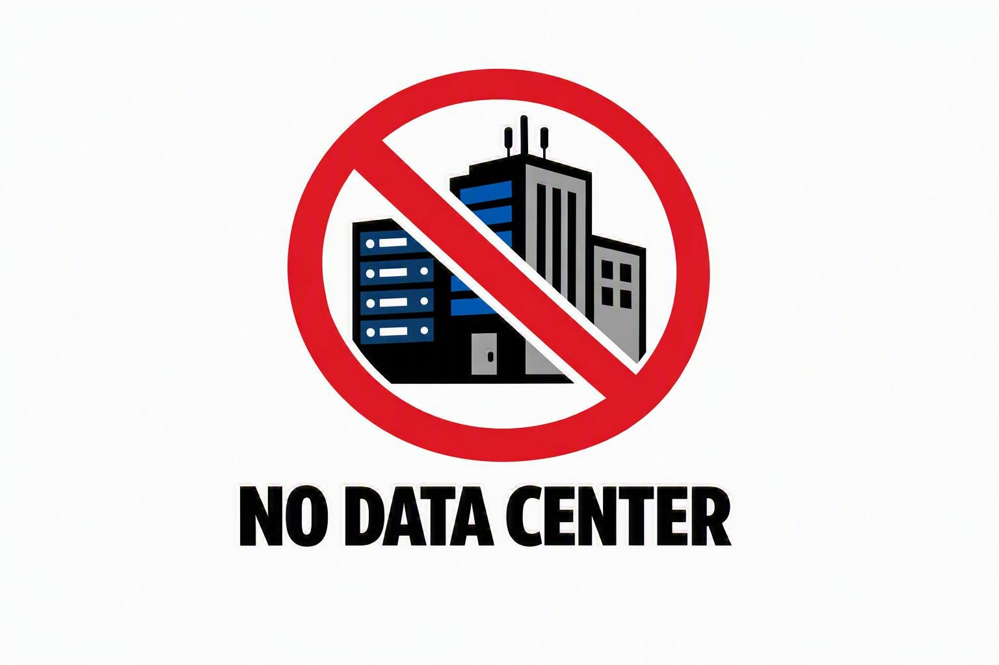
Citizen Activism Works
Communities Are Organizing
  Local activists
  Community groups
  Online networks

Slide 6
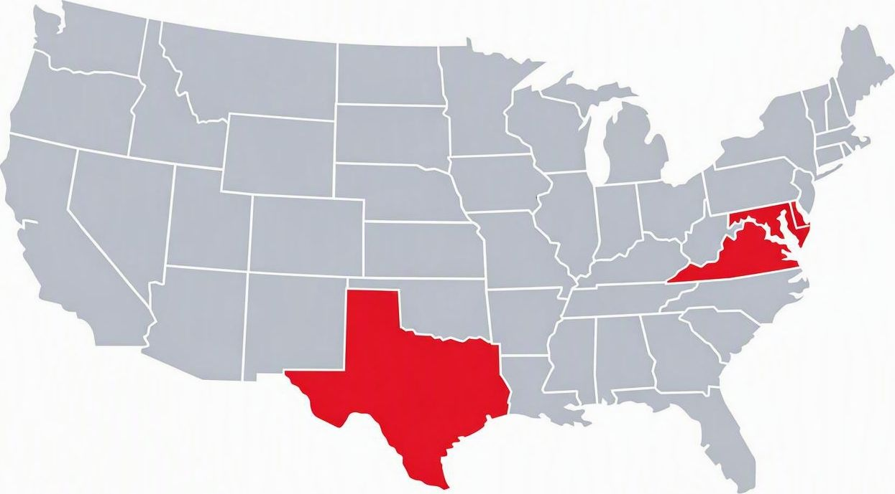
A National Movement
Opposition Is Growing Nationwide
  Virginia activism
  Texas regulations
  Maryland legislation
  Delayed and cancelled projects

Slide 7
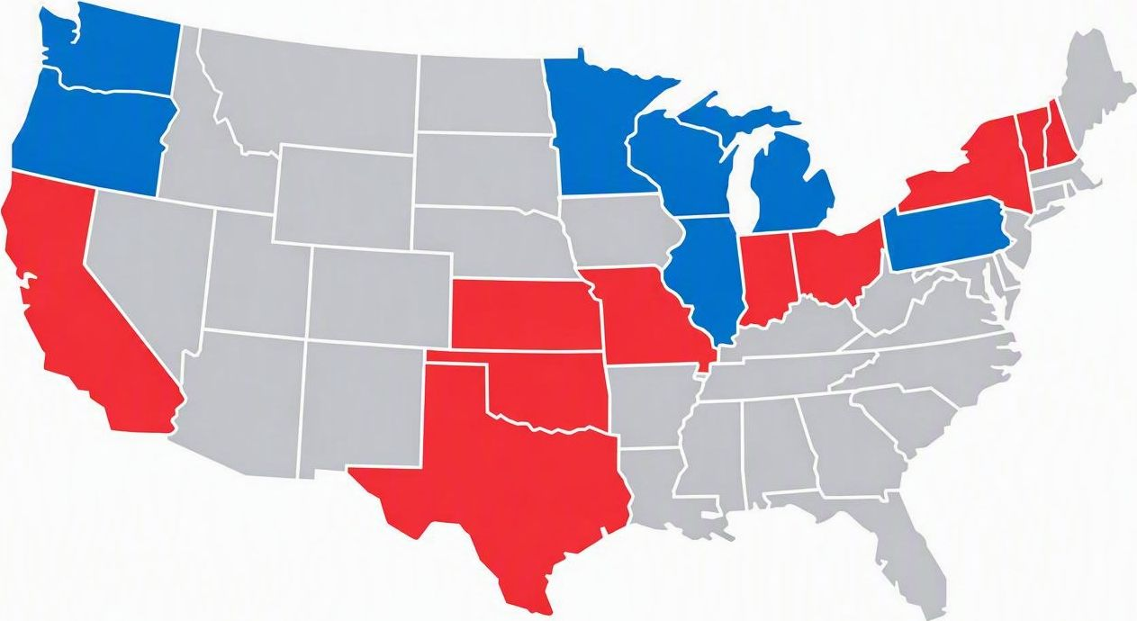
Not a Partisan Issue
Both Republicans and Democrats Agree on One These Things:
  Increased energy demand
  Environmental impacts
  Infrastructure costs
  Need for local control

Slide 8
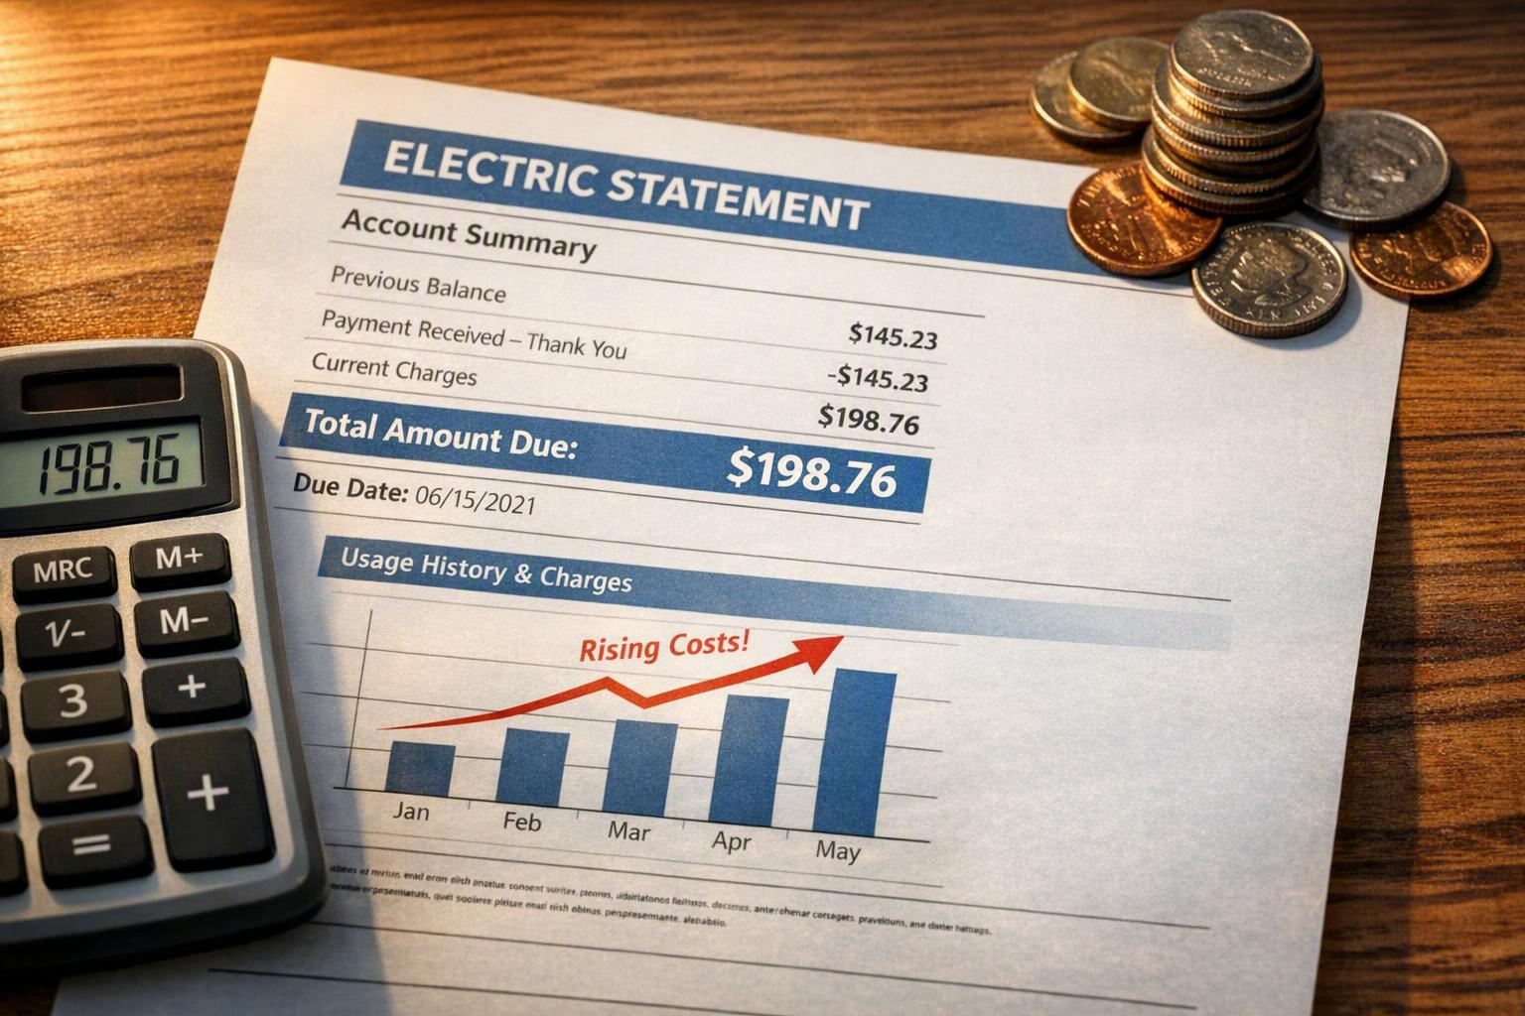

The Questions Residents Keep Asking
Who Pays?
  Can families afford higher electric bills?
  Will the grid remain reliable?
  Will infrastructure keep pace?
  Will local benefits match the promises?

Slide 9







Why People Oppose Data Centers
The Major Concerns
Electricity costs
Grid strain
Water consumption
Environmental impacts
Noise
Historic resources
Limited long-term jobs

Slide 10

The Real Issue
TRUST IS GONE
The industry’s greatest challenge is no longer finding land or power.
Industry’s greatest challenge is rebuilding trust.

Slide 11

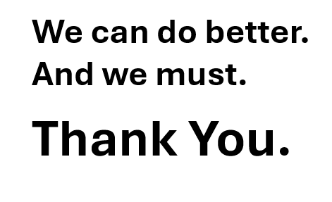
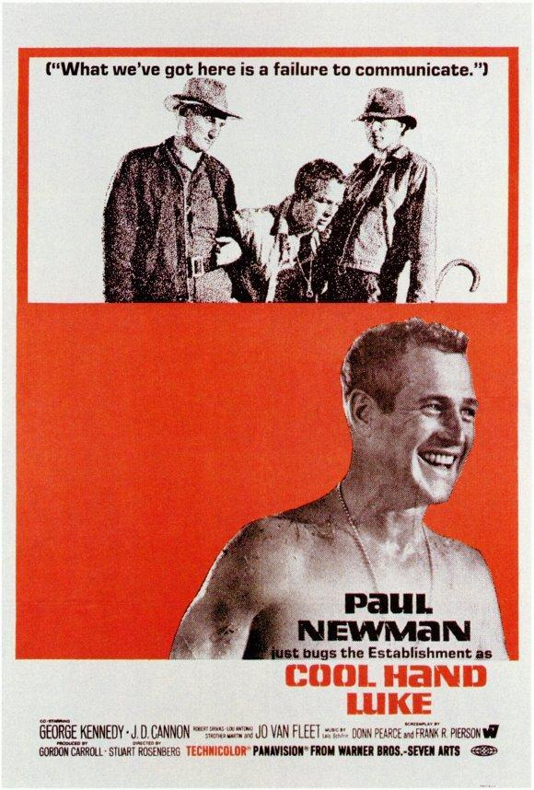
Conclusion
What we've got here is failure to communicate.”
— Cool Hand Luke (1967)

