Slide 1
Quality of Life Issues
What’s that sound?
Where’d the sun go?

Slide 2
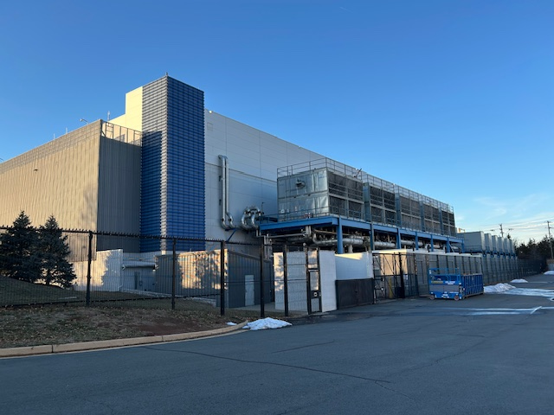
Loudoun County Virginia has 53.3 million square feet of data centers in operation or under development – Loudon Virginia Economic Development
A growing number of data centers are being built close to residential areas, causing residential impacts
Residential neighborhoods are generally expected to be safe, quiet, and pleasant places to live, whereas industrial facilities are often large, unsightly, and potentially noisy.
Data centers are industrial facilities that are largely incompatible with residential uses
Data Centers in Virginia, 2024
Joint Legislative Audit and Review Commission,
Report to the Governor and General Assembly of Virginia

Slide 3
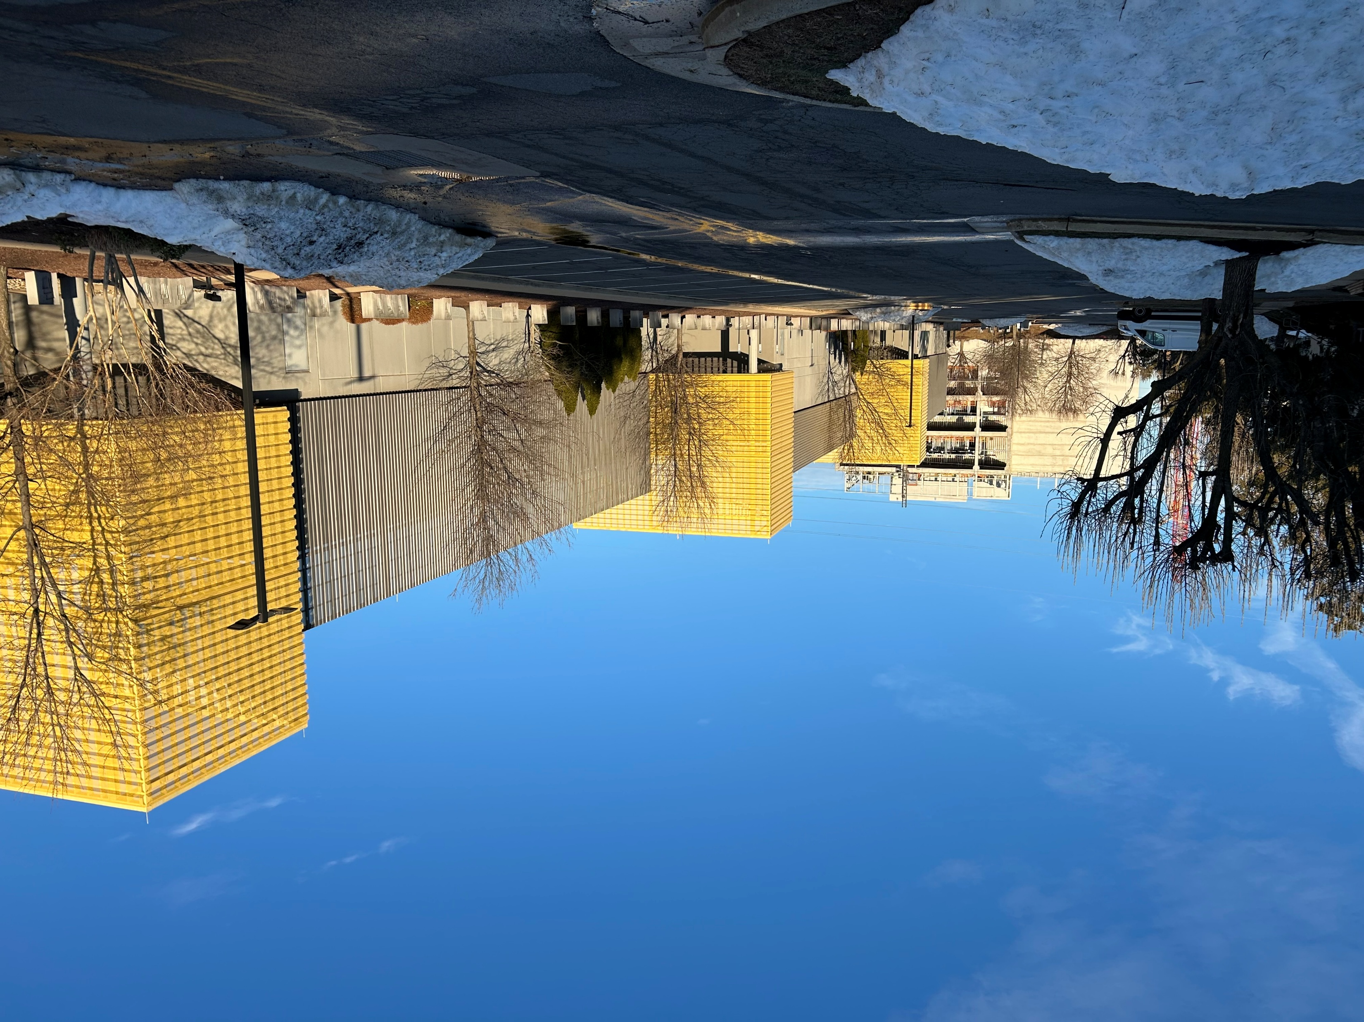
Ashburn, VA

Slide 4
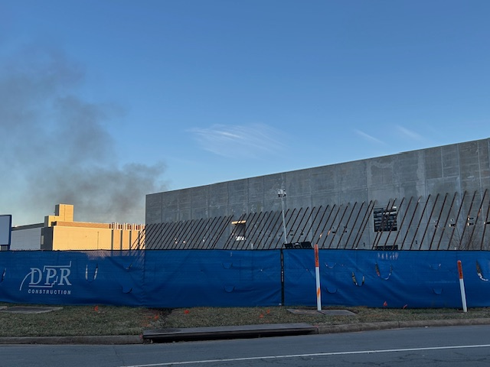
Ashburn, VA

Slide 5
February 20, 2023 Data Center Impacts on Residential Communities
Loudoun Meadows HOA
Easement Issues for Water and Sewer Access
  Unapproved destruction of HOA owned property
  Unplanned - loss of access to amenities for 10 months
  Heavy equipment and construction noise within feet of homesites
Proximity to Homes
  Data center 139 feet from nearest home
  70-ft tall buildings casting shadows over homes
  Allowing 70ft tall structures directly adjacent to homes half that size results in a “David and Goliath” unnatural difference.
https://loudouncoalition.org/wp-content/uploads/2023/03/Loudoun-Meadows-HOA-Data-Center-Inputs.pdf

Slide 6
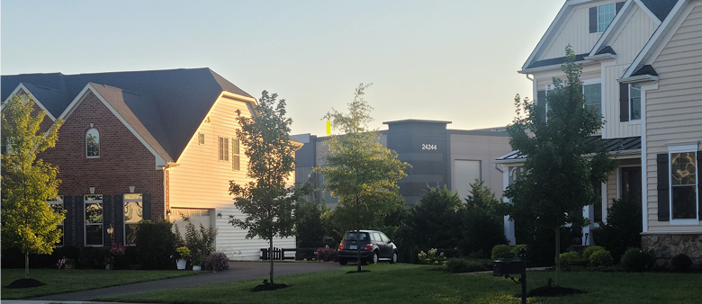
Homes in Loudoun Meadows

Slide 7
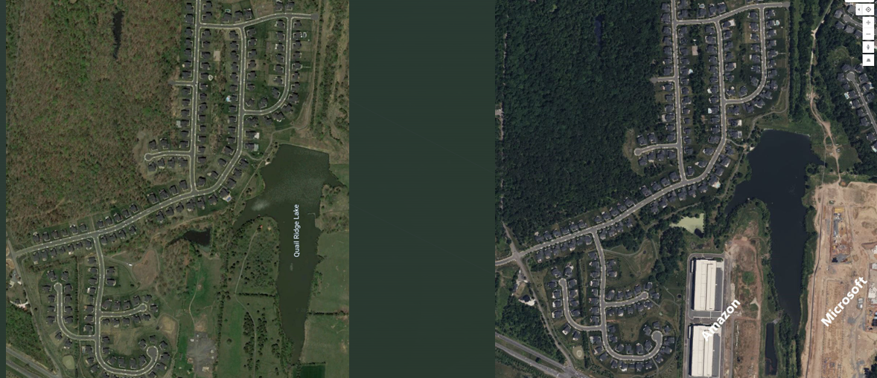
Loudoun Meadows 2018
Loudoun Meadows 2023

Slide 8
His neighborhood was overtaken by data centers. He wants a $500 million deal to move out.
Business Insider
Homeowner Mital Gandhi tries to convince his entire HOA, 143 families, to sell their homes to a data center developer.
"The construction noise, the construction traffic, the running of their emergency generators in the middle of the night… Some of them didn't have proper baffling on their air conditioners, so there was this massive humming all the time," Walt Purnell
"We love Ashburn, it's a fantastic area," Gandhi said. "Unfortunately, we didn't know 13 years ago that it was going to be Data Center Alley."
https://www.businessinsider.com/ashburn-virginia-the-regency-data-center-sale-deal-2026-6

