Slide 1
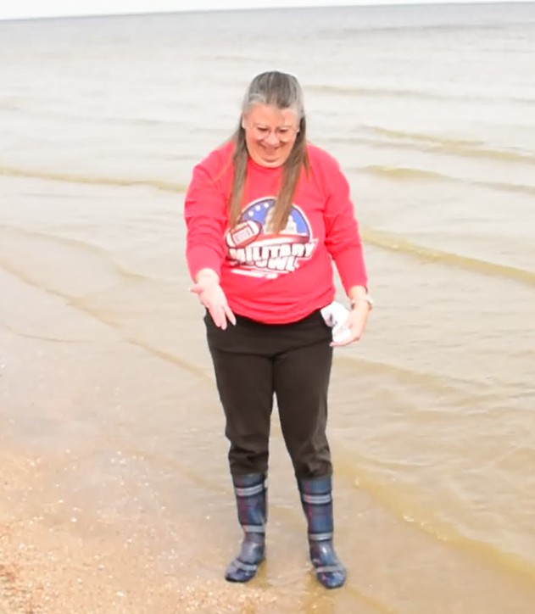
About Janette
Doctorate in Ecological Psychology & Environmental Humanities, with a specialty in climate response and resilience
>20 years teaching natural sciences and sustainability in CCPS and at the college level
Member, Calvert County Environmental Commission
Fell in love with Brownies Beach
Looking for shark teeth fossils on Brownies Beach in winter

Slide 2
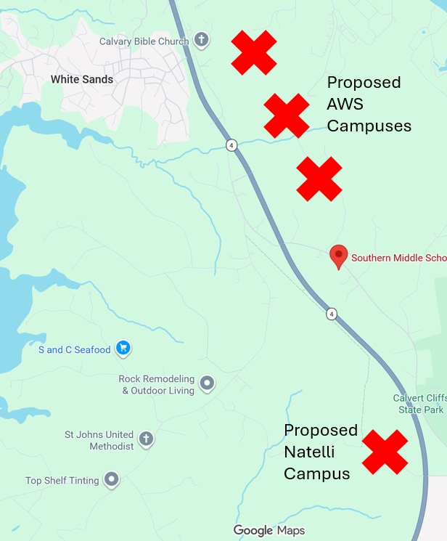
Proposed Data Centers in Calvert
Two projects currently proposed
  8 data center buildings at Calvert Cliffs Nuclear Power Plant
  4 data center buildings at land donated to Calvert to become a park (Natelli)

Slide 3
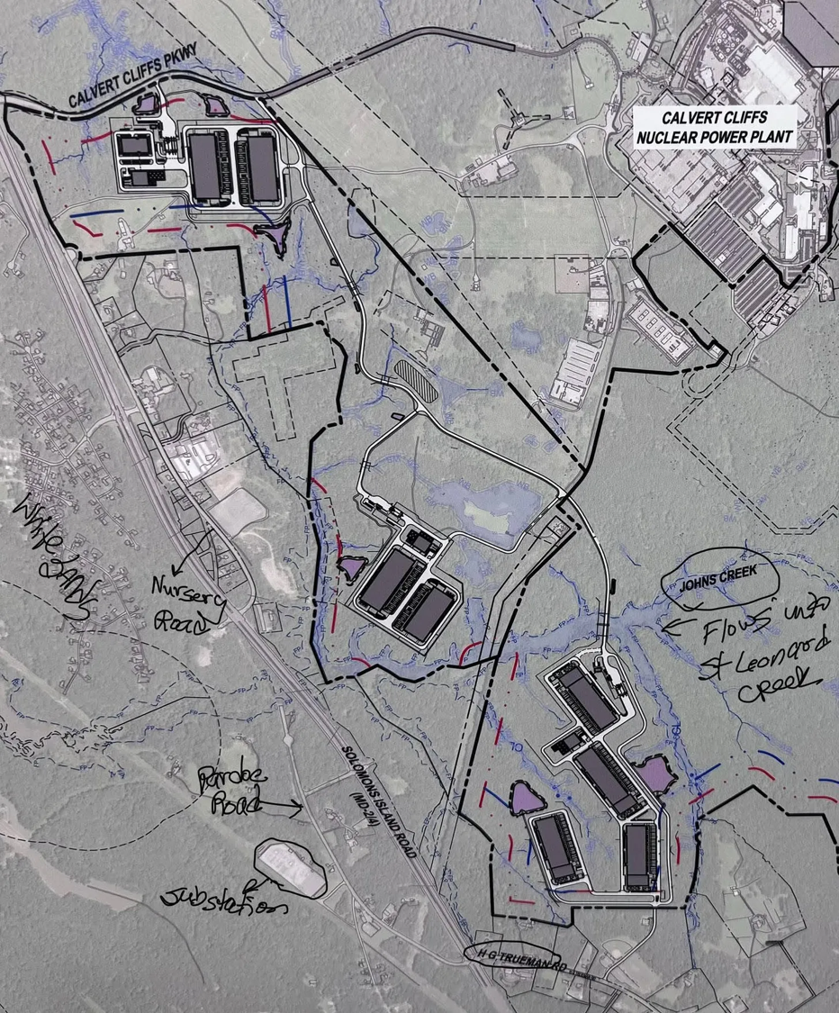
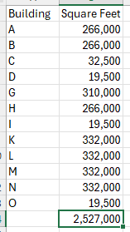
AWS @ Calvert Cliffs
For comparison:
1 football field = 57,600 square feet
AWS = 43.87 football fields OR
Ravens Stadium = 1.5 million square feet
Forested wetlands
Numerous protected species
Beavers = keystone species

Slide 4
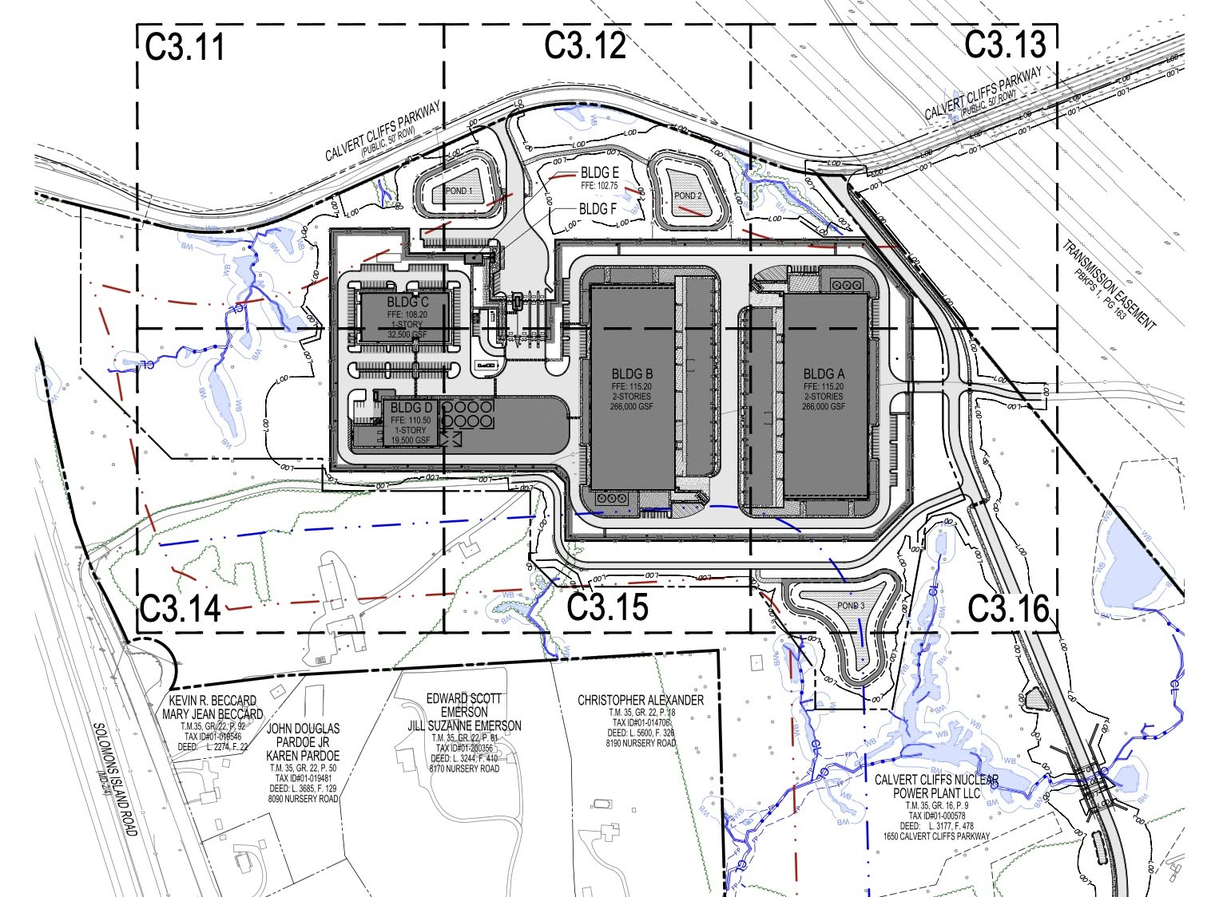
AWS @ Calvert Cliffs
Campus 1
Blue dashed lines = 400’ offset from residential spaces
Red dashed lines = 200’ offset

Slide 5
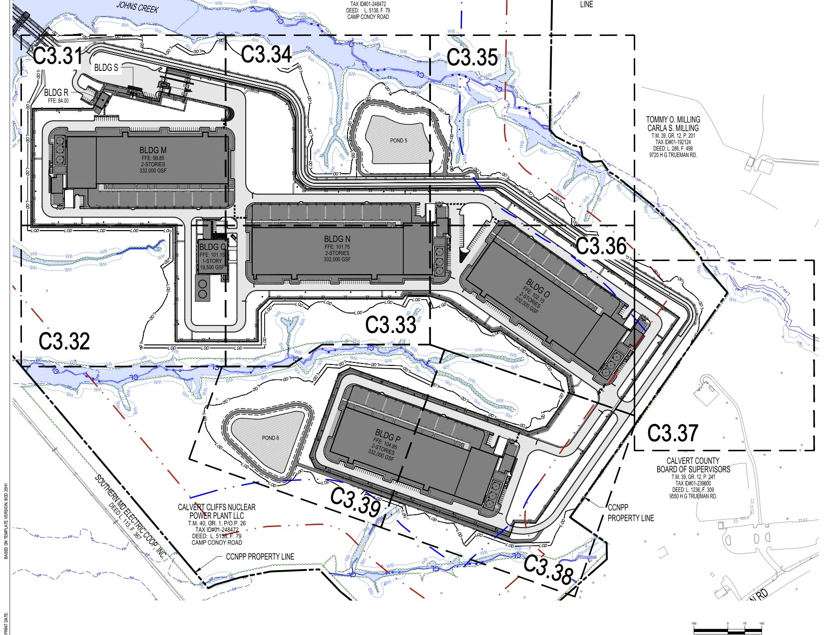
AWS @ Calvert Cliffs
Campus 3
Blue dashed lines = 400’ offset from residential spaces
Red dashed lines = 200’ offset
BGE Park

Slide 6
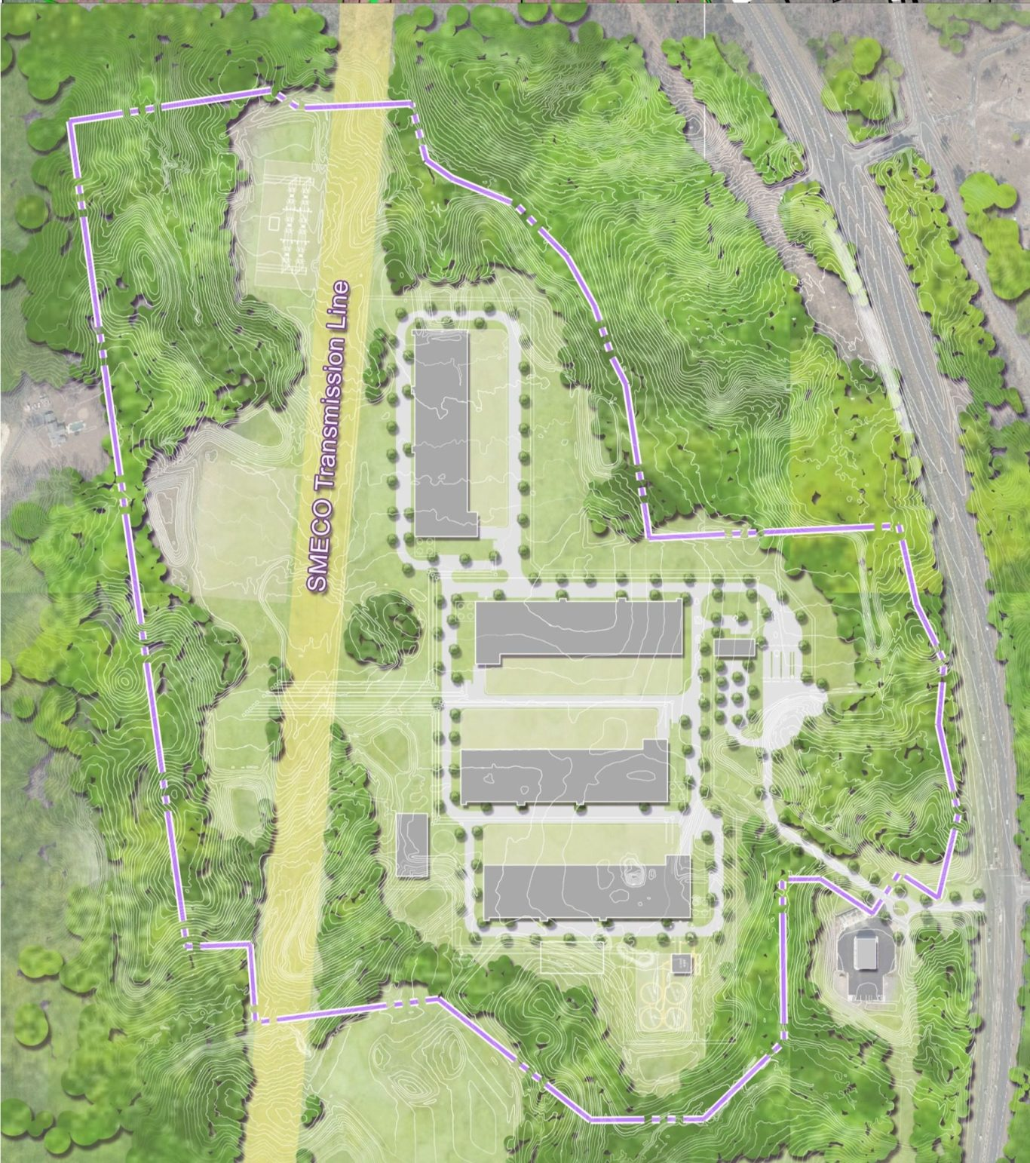
Natelli Holdings
Wants to purchase land donated to county intended to become public park
4 proposed data center buildings

Slide 7
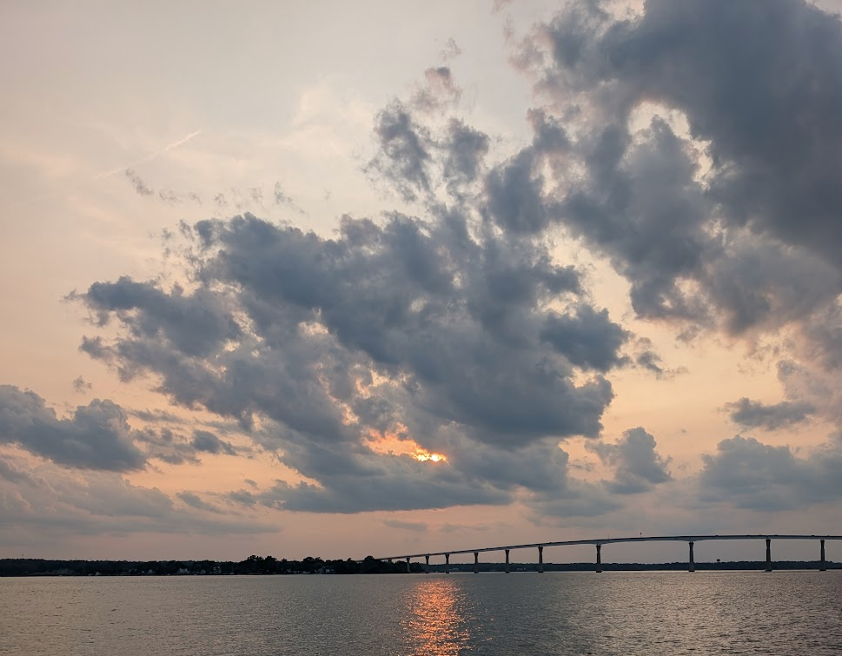
Noise Pollution
IMPACTS
Disturbs sleep, produces cardiovascular, cognitive, and mental health impacts
Stresses fish and raises their cortisol levels
Noise levels can reach 80-90 decibels at a data center
  Cooling equipment
  Generators
Sound travels through air and water
Sound waves coming from two different directions amplify waves
TJ Bridge from Solomons

Slide 8
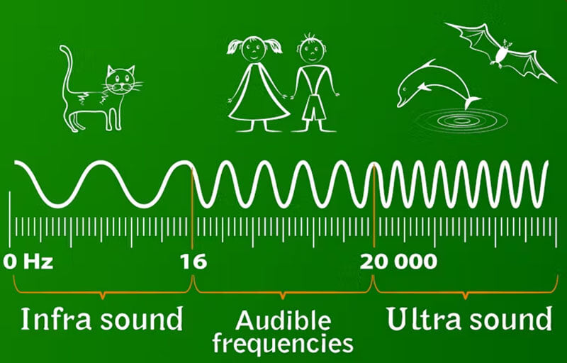
Infrasound
IMPACTS
“Infrasound at high volumes can directly affect the human central nervous system, causing disorientation, anxiety, panic, bowel spasms, nausea and vomiting.”
Infrasound is ultra-low frequency (below 20 hertz; below human hearing levels)
  Produced by mechanical operation
  Can penetrate buildings

Slide 9
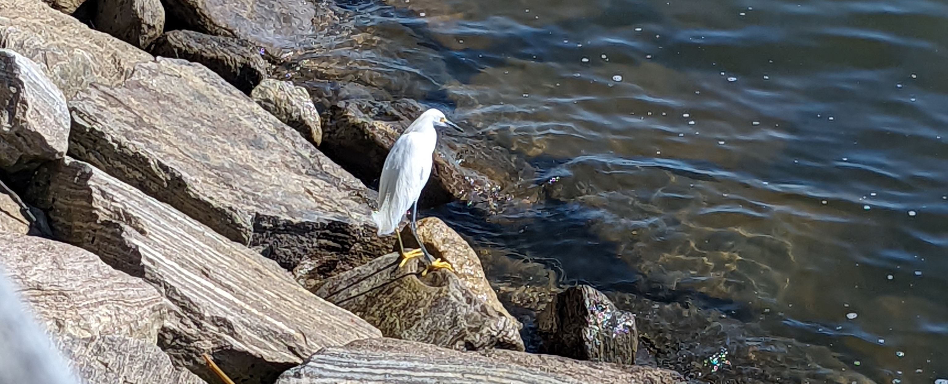
Water Usage/Pollution
IMPACTS
Concentrated water cannot be returned to the Bay
Increased pollutants will make their way into the Bay
Impacts to plants and animals (food sources)
Evaporative cooling
  Changes water chemistry by concentrating nutrients and minerals
  Reduces amounts of water
Removing forests over wetlands on Johns Creek will reduce water filtering
Asphalt surfaces will increase pollution runoff into streams, rivers, and Bay
Crane

Slide 10
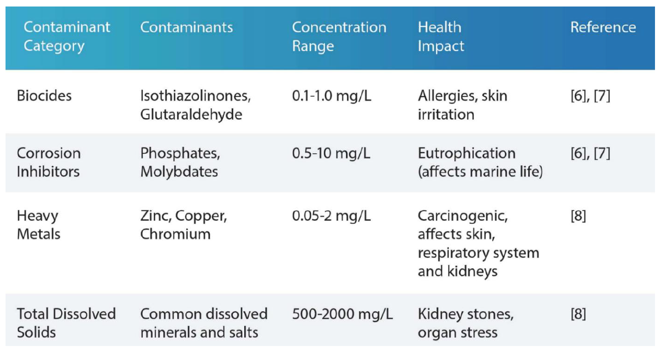
Categories of Pollutants of Concern and their Concentrations
Taken from written testimony of STEPHEN E. PETTY, P.E., C.I.H., C.S.P. to the Ohio Select Committee for Data Centers, June 1, 2026

Slide 11
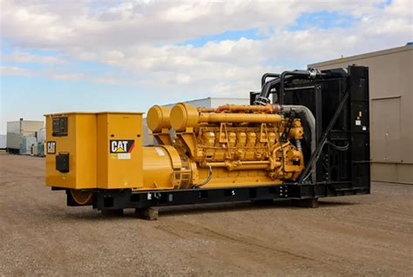
Air Pollution
IMPACTS
Humans: diesel exhaust contains >40 cancer-causing substances
Exhaust mixes with water causing acid rain
In the Bay, it will cause acidification, reducing Bay pH levels
  Reduces calcium and carbonates needed by oysters and blue crabs for shell building, reducing populations
Data centers require massive generators for backup power
  Frederick AWS data center: 4 buildings needed 99 generators of various sizes
    92 - 2,750kw
    6 - 750kw
    1 - 250kw
Require regular cycling and testing
May be required to turn on generators to reduce strain on electric grid

Slide 12
Data Center Heat Island
Heat generated/removed from data centers have increased average temperatures 3.6°F
Minimum=.54°F; Maximum=16.4°F
Distance from data center extended up to 6.2 miles
IMPACTS
Warmer air and land temperatures up to 6.2 miles
Potential increases in Bay water temps
  Hypoxic (low oxygen levels) conditions ➔ Dead Zones
  Impacts aquatic life

Slide 13
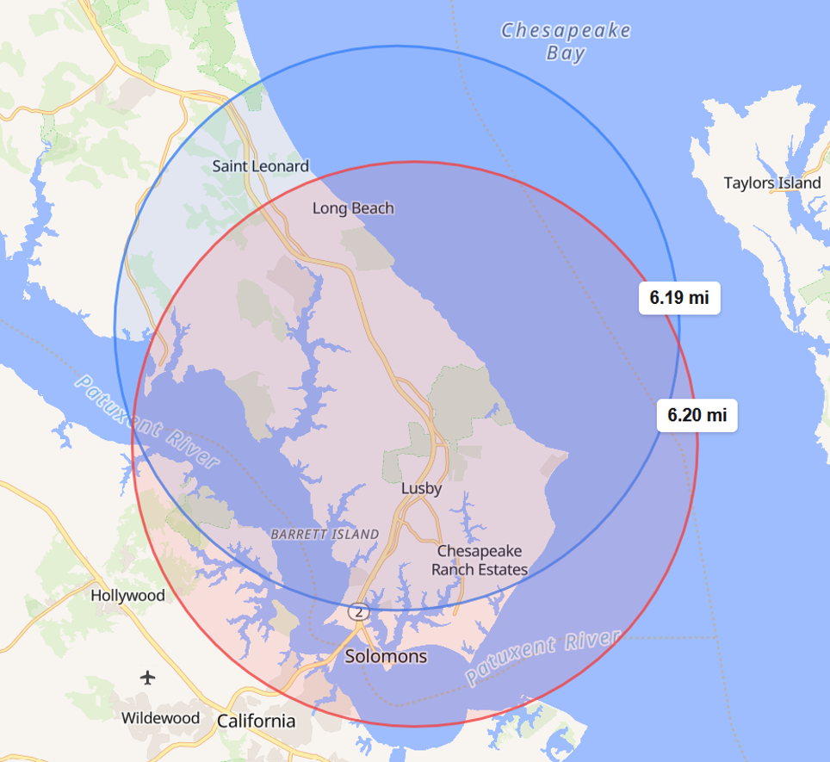
Heat Island Potential Radius
Blue circle = AWS
Red circle = Natelli

Slide 14
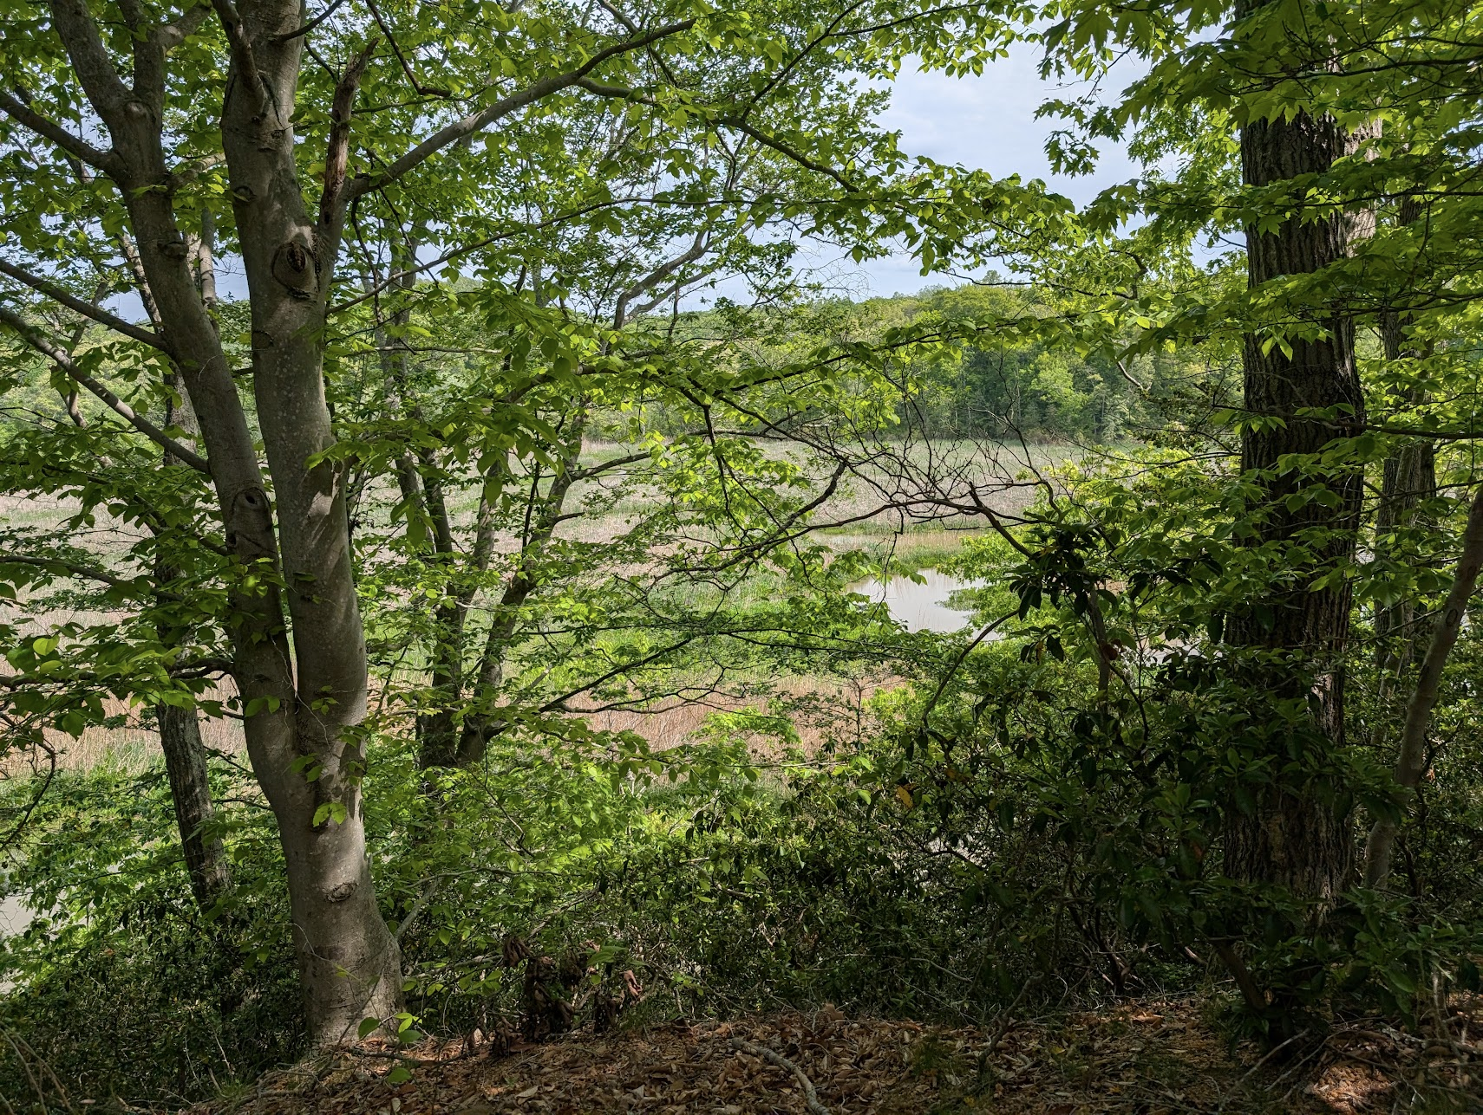
PFAS Usage
PFAS are also known as “forever chemicals”
Used in data center cooling
Possibly used in fire suppression
Kings Landing Park
IMPACTS
Humans: multiple human health impacts including increased cholesterol levels, pregnancy complications, and some cancers
PFAS-contaminated water should not be consumed or used for cooking

