Slide 1
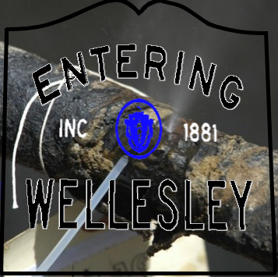
Gas Leaks In Wellesley
Presentation to the Board of Selectmen
February 29, 2016
Wellesley Natural Resources Commission
Wellesley Sustainable Energy Committee

Slide 2
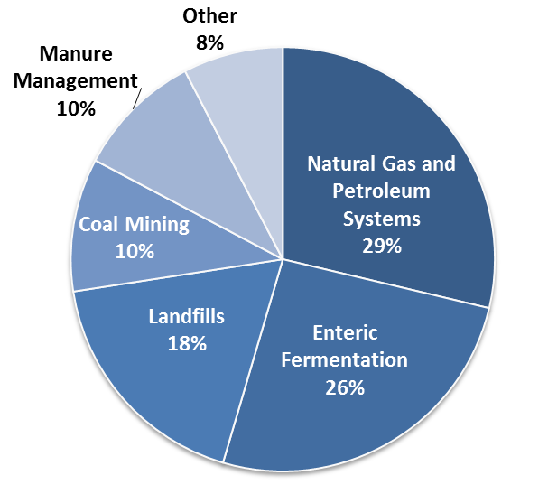
Sources of Methane
Notes:
Enteric Fermentation: Breakdown of Carbohydrates into simple molecules for absorption by Animals.

Slide 3
Global Impact
In the U.S., leaks from natural gas systems account for 29% of all methane emissions.
Methane (CH4) is the second most prevalent greenhouse gas emitted in the United States from human activities.
Pound for pound, the comparative impact of CH4 on climate change is 84X at onset and 21X that of CO2 over a 100-year period.

Slide 4
Notes:
Natural Gas, 95% of which is methane, is roughly 86 times as potent as carbon dioxide as a driver of climate change over a period of 20 years, or 35 times as potent over the span of a century.

Slide 5
Causes of Gas Leaks
Pipe materials: Nearly 45% of the pipes are made from cast iron or other corrosive and leak-prone materials.
Age of pipes: More than half of the pipes are more than 50 years old.
Materials Reaction: Properties of gas dries out packing at pipe joints.
Pressure: Since pressure in pipe is higher than air pressure, gas escapes where seal is broken.

Slide 6
Wellesley Gas Leak Situation
In Mar 2015 NGrid report, 121 documented leaks including 8 on Route 9
In 2015, 57 Wellesley Fire Department responses to outdoor odor of gas
Pressure in Wellesley pipes is 4x that of Boston streets but Weston pressure is 30X Wellesley’s
Pressure in pipe under Route 9 is 40X Boston’s
5 year moratorium on pavement cuts after Route 9 repaving project

Slide 7
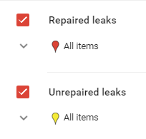
Documented Wellesley Leaks
Notes:
121 unrepaired leaks. The oldest is from 1992. Unaccounted For Gas exceeds 8 billion cubic feet per year and is worth $50 Million.

Slide 8
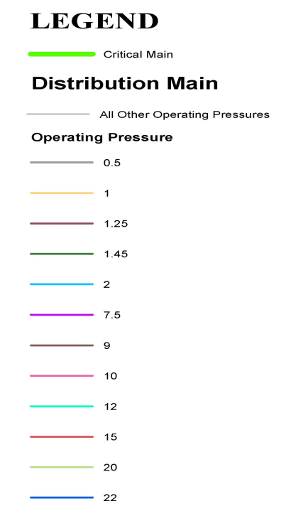
Notes:
The vast majority of gas lines in wellesley are pressurized to 2 PSI. Those along Rt. 9 are pressurized to 20-22PSI.

Slide 9
Wellesley Impacts
Safety – Risk of explosions
Local Air Pollution – Health impact from inhalation
Undue Cost to Consumers – We pay for leaked gas
Damage to Wellesley Trees and Plants
Disruption of Traffic Flow
DigSafe costs to DPW and MLP
Climate Impact – Methane contributes 25% of human-caused global warming.
Notes:
1 Leak adjacent to the HS, 2 leaks within a block of the Middle School, 2 within a block of Sprague, 3 within a block of Farms Station, 2 identified near our Town forest, 1 less than a block away from Town Hall.
Ground Level Ozone: Causes chest pain, coughing, throat irritation, and congestion. It can worsen bronchitis, emphysema, and asthma and can reduce lung function and inflame the linings of the lungs. Repeated exposure may permanently scar lung tissue
Leaking gas replaces oxygen in tree roots and dries them out. No count in Wellesley but Newton inventoried 220 dead and 190 damaged trees and is suing the gas company

Slide 10
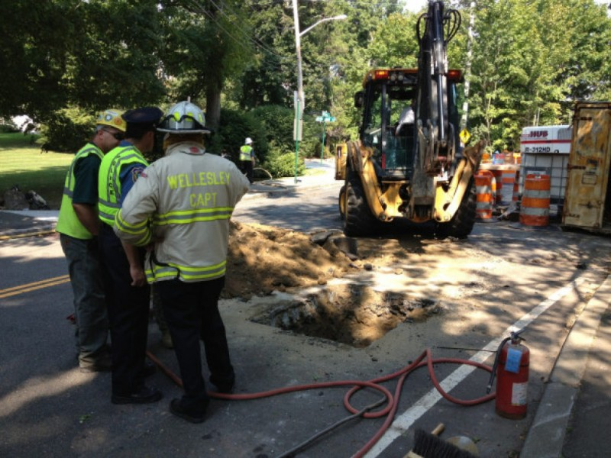
Safety
“Crews are shutting down natural gas on Rockland Street after a gas main was struck in the area.
Authorities have closed Linden Street between Kirkland Street and Route 9 as officials repair the leak.
"There is a strong smell of natural gas in the area," according to a police alert.
Wellesley Patch - August 31, 2012
Notes:
Ground Level Atmospheric data from Boston. Note the background atmospheric level of Methane is 2.2ppm. Emissions from natural gas were found to be two to three times larger than predicted by existing inventory methodologies and industry reports

Slide 11
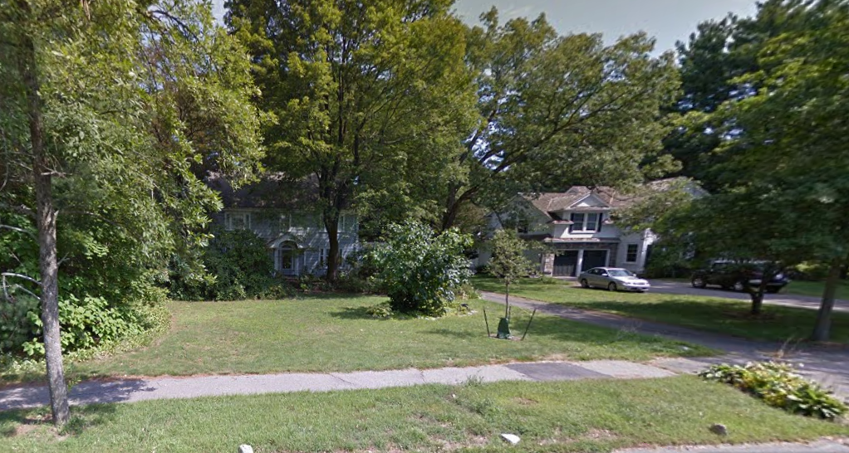
Tree Damage
2009
2011
Notes:
Tree Removed from 200 Grove Street after years of damage from Natural Gas.

Slide 12
Current Gas Leak Management
DPW and NGrid meet at least once a year
Fire Department investigates all gas leak reports
Leaks are graded as 1, 2 or 3 by order of safety risk
Level 1 and 2 leaks are repaired quickly (but not always effectively)
Town issues a permit to cut streets
5 year moratorium on cutting new pavement with exceptions for safety reasons
Oldest Level 3 leak is 24 years old, average is nearly 8 years

Slide 13
Challenges to Mitigation
Leaked gas in rate base – No financial incentive for NGrid to repair
Multiple repairs in rate base – No financial incentive for high quality repairs
Lack of Tight Coordination Between Town and NGrid– Coordination not an NGrid priority
Old infrastructure – Fix a leak and new pressure will create a leak nearby
Disruption of Cut Up Streets – Short term downside of repair acceleration

Slide 14
Recommended Actions
THERE IS NO PERFECT OR COMPLETE SOLUTION TO THIS COMPLEX PROBLEM!
State-wide Action – Encourage mitigation by a BOS Resolution to support H2870 and H2871

Slide 15
H2870
Precludes utility companies from charging customers for the cost of lost and unaccounted for gas
Currently, no financial incentive to reduce leaks
Phased in reduction to zero of amount of lost gas that can be applied to rate structure
Accelerated repairs becomes a good business decision with est. payback to utility of 1 to 5 years
51 sponsors and co-sponsors including Sen. Creem
Supported by Rep. Alice Peisch
Notes:
Two bills assigned to the Joint Committee on Telecommunications, Utilities and Energy ensure that gas consumers no longer pay for gas leaked from neglected, obsolete and decrepit pipes

Slide 16
H2871
Encourage Gas Leak Repair During Road Projects
Requires all gas leaks under a road to be repaired when it is opened up for a construction project
Puts additional pressure on utilities to cooperate with host communities
49 sponsors and co-sponsors including Sen. Creem
Supported by Rep. Alice Peisch

Slide 17
Towns Supporting HR 2870/2871
Arlington, Bedford, Boston, Brookline, Cambridge, Chelmsford, Concord, Dalton, Framingham, Lexington, Lowell, Malden, Marblehead, Newton, Northampton, North Adams, Pittsfield, Somerville, Swampscott, Waltham, and Wayland.

Slide 18
Recommended Actions
Local Action – Form a Wellesley Gas Leaks Working Group
Purpose – Monitor situation, seek additional cooperation and coordination and report progress annually to BOS
Meetings – Several time a year
Membership - BOS, DPW, Fire, Health, NRC, SEC, Law
Best Practice – Based on Boston, Cambridge and Newton

Slide 19
Conclusion
Each leak small but together are “Death by a Thousand Cuts”
Economic incentives for good business decisions
Consumer fairness for gas customers
Efficiencies from closer cooperation
* * *
The NRC and SEC recommend the BOS:
Create the Gas Leaks Working Group
Enact the proposed resolution supporting H2870 and H2871

