Slide 1
Save Maryland’s Forests:
Sierra Club Webinar on
Forest Conservation Act (FCA) Bill
January 23, 2018

Slide 2
Agenda for Webinar
Welcome & Kickoff | Nancy Plaxico Volunteer Lead for FCA Bill, Sierra Club MD | 2 min
Overview of FCA Bill | Nancy Plaxico | 10 min
Why FCA Bill is Needed | Joan Maloof Professor Emeritus at Salisbury University, Founder of Old-Growth Forest Network, author of The Living Forest & other books on forests | 5 min
Political Landscape for Bill & Our Lobbying Plans | Mark Posner Legislative Chair, Sierra Club MD | 5 min
Action Steps | Nancy Plaxico | 3 min
Q&As and Discussion | Zack Gerdes Conservation Organizer, Sierra Club MD staff | 10 min
Close | Nancy Plaxico | 1 min

Slide 3
Why is the FCA bill needed?
Despite the FCA’s goal of “no net loss” of forest to development, Maryland has lost more than 100,000 acres of forest to development since the FCA was enacted in 1991.
The state is projected to lose another 176,000 acres by 2035 (a) unless the law is strengthened.
Where development pressure is intense, developers have cut down more than 40% of forests on average.
What has become clear is that the greatest loss is on more heavily forested land tracts that are developed. Recent research from the U of Maryland confirms that the FCA is working on tracts with less than 60% existing tree cover, but is not working on more heavily forested tracts.
Those are often in larger, intact forests that provide the greatest ecological benefits and are the most important.
The FCA bill is focused on protecting these most valuable and vulnerable forests.

Slide 4
Why is the FCA bill needed?
Forests are vital to Maryland’s environment and economy:
Promote Water Quality
Promote Air Quality
Revitalize the Chesapeake Bay
Combat Climate Change
Increase Property Values
Provide Recreation Opportunities
Provide Wildlife Habitat
Enhance Health and Well-Being

Slide 5
Why is the FCA bill needed?
Forests are vital to Maryland’s environment and economy:
The ecosystem value of Maryland’s forests is tens of billions of dollars.
Economic benefits of forests include removing thousands of tons of pollutants each year from our air and water.
The state’s loss of 4,200 acres of forest to development each year results in $126 million in increased stormwater mitigation costs alone.
Forests are critical to restoring the Chesapeake Bay. Forests along streams reduce pollution entering waterways by 50% to 90%.
Forests are critical for clean water, clean air, and our quality of life.
We continue to lose forests in Maryland at an alarming rate – especially our most important forests.

Slide 6
What does the FCA bill do?
Focuses on RETENTION of PRIORITY FORESTS
Expands and strengthens the definition of Priority Forests
Requires retention of Priority Forests unless stringent criteria are met
If clearing of Priority Forests is approved, replacement must be 1 for 1 (1 acre of trees replanted for every 1 cut down - current law is 1 for 4)
Moves up review of developer’s Forest Conservation Plan much earlier in the development review process, when it’s easier to make changes
Improves Fees-in-Lieu program (when developer pays into a fund for required replanting) so local governments will partner with non-profits and other organizations to accomplish the replanting rather than letting the funds sit idle
Requires updating of the 1997 Forest Conservation Manual
It’s much more valuable to retain existing forests than cut them down and replant young trees that won’t have the same ecosystem benefits for decades.

Slide 7
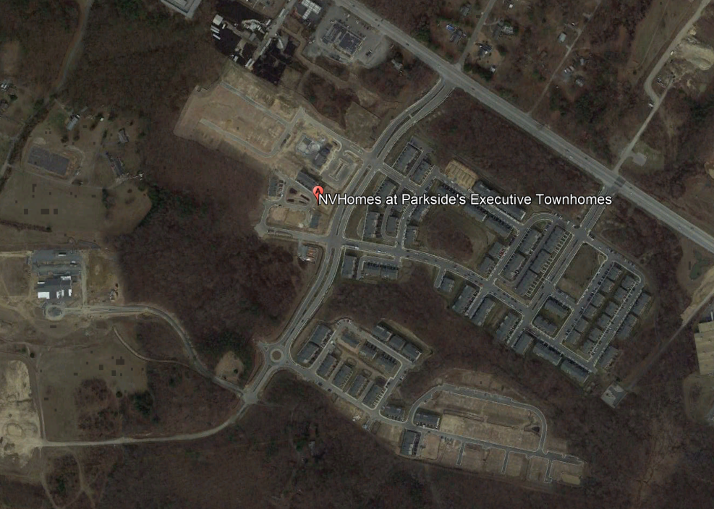
Example of what’s happening to our forests
This Anne Arundel County development cleared 135 acres of forest and had to replant only 21 acres under the FCA – a net loss of 84%!
Such destruction of forests is happening across the state.
Notes:
Developers are free to cut the largest, most intact forest habitats at the lowest mitigation cost.
It’s cheaper and easier for them to sprawl out into private timberland than to focus on smart growth and right-sizing developments closer to transit and existing infrastructure.

Slide 8
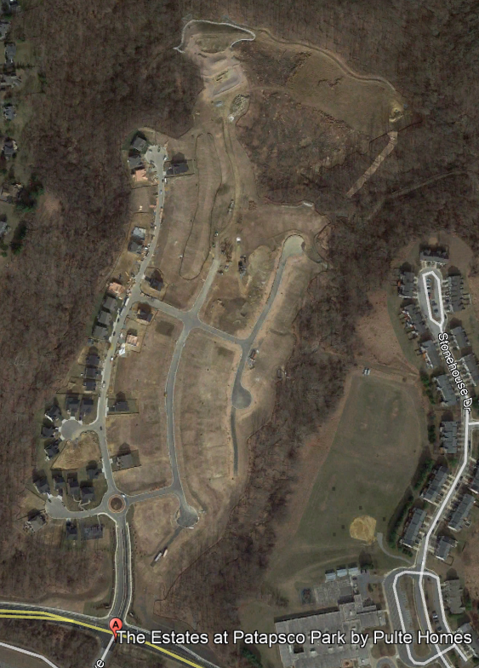
Example of what’s happening to our forests
This Howard County development cleared 48 acres of forest and had to replant only 12 acres under the FCA – a net loss of 75%!

Slide 9
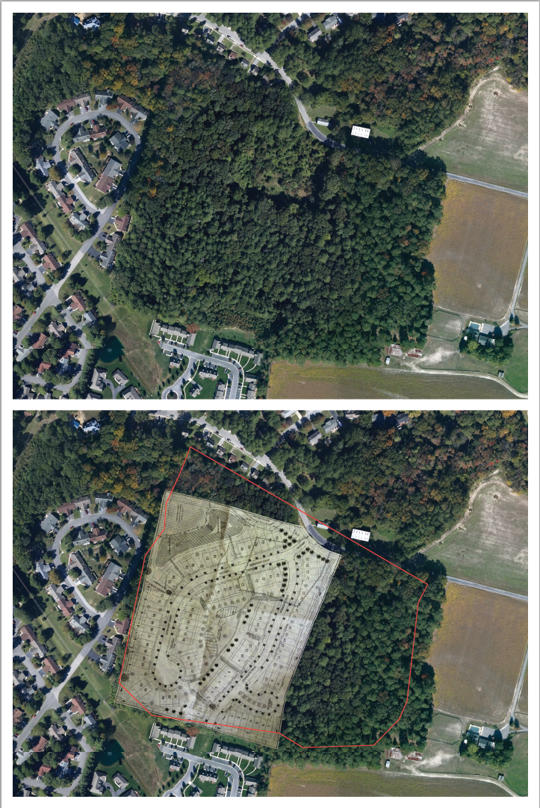
Glen Heights Community Forest in Salisbury
At the headwaters of the Wicomico River, this was one of last remaining forests in Salisbury. Many of the trees were over 100 years old and likely had been growing since the 1800s. One of the trees was the largest of its species in Maryland.
The forest provided protection against flooding and erosion, filtering of runoff into the Wicomico River and Chesapeake Bay, natural beauty, wildlife habitat, air purification, and many other benefits.
In 2013 the owner proposed to develop the property or sell it for $395,000. Despite lobbying of the city and intensive efforts by local activists, sufficient funds could not be raised to buy the property. In Oct. 2016 the developer began cutting down the trees, and plans to build 90 townhomes on the land.

Slide 10
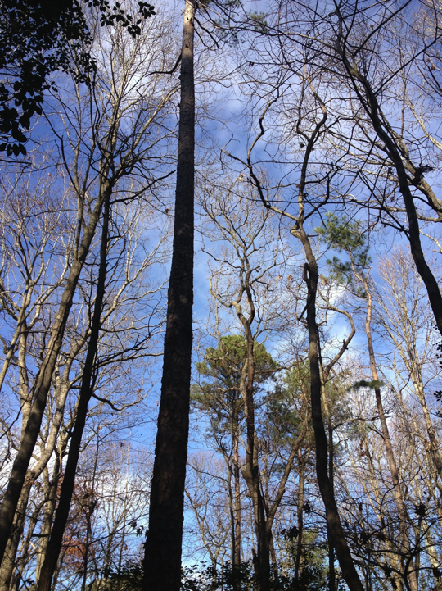

Slide 11
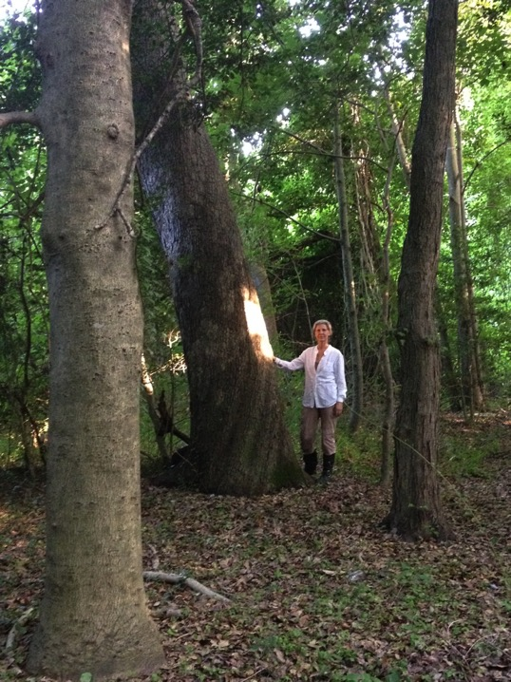

Slide 12
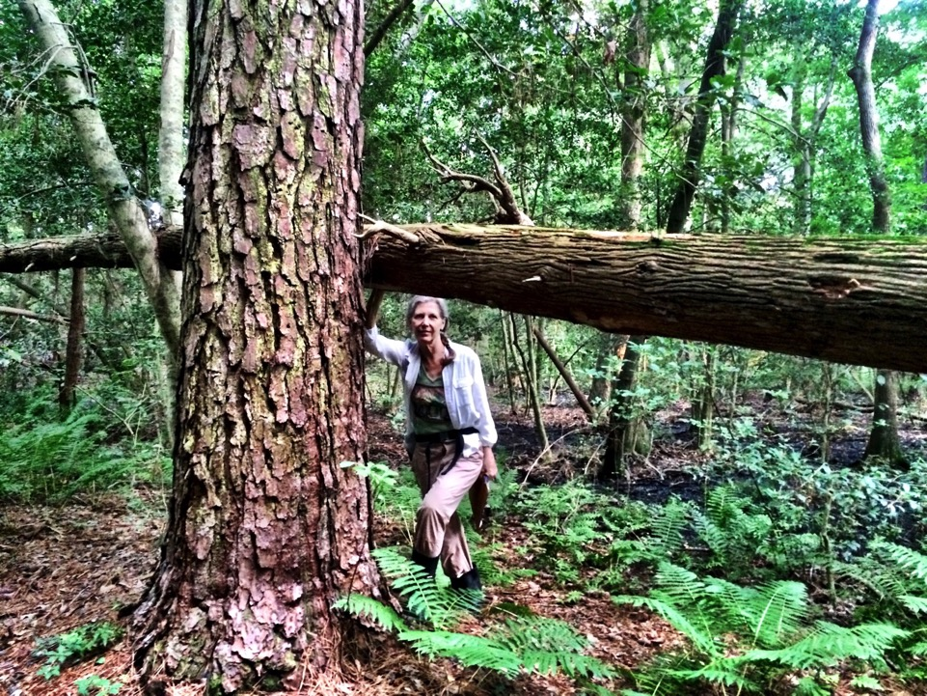

Slide 13
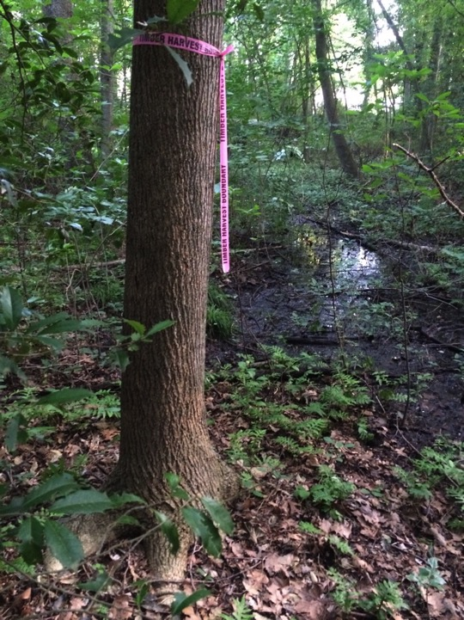

Slide 15
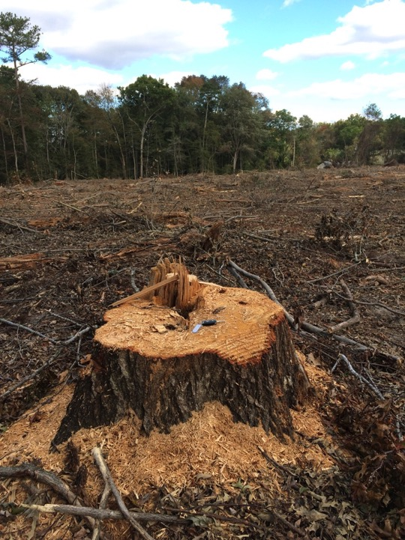

Slide 16
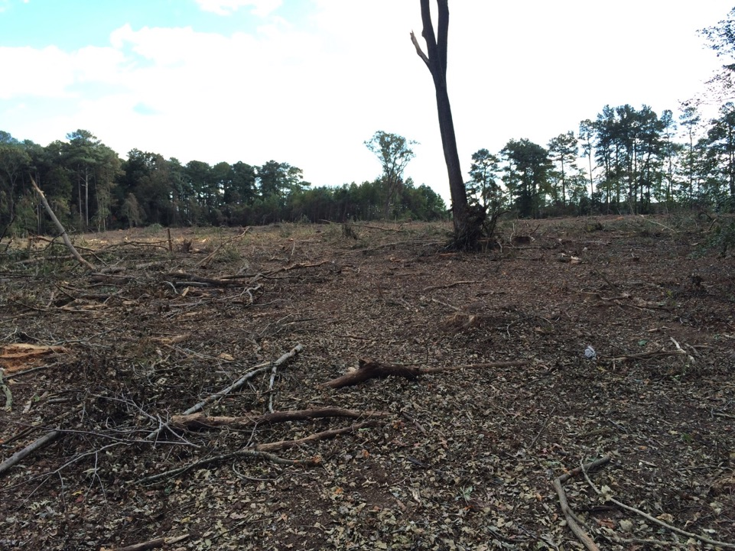

Slide 17
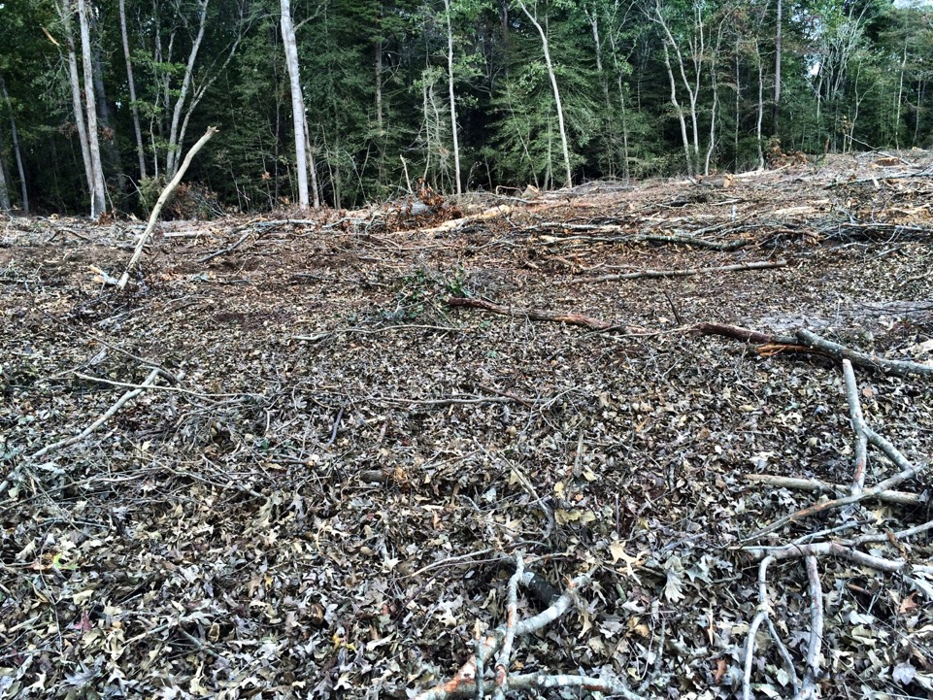

Slide 18
Political Landscape for Bill & Our Lobbying Plans
Mark Posner

Slide 19
Action Steps
Links for these will be in the email you receive after the webinar
Contact your legislators now to urge them to support the FCA bill
Sign up to support grassroots organizing for the bill
Contact Nancy Plaxico if you have local examples of forests lost to development
Join the social media campaign for the bill
Sign up for Sierra Club Lobby Night on Feb 26

Slide 20
Q & As
Zack Gerdes will moderate

Slide 21
Thank You!
Nancy Plaxico

