Slide 1
PUBLIC MONEY IN PUBLIC HANDS FOR THE PUBLIC GOOD
A People’s budget for Iowa

Slide 2
All political power is inherent in the people. Government is instituted for the protection, security, and benefit of the people, and they have the right, at all times, to alter or reform the same, whenever the public good requires it. Bill of Rights to the Iowa Constitution, Article I, Political Power, Section 2

Slide 3
Government as “growing the economy” VERSES Government as trustee of all the things we share—also known as “the commons”
Protecting, enhancing and restoring our shared public wealth is the central responsibility of government.

Slide 4
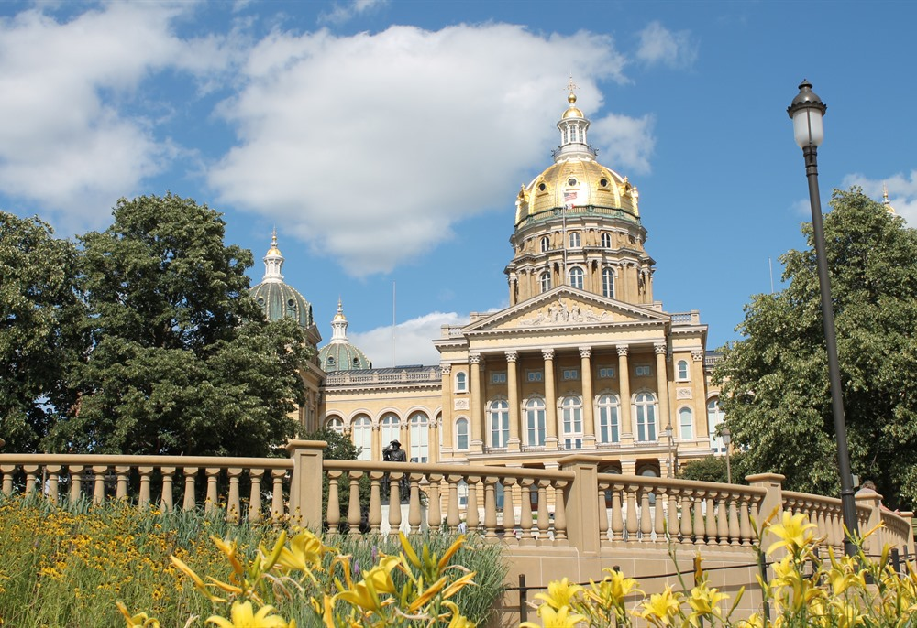
Government Is the Trustee of the Things We All Share
A fiduciary duty is a legal obligation to take care of assets for the sole benefit of a designated beneficiary. It is time for government to return to its primary function of serving the public good, the common good.

Slide 5
Governor Reynolds
The 2018 budget for Iowa put forward by Governor Reynolds is built on the premise that government’s primary responsibility is to the economy; it woefully neglects the common assets of the State. The four goals of the Reynold’s budget reflect her view of what government is for and stand in sharp contrast to the fiduciary duties of government: Her goals are:
· Create a Competitive Business Environment;
· Develop the Most Innovative Energy Policy in the World;
· Educate our Children for the Knowledge Economy;
· Train Iowans for the Jobs of Tomorrow.
Even education is designed to funnel kids into the economy, rather than develop their unique skills and enable them to be effective citizens.

Slide 6
The public trust should be designed into the state budget.
The public or common good
All must be funded sufficiently.
Education
Public health
The environment
Infrastructure such as road and bridges
Government services such as courts

Slide 7
State Budget Principles
The common wealth and public health are the basis of the economy.
Tailor the budget to the public assets.
Corporations must pay their fair share.
No privatization of essential governmental responsibilities.
Fund solutions that solve more than one problem.
Prevent problems rather than clean up the mess later.
Keep public money within the state.
Budget and spending processes should be transparent and accountable.
Taxes should be fair.
Tax incentives should benefit the public good and the commons.
Revenue should be adequate to care for the common wealth and public health.
Revenue streams should be stable and predictable.
The tax system should be simple.

Slide 8
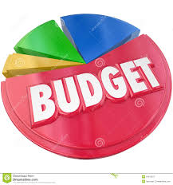
THE BUDGET PROCESS
Revenue estimation
Guidelines sent to state agencies in June or July
Departments compile budget needs
Agency hearings held in November
Public hearings held in December
Governor submits proposed budget to Legislature by Feb 1
Legislature adapts a budget by April or May
Governor approves or changes budget and returns it to legislature
Budget goes back to governor for approval
Fiscal year begins in July

Slide 9
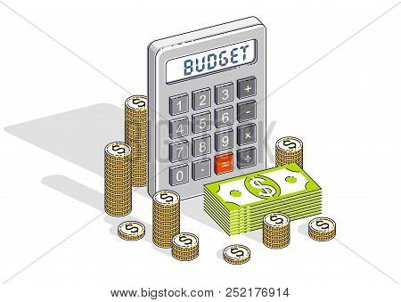
Recommendations for a People’s Budget
Set goals
Designate a legal guardian for future generations
Establish robust funding for essential government services
Establish corporate tax rate at an appropriate level to fund key state budge goals
Eliminate corporate tax incentives
Hold public meetings around state to solicit public input
Transparency on where money comes from and how it is spent
Establish a state bank

Slide 10
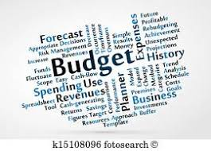
How to get involved
Attend the public hearings in November or December
Write the governor
Write your state senator and state representative

