Slide 1
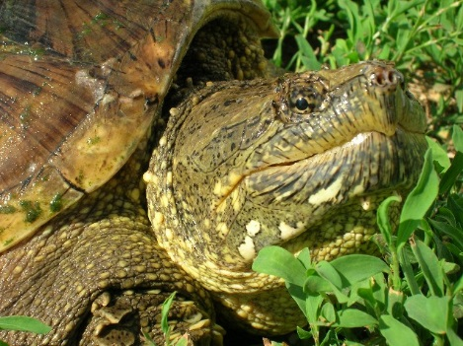

Policy on Iowa’s Turtle Harvest
Photo by Mark Rouw
Pam Mackey Taylor
Conservation Chair
Iowa Chapter of the Sierra Club

Slide 2
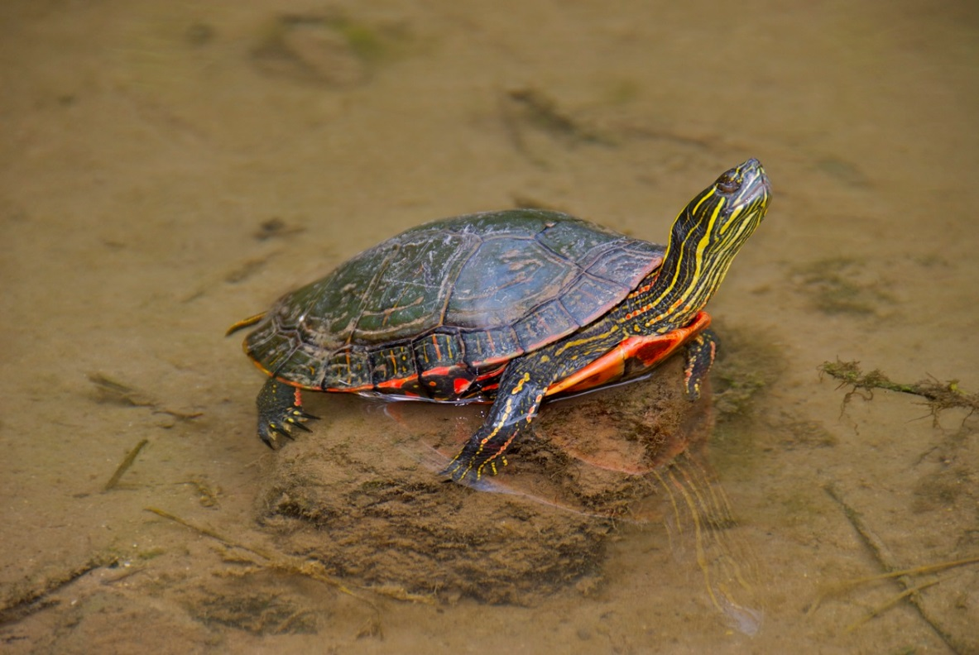
Sierra Club believes the current year-round harvest of turtles is unsustainable
For all 4 harvested species
common snapping turtle
spiny softshell turtle
smooth softshell turtle
painted turtle
Sierra Club wants to ensure that Iowans have an opportunity to enjoy viewing and photographing turtles as well as trapping turtles.
Photo by Larry A. Stone

Slide 3
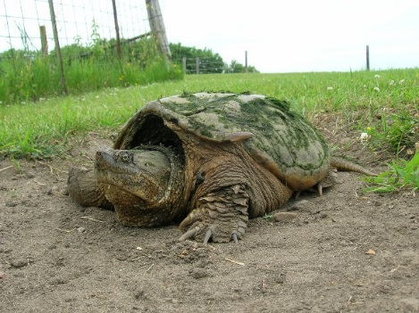
Sierra Club supports closing the season between January 1 and July 15, for both commercial and sport trappers
Photo by Mark Rouw
Closing the season during some of the months the turtles are breeding, to allow the turtles to sustain or increase their populations, while allowing some turtles to be harvested
Funding on-going field studies, including monitoring the populations
Being prepared to close the season or to significantly restrict the quantity of turtles or the pounds of turtles that can be harvested, should studies indicate that a species is facing serious population declines

Slide 4
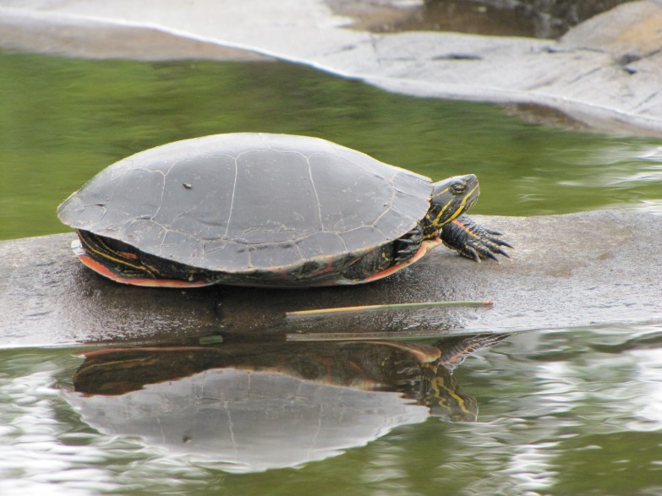
Additionally …
Continuing the reporting required from commercial harvesters
Surveying the sport trappers similar to the bow hunter survey
Increasing the number of streams and lakes where turtles are tested for toxins (such as mercury) to ensure that the meat is safe for human consumption
Photo by Ray Harden

Slide 5
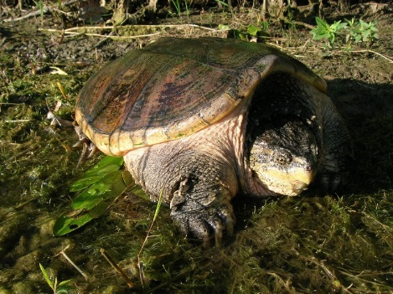
Closing the season January 1 to July 15 protects turtles during the early months of the breeding season
Photo by Mark Rouw
Snapping turtles breed in April through November (up to 30 eggs per nest).
Painted turtles breed in April and lay their eggs (average of 12 per nest) in May or June. They also breed in the fall and throughout the summer.
Smooth softshell turtles breed in April and May and lay their eggs (10 to 30 per nest) in June or early July. They also breed in the fall.
Spiny softshell turtles breed in April and May and lay their eggs (12 to 30 eggs per nest) in June or early July.

Slide 6
Adults reach sexual maturity when they are several years old, increasing their risk of being harvested before they have been able to start regenerating their population
 | Age males reach maturity | Age females reach maturity
snapping turtles | 4 to 5 | 6 or 7
painted turtles | 2 to 4 | 6 to 10
smooth softshell | 4 | 9
Spiny softshell | 4 to 5 | 8 to 10

Slide 7
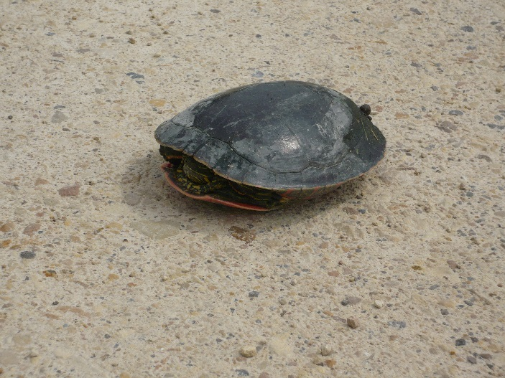
Turtles face challenges in sustaining their populations
Photo by Pam Mackey Taylor
A small percentage of young turtles survive into adulthood
Nest predation from raccoons, dogs, and other mammals
Turtle habitat has been destroyed across the state
Iowa’s polluted waters affect the ability of turtles to survive
Painted and snapping turtles are killed by automobiles as they move to and from nesting sites
Floods can destroy nests or inundate preferred nesting sites, while drought can dry the wetland habitat that turtles need

Slide 8
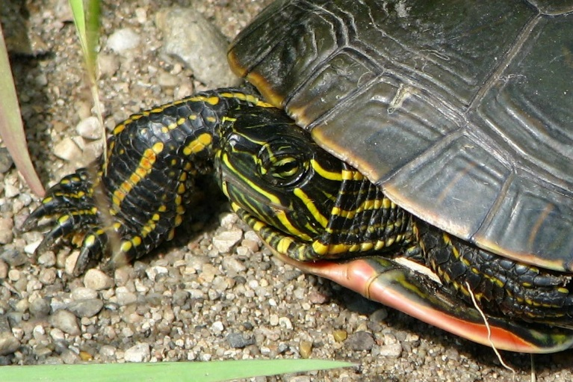
No one knows the health of the turtle population in each wetland, river, stream, or lake in Iowa
“There have been no studies to quantify the effects of turtle harvest in Iowa, and some wetlands may be more susceptible to over harvesting than others. A monitoring initiative should be utilized to track numbers of turtles harvested annually by each licensee in Iowa so that trends can begin to be analyzed.”
Jeffrey B. LeClere, A Field Guide to the Amphibians and Reptiles of Iowa,
ECO Herpetological Publishing and Distribution, 2013, page 12
Photo by Ray Harden

Slide 9
2015 Draft Wildlife Action Plan
Species | Reptile of Greatest Conservation Need? | State rank
Snapping turtle | Yes | S5 - secure
Smooth softshell | yes | S4 – apparently secure
Spiny softshell | yes | SNR – conservation status not ranked
Painted turtle | no | S5 – secure
Reptiles of Greatest Conservation Need are those that have low and or declining populations and are in need of conservation action.

Slide 10
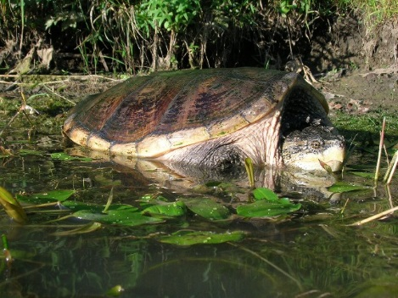
The snapping turtle is showing signs of over-harvest
Photo by Mark Rouw
“Iowa Department of Natural Resources Fisheries personnel working on the Mississippi River are noticing less common snapping turtles than in previous years, and also note that large turtles are rarely caught anymore.”
Jeffrey B. LeClere, A Field Guide to the Amphibians and Reptiles of Iowa,
ECO Herpetological Publishing and Distribution, 2013, page 124

Slide 11
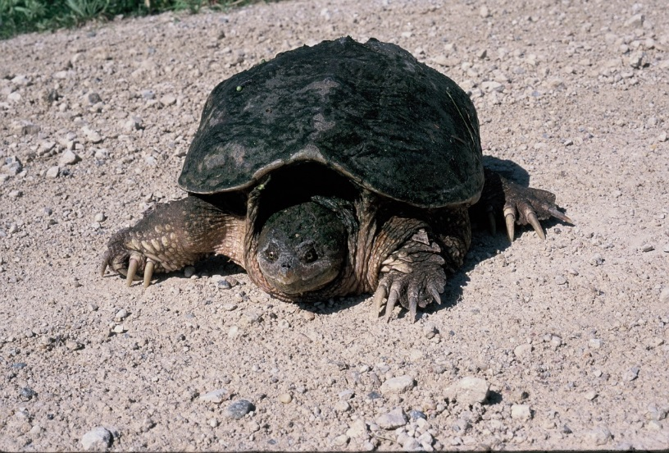
DNR Staff noted in the 2015 Preclearance Form for the Notice of Intended Action on a Turtle Season:
Neither males nor females are approaching their maximum size at time of harvest - females are harvested at 80% of their maximum size; males at 55% of their maximum size
Few small to intermediate-sized turtles were found in samplings, indicating that too few large adult turtles are remaining in the population
Photo by Larry A. Stone

Slide 12
Findings from “Iowa’s Commercial Turtle Harvest” by Gritters et al, Iowa DNR
“Turtle harvest trends are alarming”
Photo from Iowa DNR

Slide 13
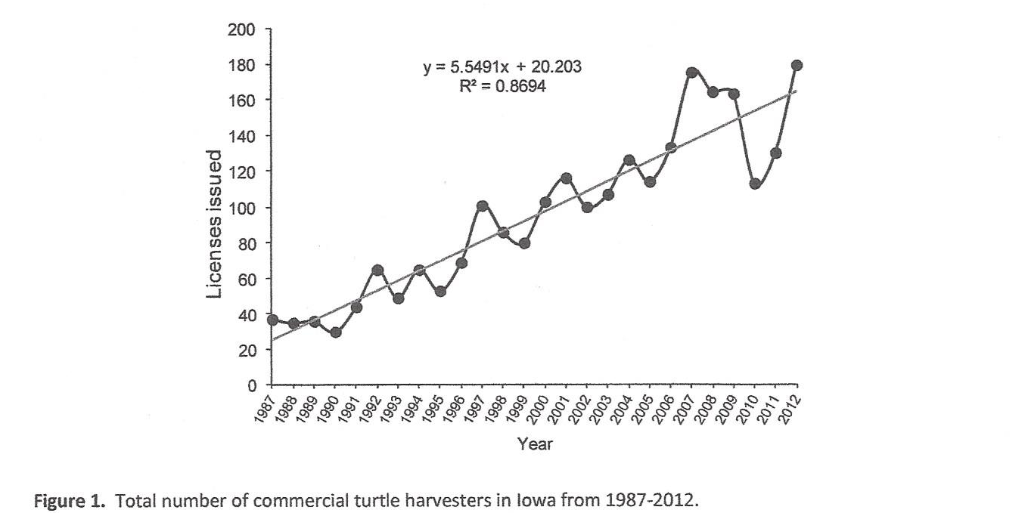
The number of commercial turtle harvesters has increased between 1972 and 2012

Slide 14
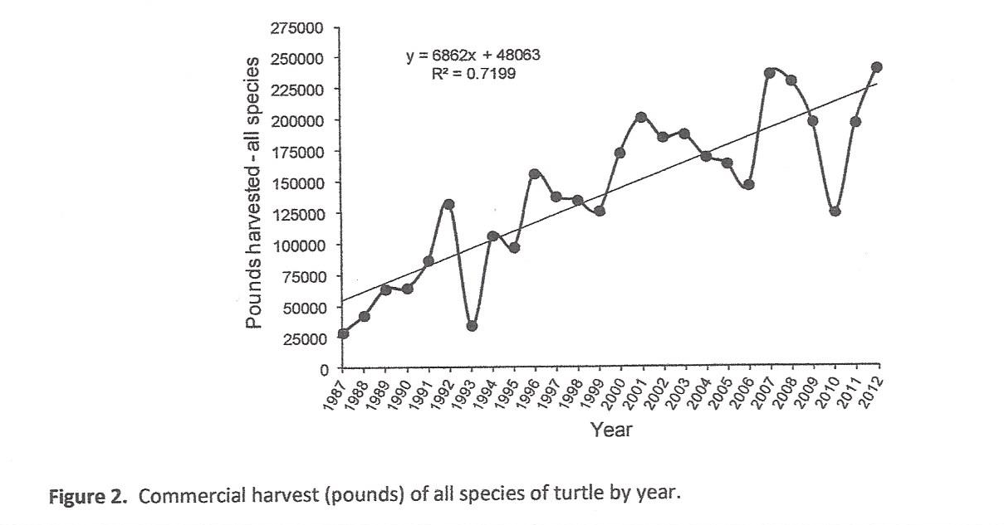
Total pounds harvested has increased significantly

Slide 15
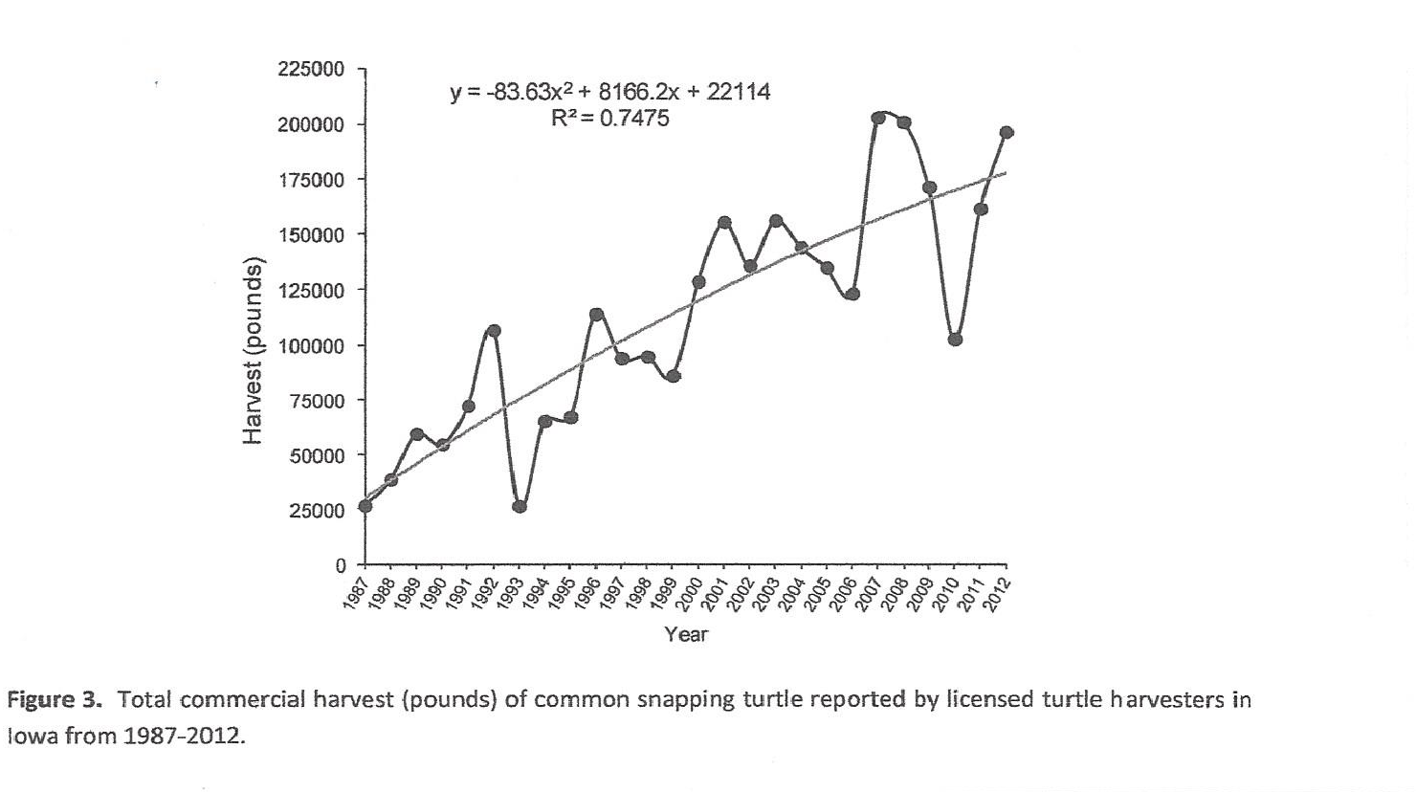
  Commercial harvest of snapping turtle has increased substantially

Slide 16
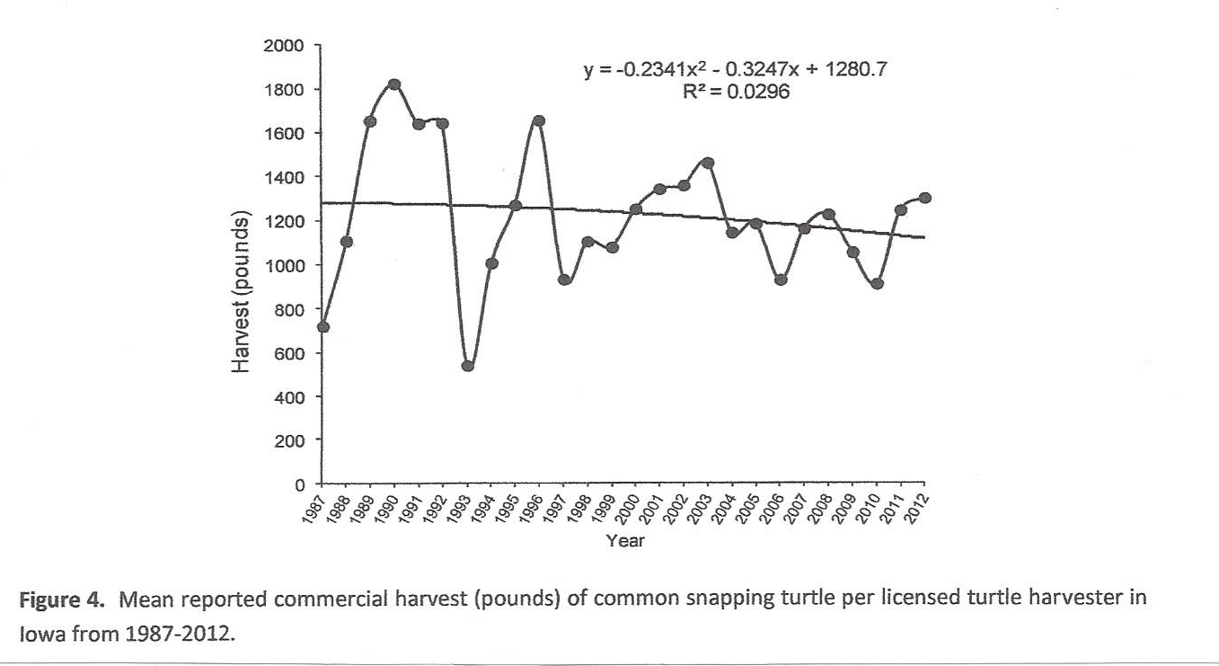
At the same time the average number of pounds of snapping turtle per harvester is decreasing

Slide 17
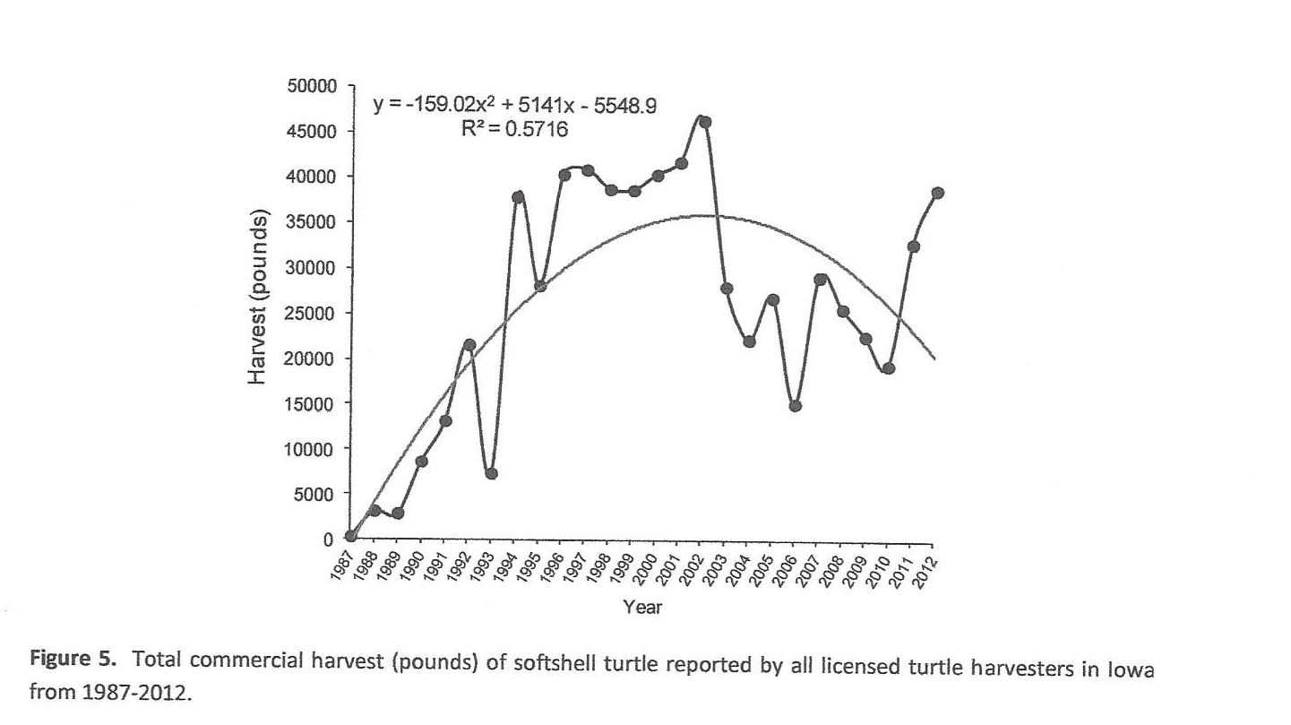
Softshell turtle harvest increased rapidly until 2001, followed by downward harvests for 8 years “Decreases such as these are concerning when harvest removes the reproductively viable adults which causes a reduction in reproductive ability and thus sustainability.”

Slide 18
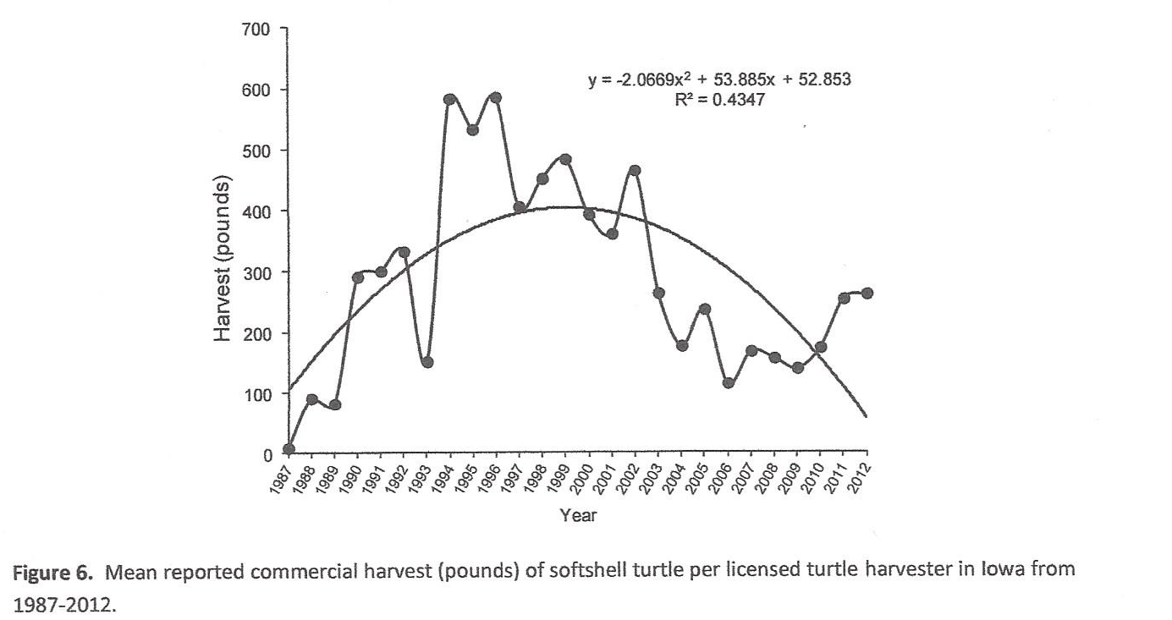
  Average pounds of softshell turtles commercially harvested are declining precipitously

Slide 19
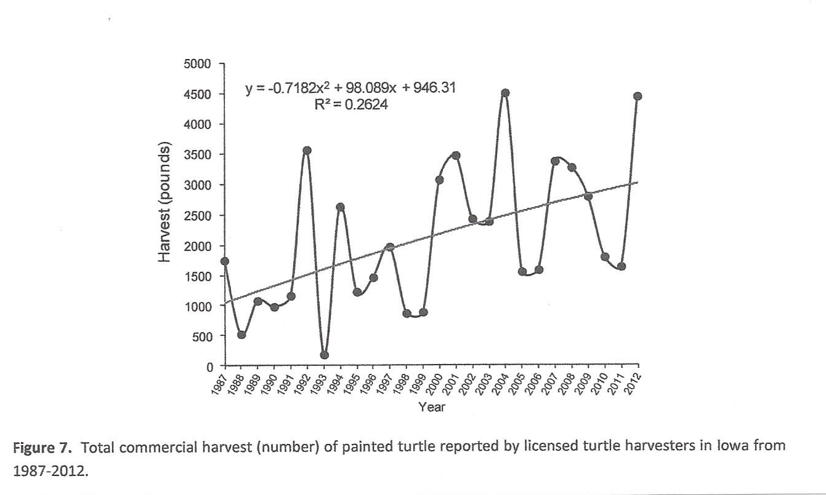
Total pounds of painted turtles commercially harvested is increasing

Slide 20
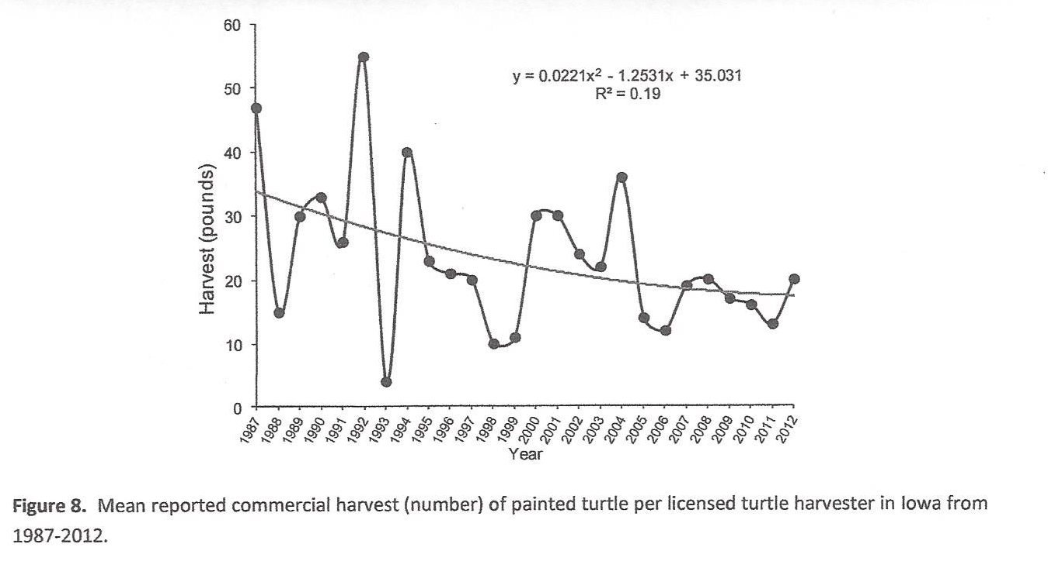
Average pounds of painted turtle is declining

Slide 21
One can only conclude that unchecked harvest can lead to extirpation
Large turtles are targeted year after year
Which leads to harvesting smaller adult turtles
Which encourages more trapping in order to maintain the trapper’s income or to reach the sportsman’s quota
That leads to fewer adults, and fewer eggs being laid
Because turtles have low nesting success and low hatchling success that leads to fewer surviving juvenile turtles
All of this creates a spiral toward extirpating the turtles
Photo from Iowa DNR

Slide 22
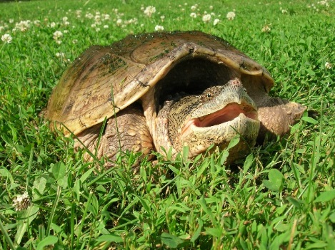
Even sport trappers can have a devastating effect on turtle populations
Sport trappers are allowed to capture 100 pounds of live turtle or 50 pounds of dressed turtle
The smaller the turtle, the more turtles that are captured to meet the capture limit
Which puts greater pressure on the over-all numbers of individuals in the population
Photo by Mark Rouw

Slide 23
Sierra Club members are noticing the decline in turtles and are concerned
As a longtime canoeist/kayaker, my observations of all types and sizes of turtles has decreased steadily over the years. And the number of turtle sightings while canoeing/kayaking the various rivers of Iowa has decreased over 45 years as well.
We used to have snapping turtles nest every Spring along the Little Wapsipinicon River that runs through our property. We used to see as many as 9 or 10 at a time basking in the sun on one log as we waded the river. Now, if we see even one turtle of any kind, we're lucky.
At the rate of decline in our turtle population, it is a big concern to me that my great grandchildren will only be able to see a live turtle in a zoo instead of as a part of natural river wildlife.
I would certainly hope Iowa could step up and do a better job of protecting our declining turtle populations by setting and strictly enforcing the recommended season on hunting and trapping them.

Slide 24
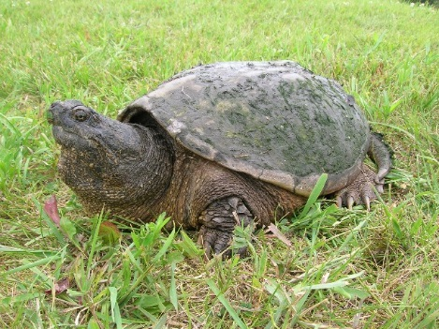
Photo by Mark Rouw
A sustainable harvest of turtles benefits all of us – commercial harvesters,
sport trappers, and outdoor enthusiasts

