Slide 1
Maryland Community Transition
Beyond Coal

Slide 2
Sounding the Alarm on Climate Disruption
In 2018, the world’s leading scientists in the UN International Panel on Climate Change warned there is only a dozen years left for dramatic action to keep global warming below 1.5 degrees Celsius.
Even half a degree will significantly worsen the risks of drought, floods, extreme heat, and poverty for hundreds of millions of people.
A half degree difference: coral reefs being completely eradicated, sea level rise would affect 10 million more people, regular ice-free summers in the Arctic, insects at risk of losing over half their habitat.
This is the difference 1/2 degree makes, yet business as usual emissions takes the world well above 2 degrees of warming.
A world in which we continue to burn coal is not a world with a livable climate for future generations.

Slide 3
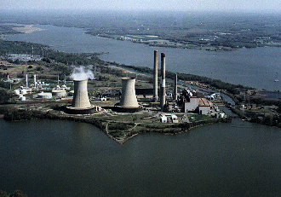
W: 3.34 H: 2.81
X: 0
Y: 0
W: 3.34 H: 2.81
X: 6.68
Y: 0
From 2011 – 2017, electricity generation from coal in Maryland has declined by nearly 60%
W: 3.34 H: 2.81
X: 3.34
Y: 2.81
Coal plants are the number one source of toxic water pollution in the country.
Since 2010, 296 coal-fired power plants have retired or announced their retirement plans

Slide 4
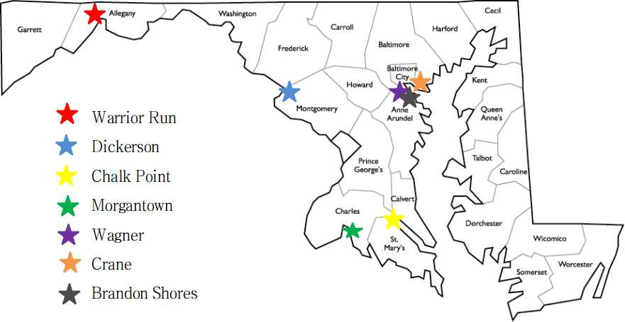
Coal Plants in Maryland

Slide 5
Maryland’s Coal Plants
By the Numbers
6 - Six coal plants in Maryland pumped out the same amount of climate pollution in 2017 as over 2,000,000 cars
5 - Five coal plants in the state were operating with expired water pollution permits in 2018
4 - Four coal plants in Maryland were built during or before the Nixon administration (two were built during the Eisenhower administration).
3 - Three coal plants are operating without modern pollution controls for smog-forming nitrogen oxides.
2 - Two plants are co-located in the same community, in northern Anne Arundel County, just south of Baltimore City
1 - One Maryland coal plant (CP Crane in Baltimore County deactivated in 2018. Recently approved to convert to fracked gas.)

Slide 7
Air Quality and Public Health
Prince George’s County recently received an F grade from the American Lung Association regarding it’s ozone pollution. Montgomery County received a D.
Unhealthy air (high ozone) days a risk to 19,633 children with asthma, and 68,009 adults in Prince George’s, and 23,814 children and 77,262 adults in Montgomery County.
88% of Marylanders, including those in Prince George’s and Montgomery live in areas deemed with unhealthy air based on EPA sulfur dioxide standards.

Slide 8
We No Longer Need Coal Power in Maryland
The Clean Energy Jobs Act, which just passed the Maryland General Assembly sets a goal for Maryland to get 50% of its energy from renewable sources by 2030.
Includes a 14.5% solar carve out by 2028 (previously we were at 2.5% by 2020). The solar carve-out alone in this bill will provide more MWh from solar than all of the electricity produced by Maryland's coal plants in 2017.
The legislation includes an additional 1200 MW of offshore wind, putting us at nearly 1600 MW by 2030.

Slide 9
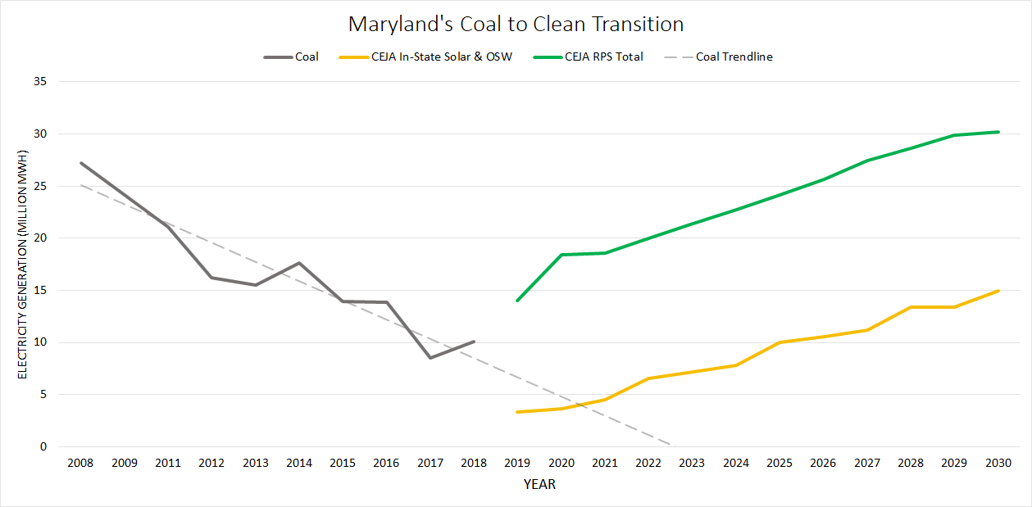

Slide 10
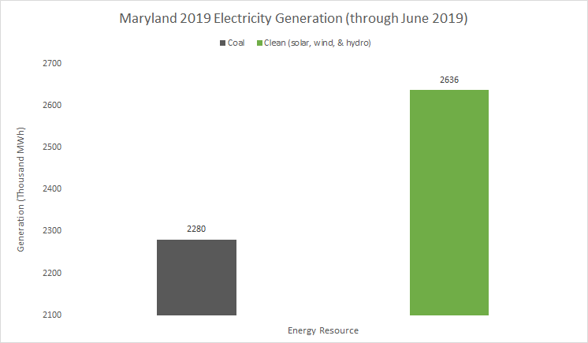

Slide 11
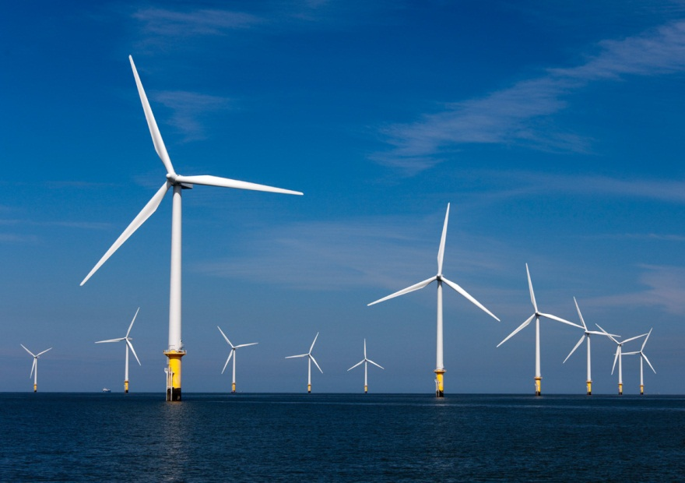
Plans for offshore wind farms off Maryland’s coast.
On July 23rd, 2019, it was announced that an offshore wind company would construct turbines at Sparrows Point in Baltimore County, site of former Bethlehem Steel plant.
Project will create 1,400 jobs, more than 900 in construction and nearly 500 during operation. This is from an 120 MW offshore wind farm!

Slide 12
Goals and Vision: Community Transition
By 2020, secure an enforceable commitment, to retire Maryland’s coal-fired power plants by 2025.
Secure just transition and protections for impacted communities and workers.

Slide 13
Our Goals and Vision
Together, the Sierra Club believes we must ensure:
Workers and communities affected by the phasing out of fossil fuels are treated fairly and justly, particularly given the burdens they have borne;
The jobs created by climate action programs and policies are quality, family-sustaining jobs;
Overburdened and underserved communities and constituencies receive equitable access to the benefits of clean energy-related economic opportunities

Slide 14
Coal Community Transition in the US
Washington State:
2011 legislation provided $55 million in investment to communities and workers facing retirement of a coal power plant.
Followed up with 2019 bill to bar utilities from purchasing any coal power.
Colorado
Creation of Just Transition Office to disburse funds to impacted workers from plant closures.

Slide 15
Coal Community Transition in the US
New York NY has Fossil Fuel Plant Closure Fund to assist communities. Funded at $19 million.
The fund provides: (1) money for the affected communities so that ordinary working people would not be on the hook for the shut down of the plant, 2) job and/or retraining for those employed at the plant, and 3) pathways to reuse the physical plant, and the site of the plant, for various activities that would enhance the economic and cultural life of the communities.
Along with the establishment of this fund, Governor Andrew Cuomo enacted pollution regulations to phase out all remaining New York coal usage in plants by 2020.

Slide 16
Maryland
“We recommend that by the end of 2020 the General Assembly and Governor work with public stakeholders to develop and finalize a responsible and specific plan for transitioning from Maryland’s six large-scale coal electricity generators over the ensuing decade, while maintaining reliable power, and for the establishment of programs that protect and support communities and workers traditionally reliant on these fossil fuel facilities before those coal plants are closed.”
Members of the Maryland Commission on Climate Change

Slide 17
Progress in 2019
Baltimore City passed Beyond Coal resolution in February.
Similar resolutions have been presented in advocacy meetings to other county councils.
Lead bill sponsor in General Assembly identified.
Sierra Club groups have collected nearly 2,000 Beyond Coal petition signatures at tabling events.
Dozens of house meetings, educational activities, and public events are steadily being organized.

Slide 18
How Can You Help?
Email Matt!
matt.dernoga@mdsierra.org
Letters to the Editor
Social media team
Petitioning
Host a house meeting
Contact your representatives
Monthly Statewide Calls
Coalition sign-on

