Slide 1
Land Use/Housing Workshop

Slide 2
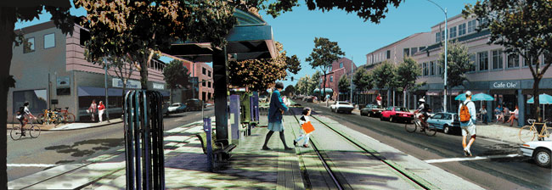
What is Smart Growth?

Slide 3
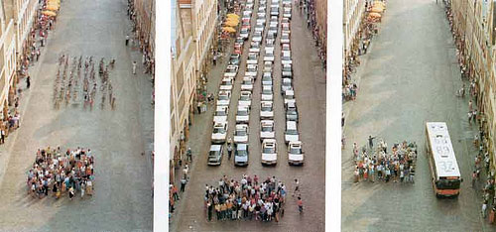
Street Packing
Want to consume lots of space? Drive!
Bikes &
drivers
Cars &
drivers
Get thee to a bus
Streetsblog.org 4 June 2013

Slide 4
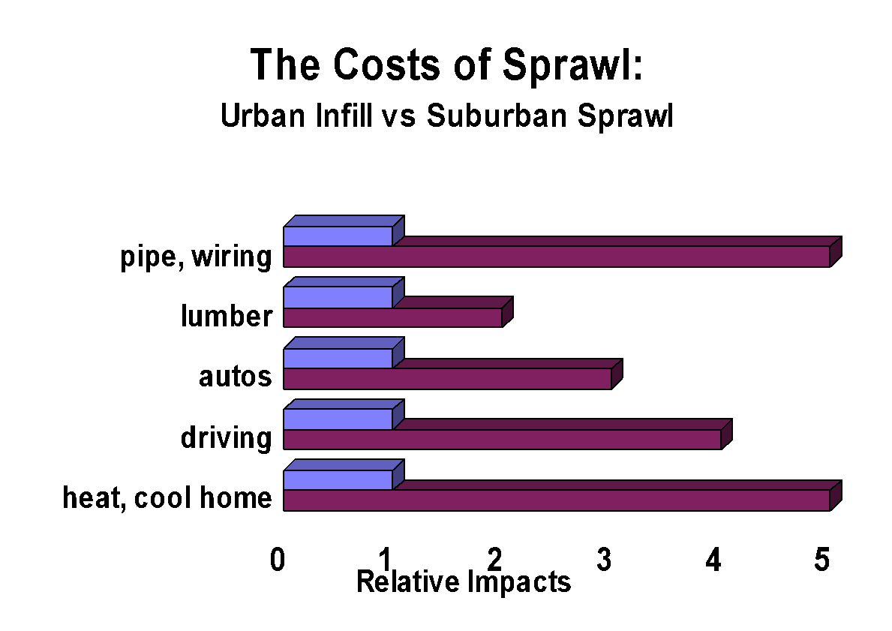
How does Land USE Relate to Climate Change?

Slide 5
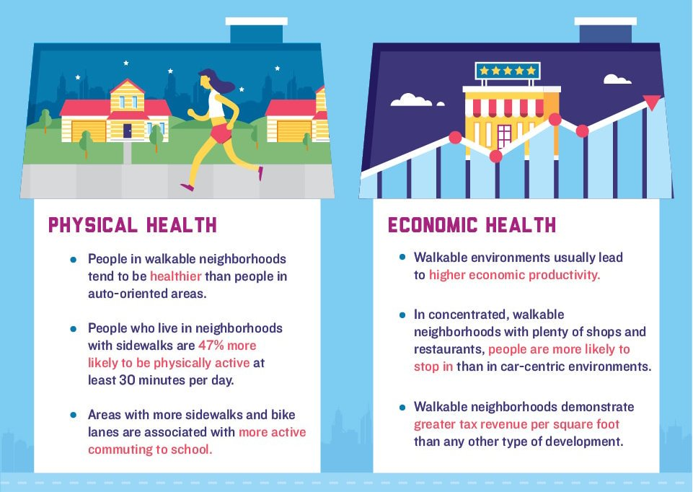
What Else MIGHT SMART GROWTH ACCOMPLISH?
Smart Growth America

Slide 6
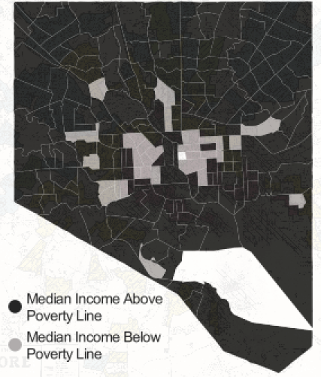
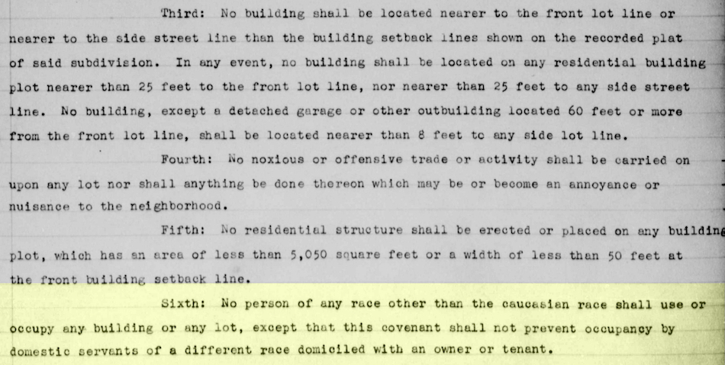
BARRIERS TO SMART GROWTH
Notes:
https://www.citylab.com/equity/2015/04/after-nearly-a-century-redlining-still-divides-baltimore/391982/
Restrictive covenant (left)

Slide 7
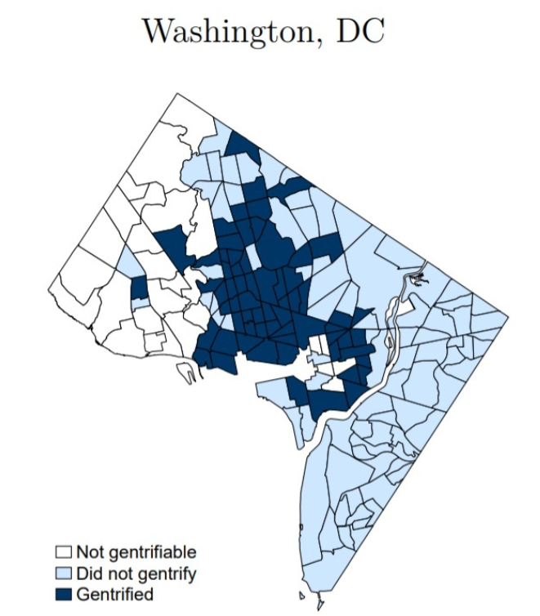
GENTRIFICATION

Slide 8
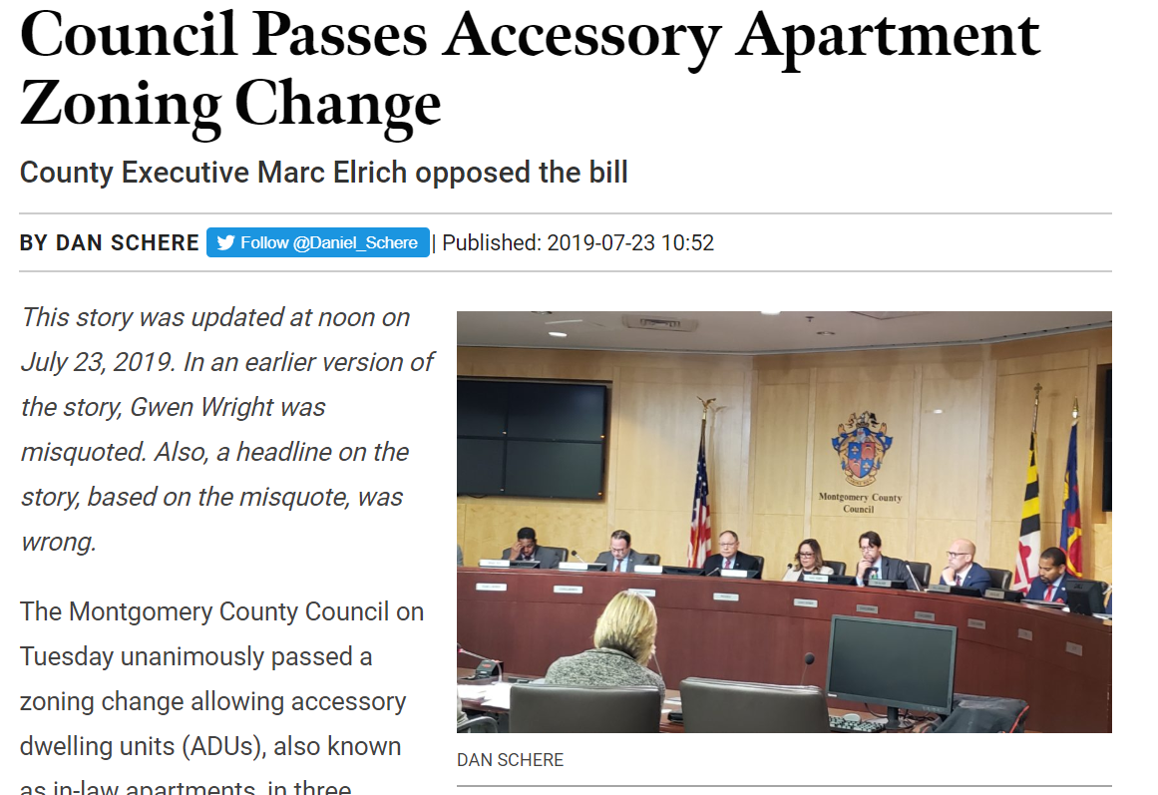
LOCAL SUCCESS STORIES

Slide 9
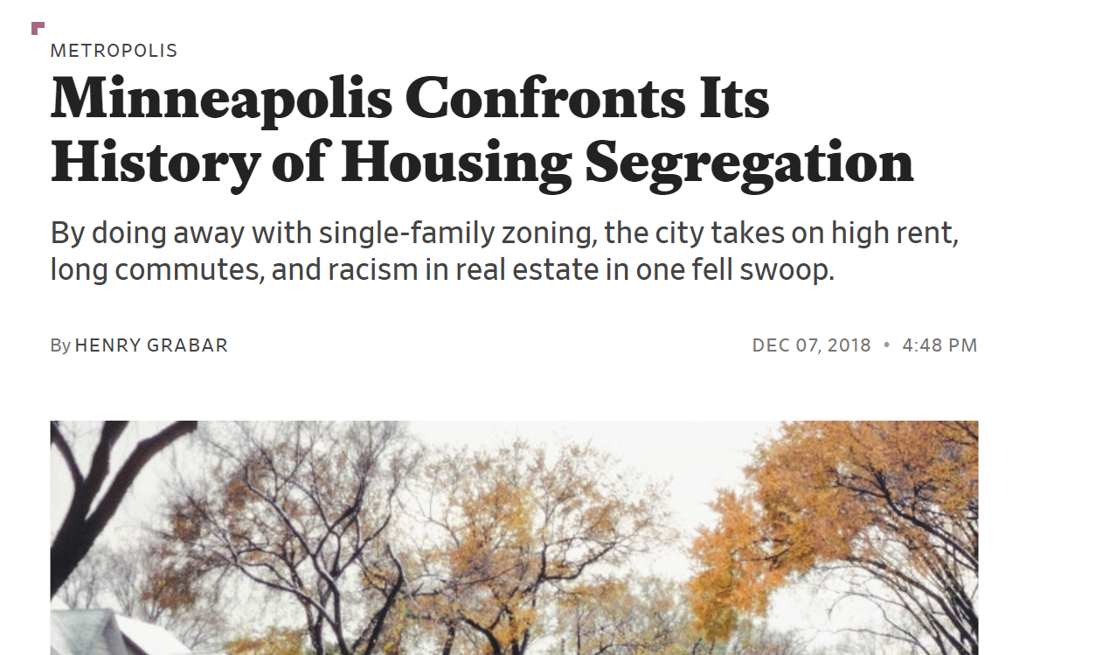
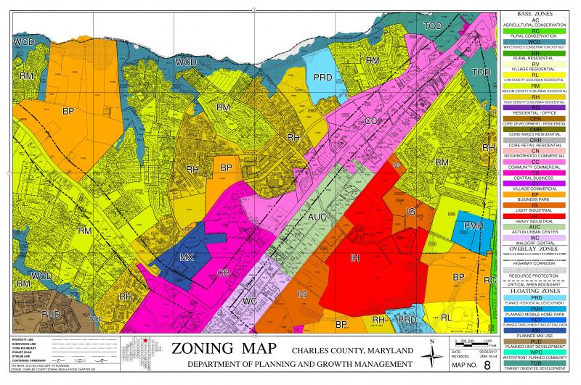
NATIONAL SUCCESS STORIES

