Slide 1
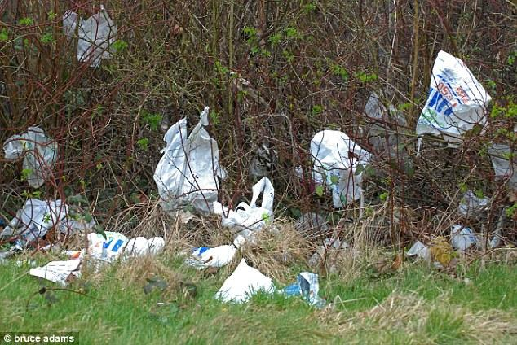
Mobilizing local evidence to reduce single-use plastics:
Foam food containers and
plastic bags
Maryland Chapter Jamboree 2019
Maryland Chapter

Slide 2
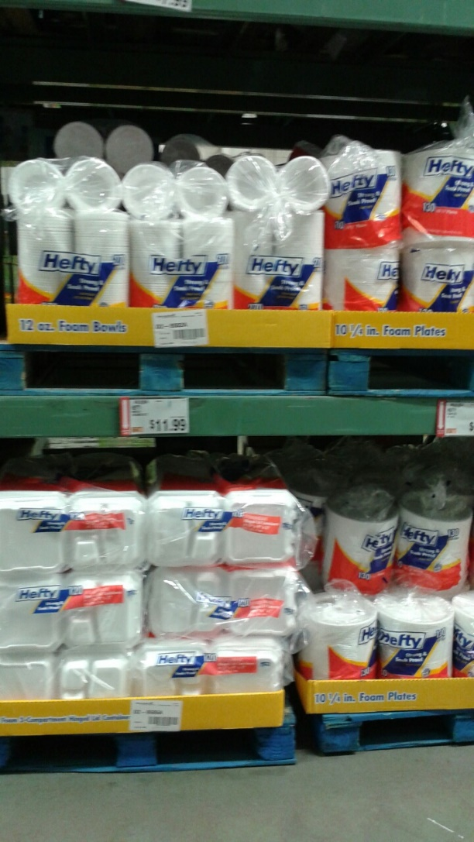
1. Survey of Food Containers at Restaurants
Objectives
Find out what % of restaurants in Prince George’s County have foam food containers
Find out what alternatives are already in use
Follow up after the foam ban is enacted to assess compliance

Slide 3
Sample & Methodology
Random sample, 15% of restaurants from the public health department (n=186)
Visit the restaurant at off-peak hour
Interviewer asks to see all single-use containers in use
Records the container type and material
Also records the physical characteristics of the restaurant (to classify later – sit-down restaurant, fast food, carry-out)

Slide 4
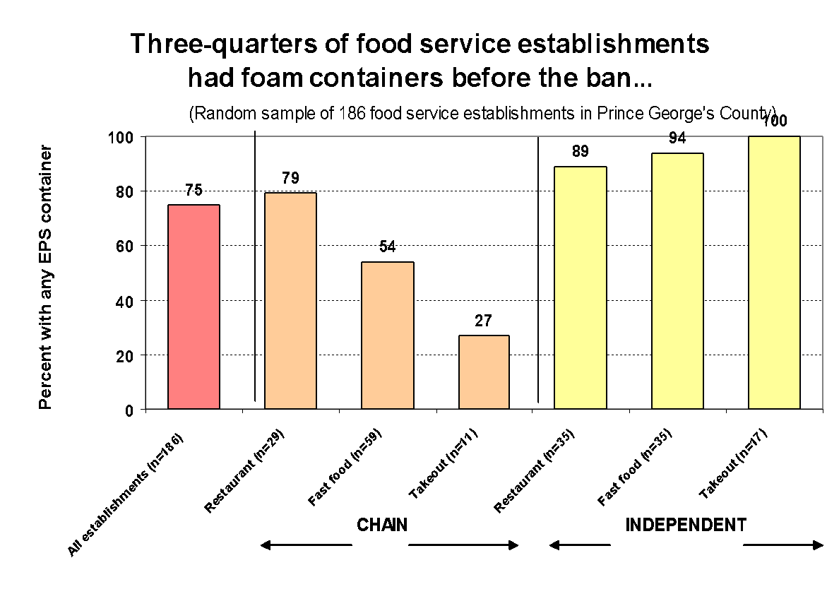

Slide 5
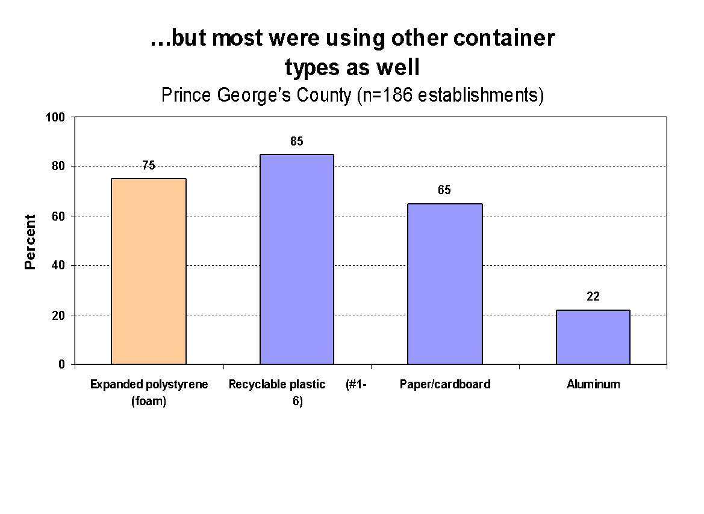

Slide 6
2. Shopper Surveys
Objectives
Document shoppers’ shopping bag choices, establish a baseline
Track changes over time
Assess the effectiveness of the Montgomery County bag tax

Slide 7
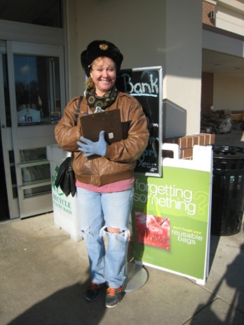
Sample & Methodology
Adult weekend shoppers’ bag choices observed as they exit the grocery store
All 48 stores from 7 chains included: Food Lion, Giant, Harris Teeter, Safeway, Shoppers, Wegmans, Weis
Enumerators discreetly observe exiting shoppers for one hour at each store exit and record bag choice category
They also note presence of paper and reusable bags at the checkout

Slide 8
Strengths
We record what shoppers actually do, not what they say they do!
Large sample size yields precise estimates
Easy to administer, can be done with volunteers, quickly, doesn’t require contact with shoppers
Tracks behavior of a well-defined population of shoppers across jurisdictions and over time
Limitations
Can’t quantify the number of bags used
Re-usable bag use is underestimated to extent that shoppers use back-packs, purses, briefcases
Not representative of the average shopper, strictly the sentinel population of weekend grocery shoppers
In Montgomery County, can’t tell whether shoppers have actually been charged for their bags

Slide 9
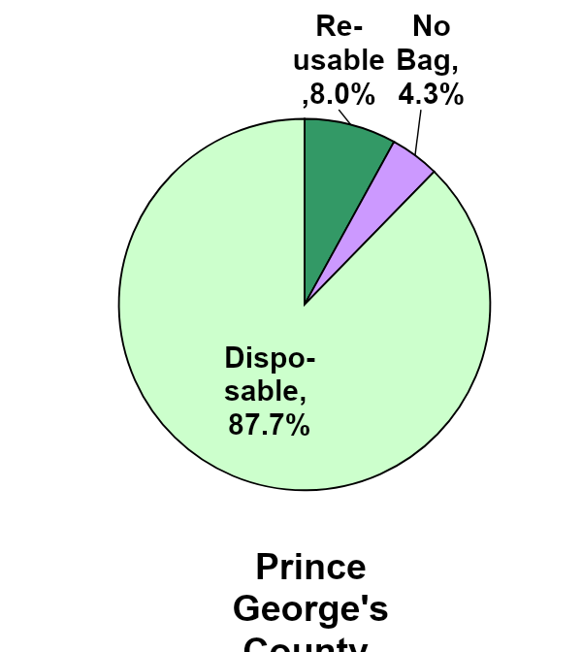
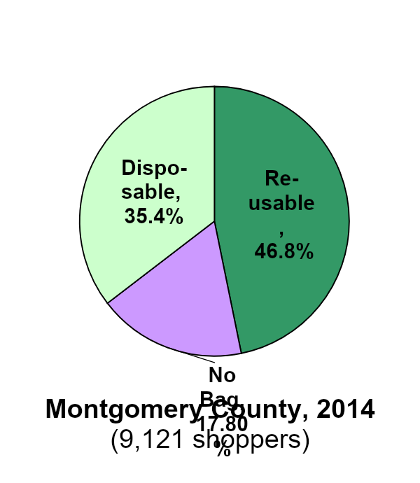
In 2014, the Shopper Survey demonstrated the impact of a 5-cent bag fee

Slide 10
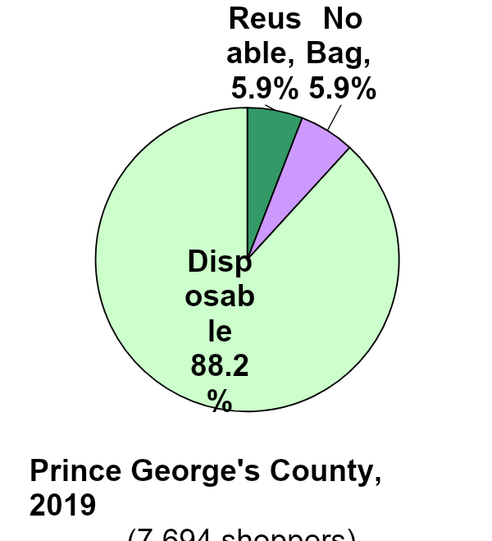
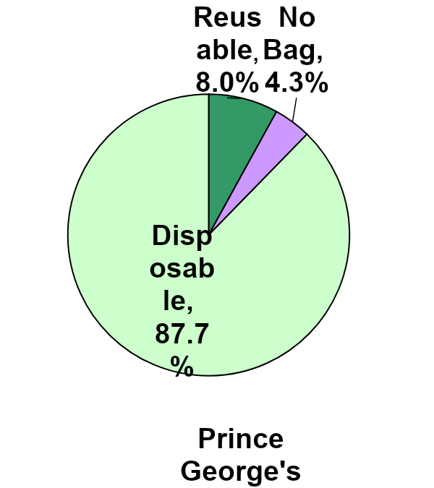
Since then, there’s been no progress in reusable bag use in Prince George’s County!

Slide 11
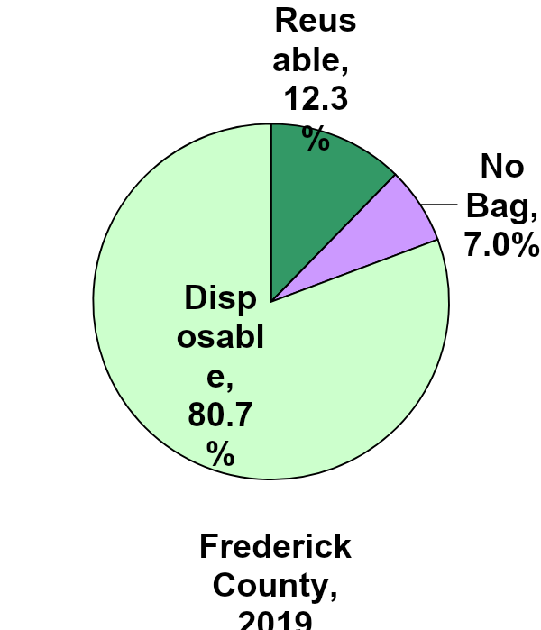
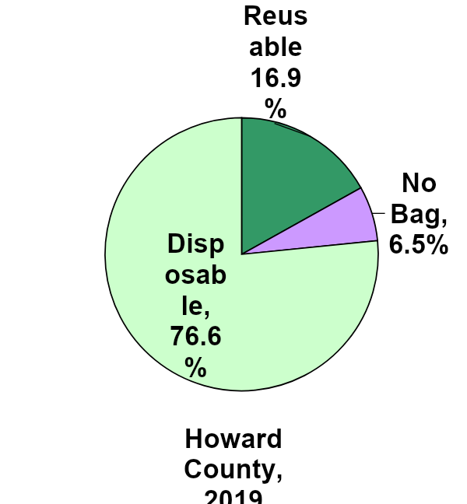
More than three-quarters of shoppers in Frederick and Howard Counties are using plastic bags

Slide 12
Feedback from volunteers

Slide 13
3. Monitoring compliance with the foam ban
Objective
Educate businesses (restaurants, retail) about the foam ban and how to comply
Measure the compliance rate
Measure improvement in compliance after the education intervention

Slide 14
Sample and Methodology
Businesses in shopping centers near volunteers
All businesses in the shopping center are listed (restaurants, retailers, pharmacies, theaters, gas stations, hotels, shipping centers)
Educational materials from the County
Presence of foam containers recorded
Infractions not reported
Return visit to those with foam 6 months later
Coverage to date: 465 businesses in 45
Shopping centers in Prince George’s

Slide 15
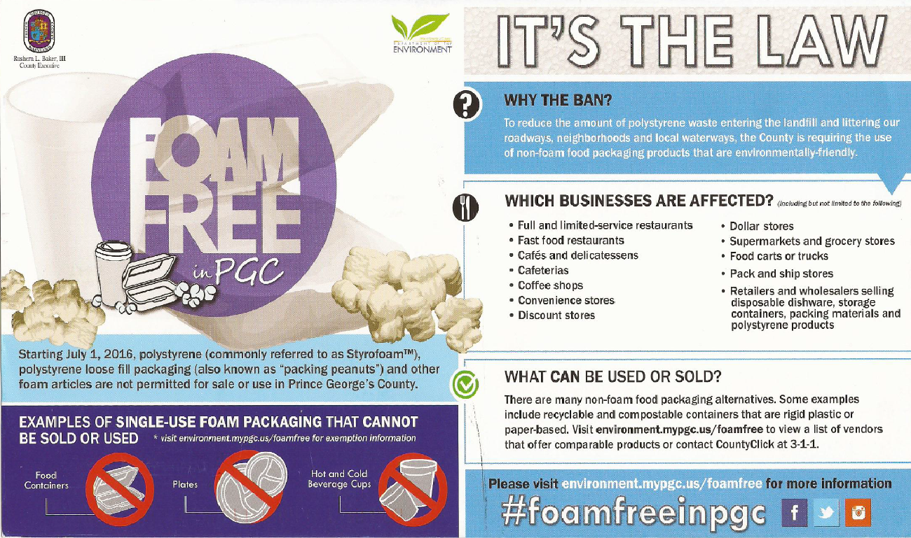
Monitoring Sheet & Educational Material

Slide 16
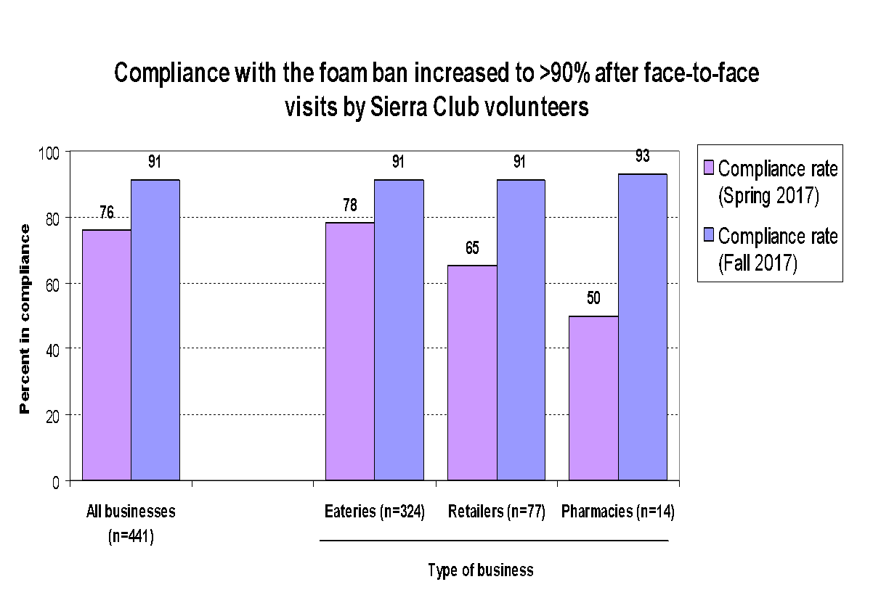

Slide 17
Lessons – Foam Ban
A well-planned, executed, and sustained education campaign is essential for rollout to businesses
Letters with DOE return address are more likely to reach the owner than a flyer
Businesses are very appreciative of the information
When owners/managers are informed of the ban and the reason, they willingly comply
Very satisfying to the volunteers

Slide 18
Opportunities!
Join the zero waste team at:
www.sierraclub.org/Maryland/zero-waste
Volunteer to help with an ongoing or planned shopper survey!
Montgomery County (Sunday afternoon)
Surveys in AA, Baltimore City, other counties
Volunteer to educate businesses for the rollout of the state-wide foam ban!
Martha.Ainsworth@mdsierra.org

