Slide 1

The Fight Against Fracked Gas Infrastructure

Slide 2
Agenda
Welcome & Agenda Review
Framing the Issue
The Potomac Pipeline
Rockwool
Gas Use in Buildings
Legislation
Questions
Close

Slide 3
Framing the Issue: Climate Change
The UN’s Intergovernmental Panel on Climate Change (IPCC) urges policy makers to make immediate and rapid reductions in short-lived climate pollutants, including METHANE
Health-harming air pollutants are carried with emissions of methane.
Short-lived climate pollutants are many times more potent than CO2, and received strong emphasis for the first time in the IPCC report.
The ENERGY, agriculture and waste industries are targeted for reductions of METHANE.
IPCC recommends deep cuts in METHANE of at least 35% by 2050.
(“Not just CO2: These climate pollutants also must be cut to keep global warming to 1.5 degrees.” Inside Climate News, 10/7/18)

Slide 4
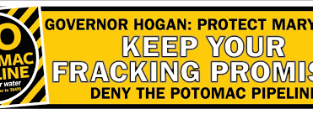
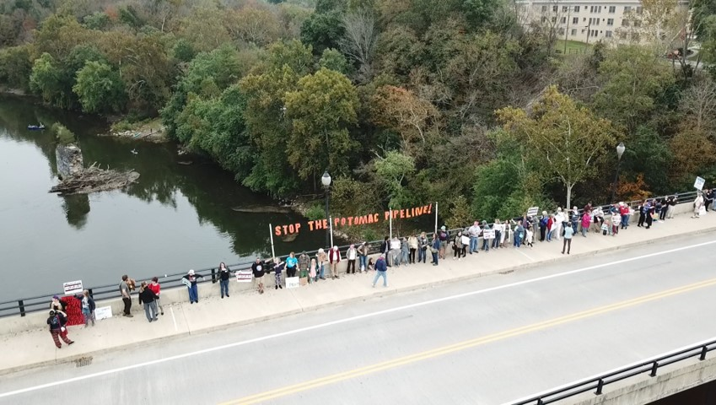

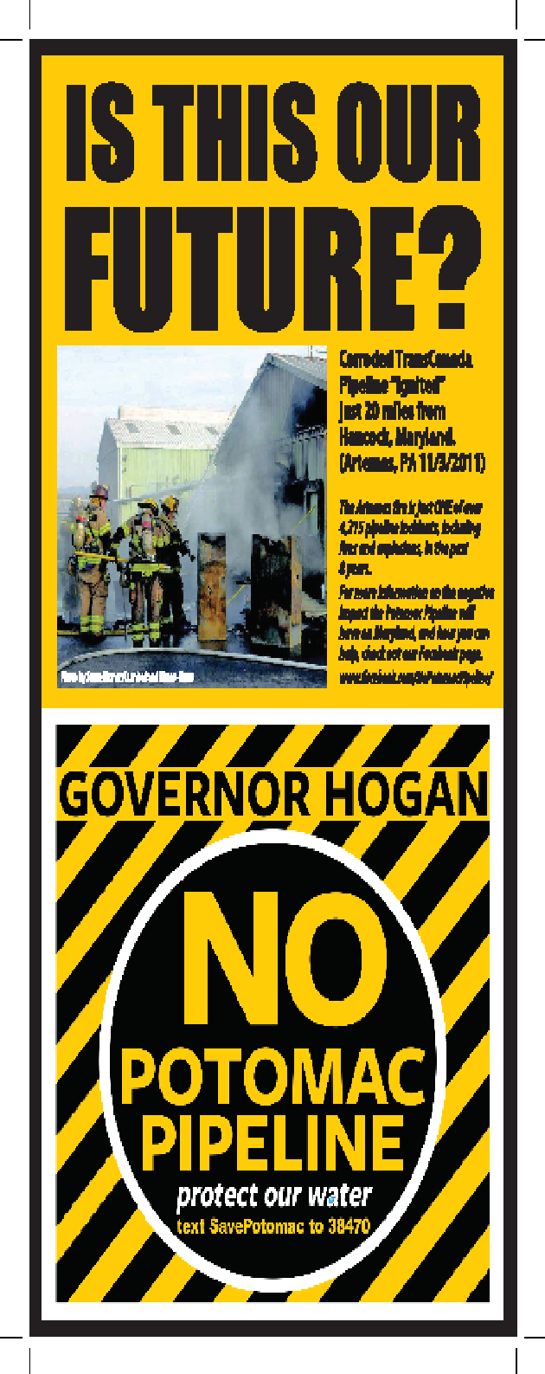
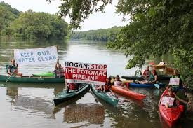
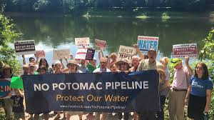
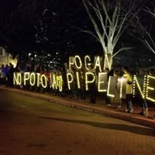
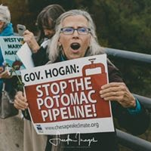
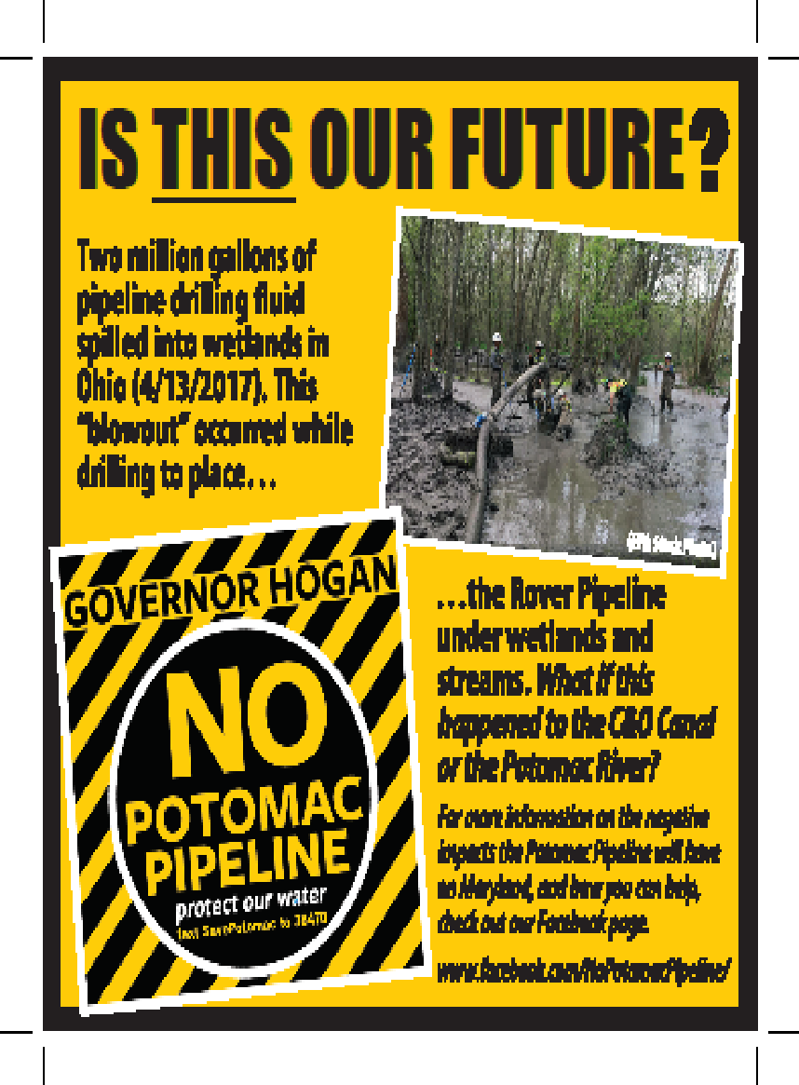

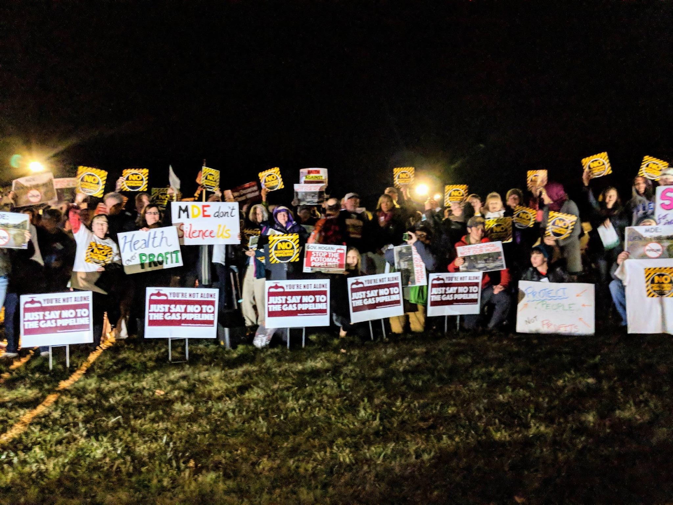

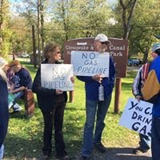

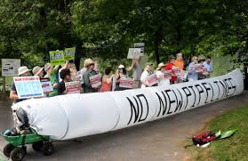
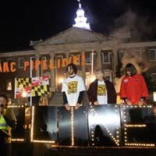
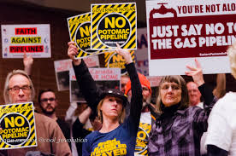
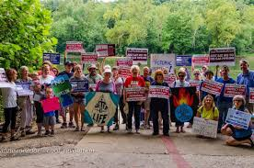

Slide 5
The Potomac Pipeline
What is the Potomac Pipeline? How did we get here?
Potomac Pipeline needs to travel under the Potomac River, through both state and federal land
Columbia Gas is seeking to exercise eminent domain over Maryland state land
Maryland defended against this proposal in federal court, and won.
  Our coalition press statement is available here: https://chesapeakeclimate.org/press-releases/potomac-pipeline-victory-federal-court-dismisses-columbia-gas-lawsuit/
  More than 60 legislators signed a public letter opposing the project.
Columbia Gas appealed this decision to the 4th Circuit Court of Appeals.
The 3rd Circuit Court of Appeals recently decided this issue on the proposed PennEast pipeline in Pennsylvania and New Jersey
National Park Service recently issued a Finding of No Significant Impact - what does this mean?
We are not out of the woods, yet. And there are more pipelines that may be coming.

Slide 6
Hands Across the Potomac

Slide 7

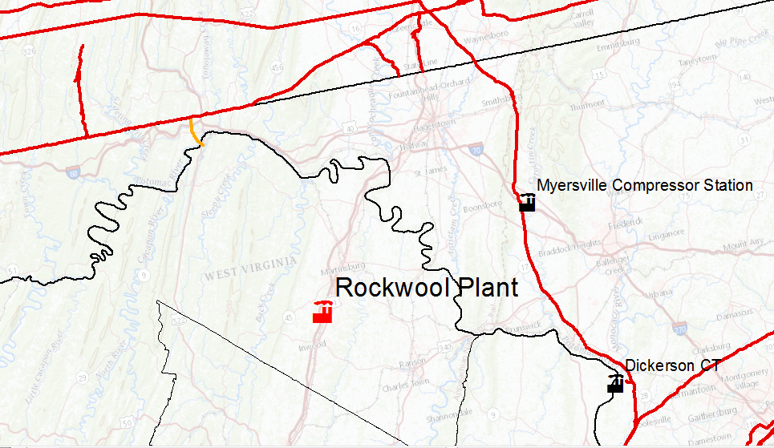
Eastern Panhandle Expansion and Rockwool Plant
Eastern Panhandle Expansion
Frederick, MD
Columbia Gas Pipeline Project
Notes:
Notes: Karst terrain under the area surrounding the Eastern Panhandle Expansion; Frederick and other population centers near Rockwool plant.
Data and Sources:
All gas power plants (Source: SNL); coal plants with potential to switch to gas (Identified by MD Chapter; Source: SNL); compressor stations (identified by MD Chapter; location found through research); Gas storage (identified by MD Chapter; location found through research); LNG import/export terminals (identified by MD Chapter; location found through research); interstate pipelines over 10 miles (Source: SNL)
Schools (Source: https://www.sabinsdata.org/user-resources/school-data); Federal Lands (Source: http://www.arcgis.com/home/item.html?id=26c2a38f94c54ad880ff877f884ff931, http://www.arcgis.com/home/item.html?id=7cbe203141804b55b311702d229135d5); Nursing Homes (Source: https://www.arcgis.com/home/item.html?id=dfbc8b4bbfa14816ab1af46c9093c9d7); Hospitals (Source: https://www.arcgis.com/home/item.html?id=f114757725a24d8d9ce203f61eaf8f75); Day Cares (Source: https://www.arcgis.com/home/item.html?id=3a9271a1a30443fca150461b35a51b53); Background (Source: https://basemap.nationalmap.gov/arcgis/rest/services/USGSTopo/MapServer)

Slide 8
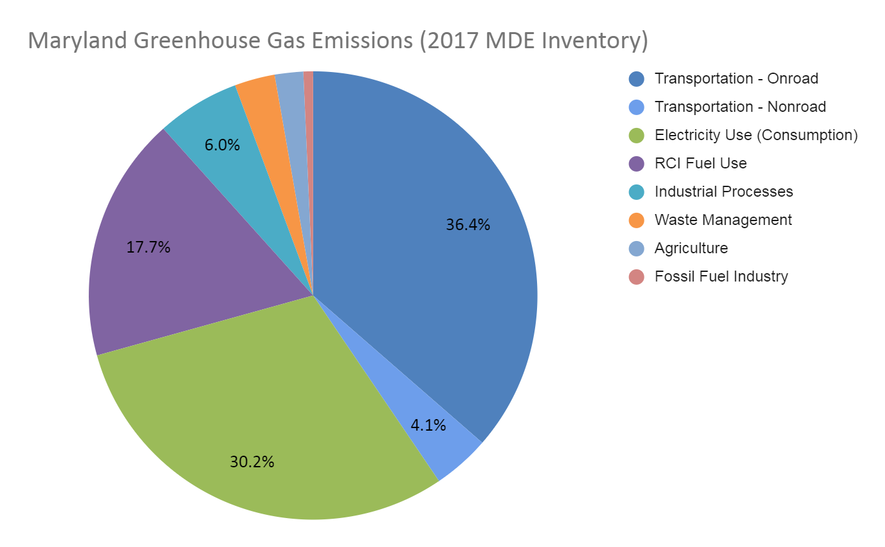
How big of a deal is gas in Maryland’s climate fight?
You’ve already heard about the methane problem -- so where do we use gas in the state?

Slide 9
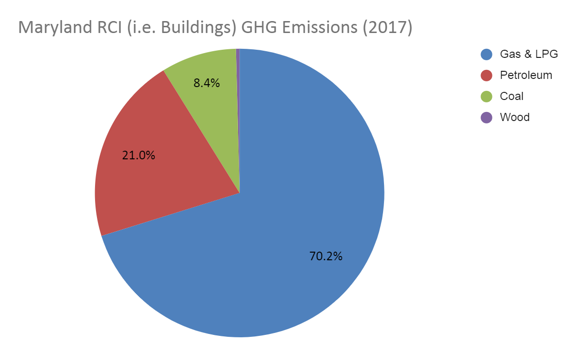
We use gas in buildings!

Slide 10
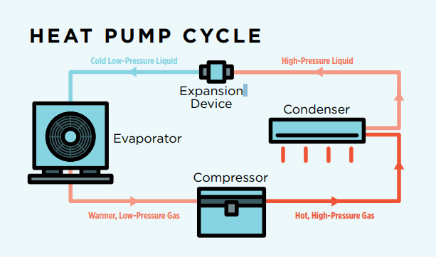
The incredible all-electric home!

Slide 11
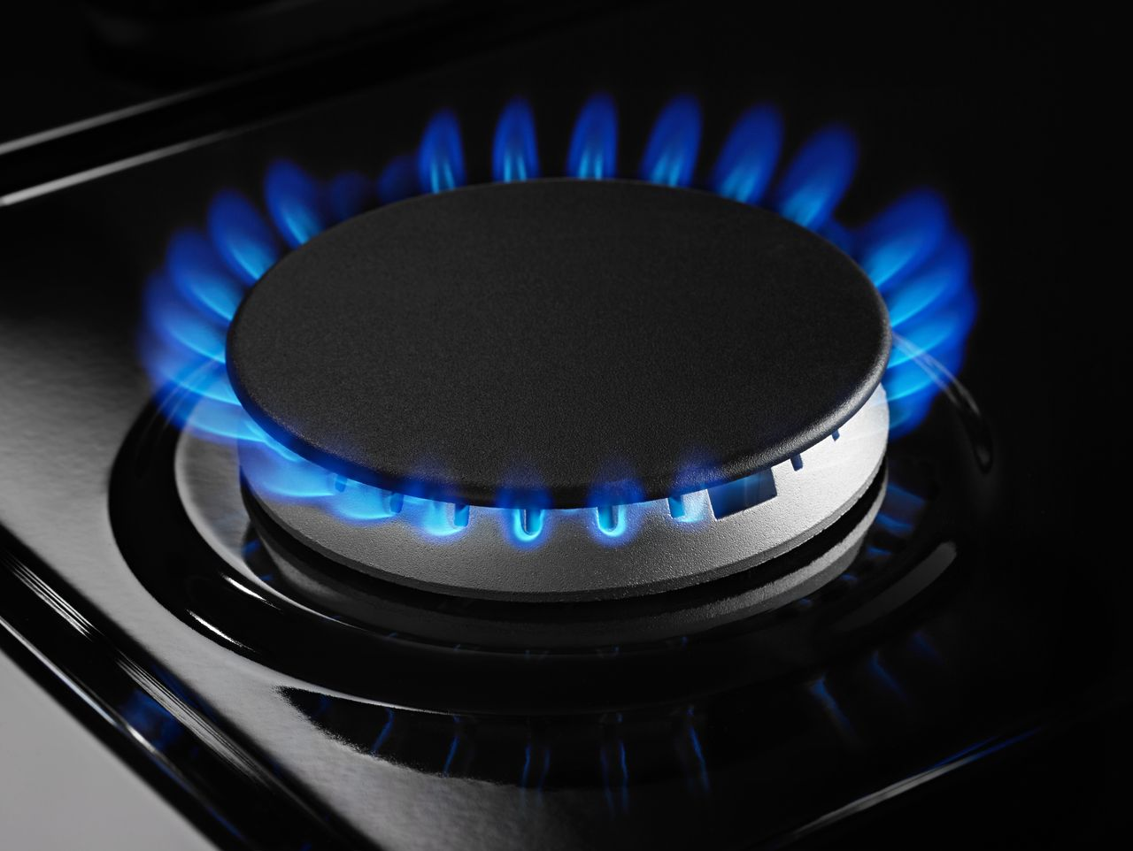

That’s right, we’re coming for your gas cook stove!

Slide 12
Not just about climate - health co-benefits are huge
Homes with gas stoves often get readings of indoor air pollution that are higher than ambient air quality health standards set by the EPA (NO2 & CO)¹
“...meta-analyses suggest that children living in a home with gas cooking have a 42% increased risk of having current asthma, a 24% increased risk of lifetime asthma and an overall 32% increased risk of having current and lifetime asthma”²
1 - https://ehp.niehs.nih.gov/doi/10.1289/ehp.1306673
2 - https://academic.oup.com/ije/article/42/6/1724/737113

Slide 13
What can we do?
To get gas out of buildings we need to:
  Stop the bleeding - end gas hookups for new buildings
  Incentivize switching from gas heating to air source heat pumps
  Plenty more - and we need to develop this effort in the coming years
Organize, build a team, and build power!

Slide 14
Legislation

Slide 15
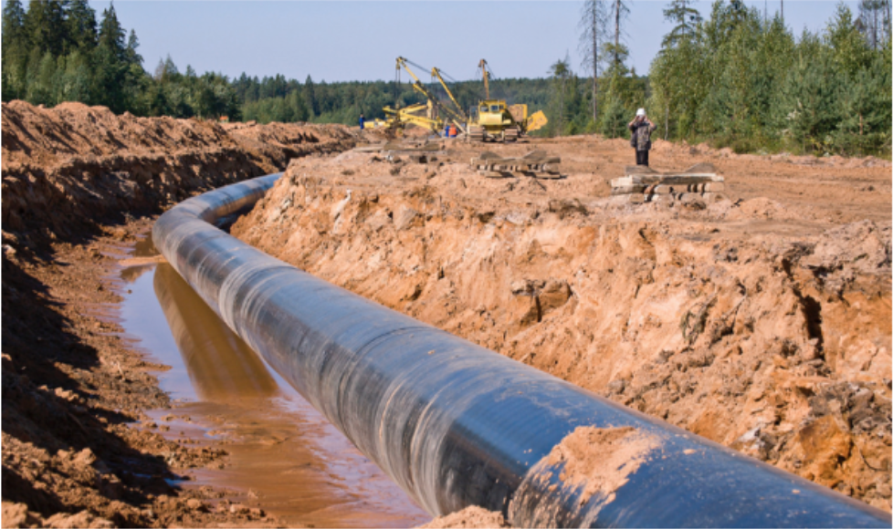
Legislation Pipeline & Water Protection Act
(SB 387- Zirkin, HB 669 - Fraser-Hidalgo)
This legislation would have required the Maryland Department of the Environment (MDE) to better protect our water resources by fully utilizing its authority under the federal Clean Water Act to conduct independent reviews of new, proposed interstate gas pipelines.
Even though Maryland banned fracking in 2017, the state is still facing expansion of fracked gas infrastructure in Maryland. New fracked gas pipelines pose significant risks to our state’s water resources and threaten communities and our climate.
7:15

Slide 16
Questions?

