Slide 1
Social Media 101
#BeyondCoal

Slide 2
Overview
Why social media is important to activism and advocacy.
Information on some basic social media platforms (IE Facebook, Twitter, Instagram), and how they work.
Tips for how to create effective posts on these platforms.
How can we use social media for the Beyond Coal campaign
Notes:
Self-explanatory

Slide 3
MD Sierra Club Social Media...
Our handles are…
Facebook: Sierra Club Maryland Chapter @SierraClubMaryland
6,747 likes 7,023 followers
Twitter: @sierraclubmd
3,458 followers 5,494 tweets
Instagram: @sierraclubmd Sierra Club Maryland Chapter
1,222 followers
Notes:
MD Sierra club social media handles: followers

Slide 4
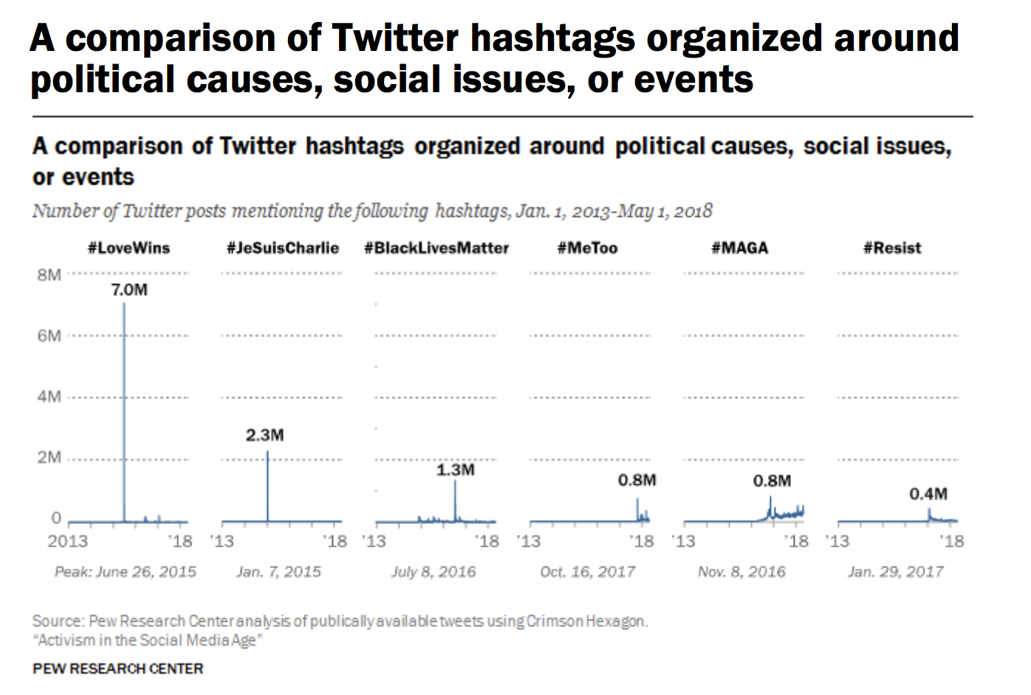
From Pew Research
Notes:
Twitter, major twitter hashtags should look familiar, we see how these twitter hashtags have become important movements, the language of twitter and social media entering our real world conversations

Slide 5
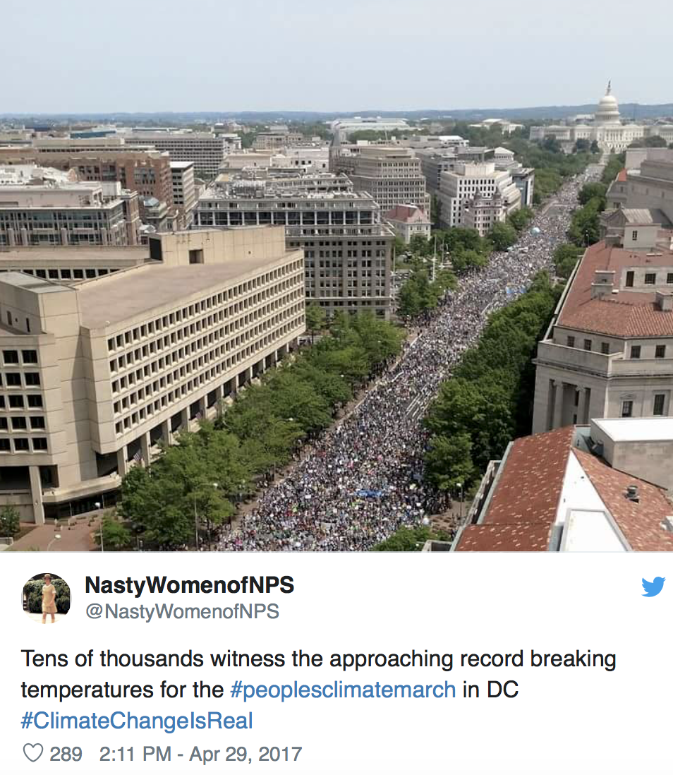
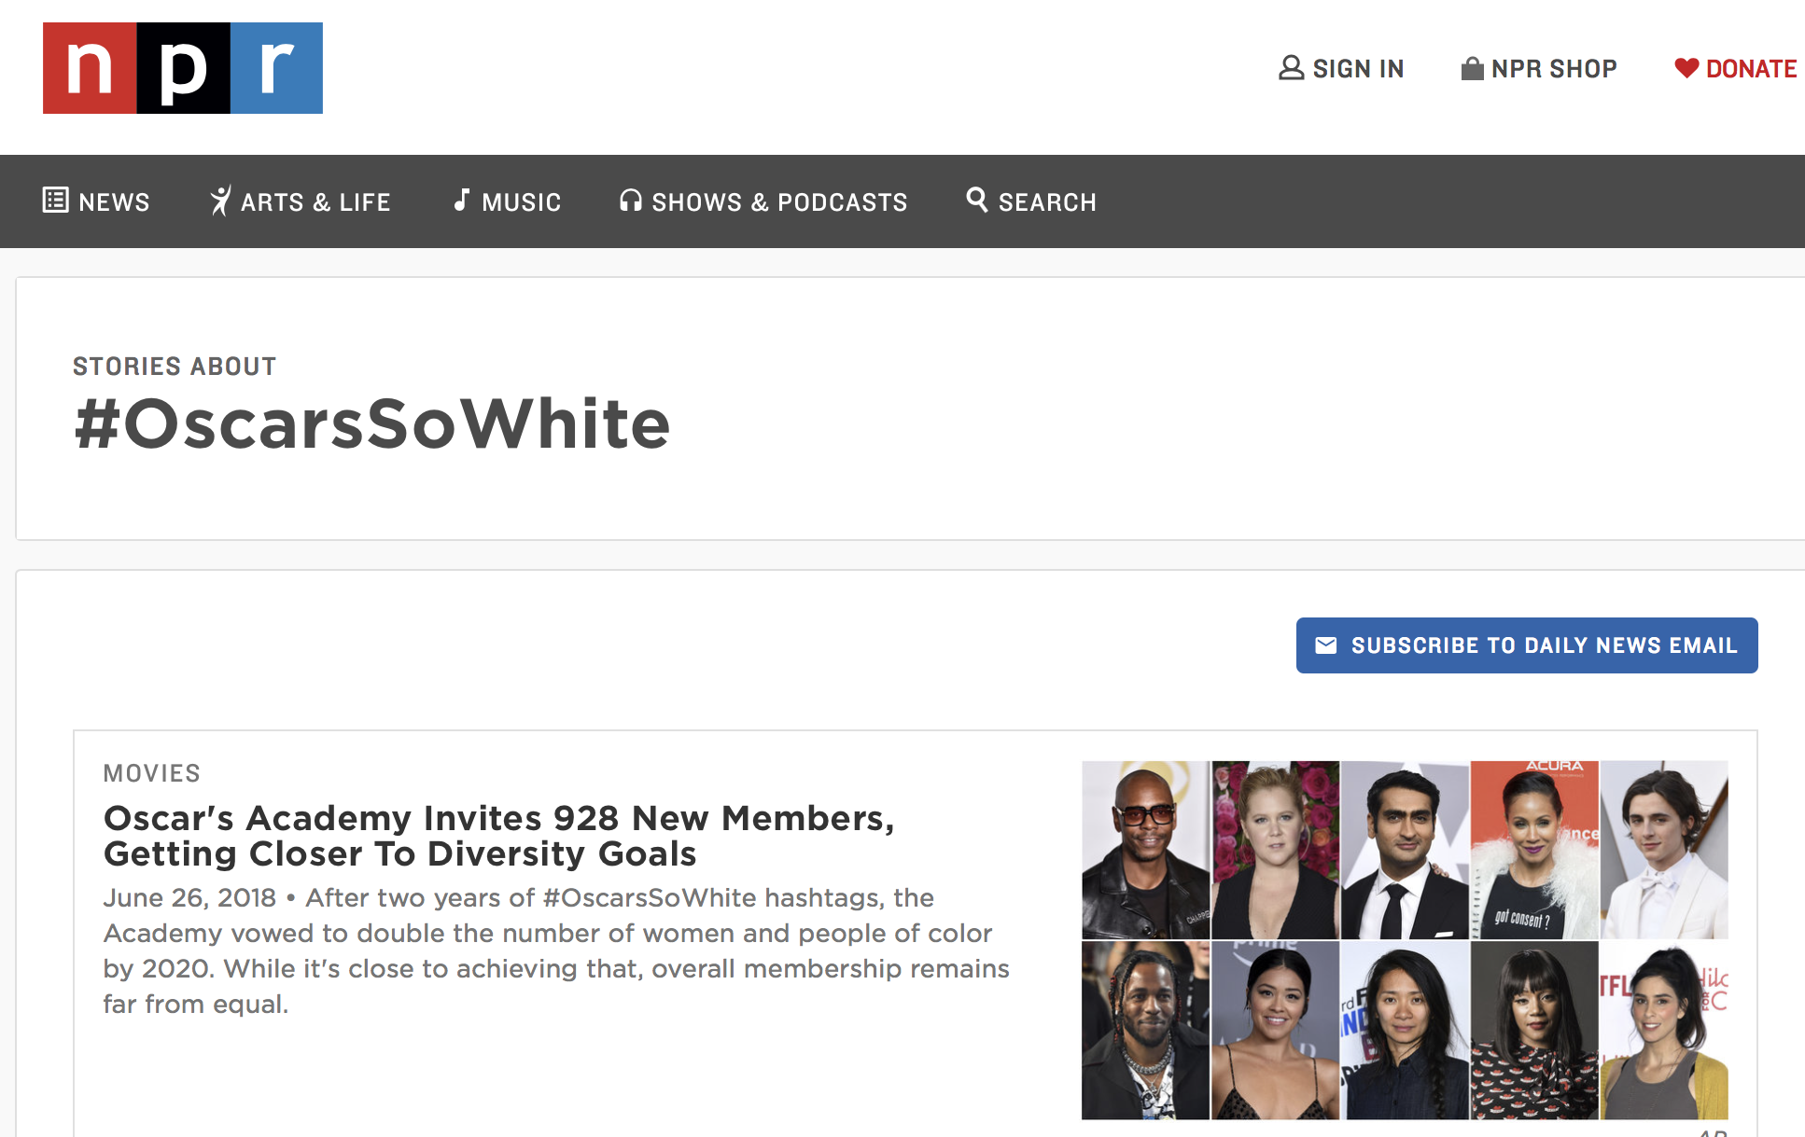
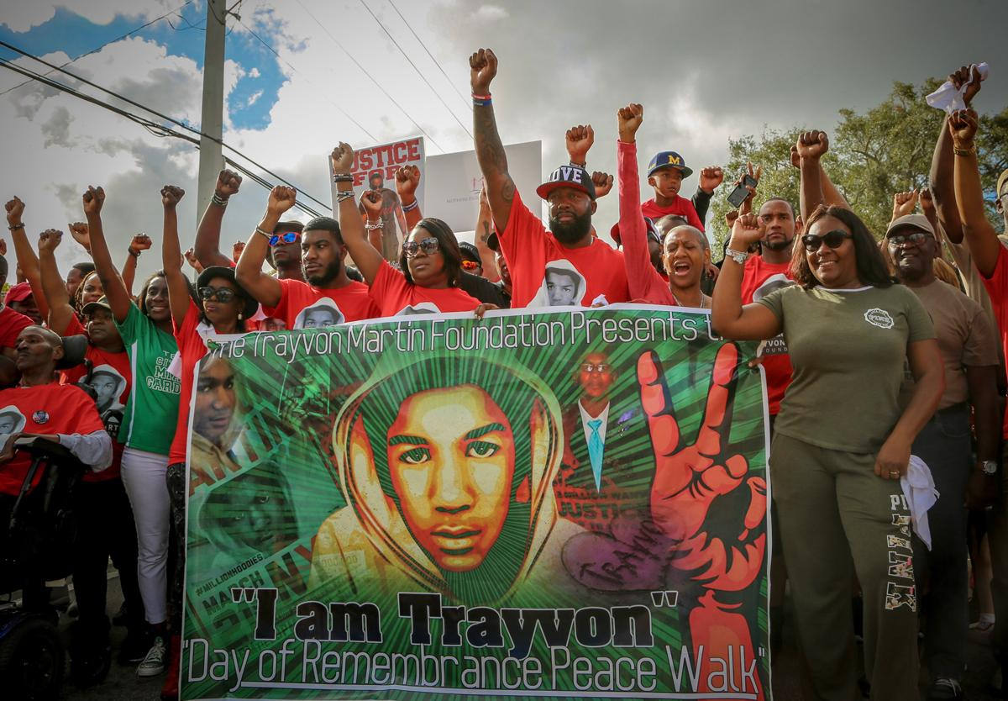
The Power of Hashtags
Notes:
Here’s an example of what we just showed you. Social media has the power to start movements and put a name to them… This can also make social media a bit of a bubble since people will search for specific tags on issues they care about. However, if you want to speak to people in a space you are not in, use of a hashtag is a way to reach into it.

Slide 6
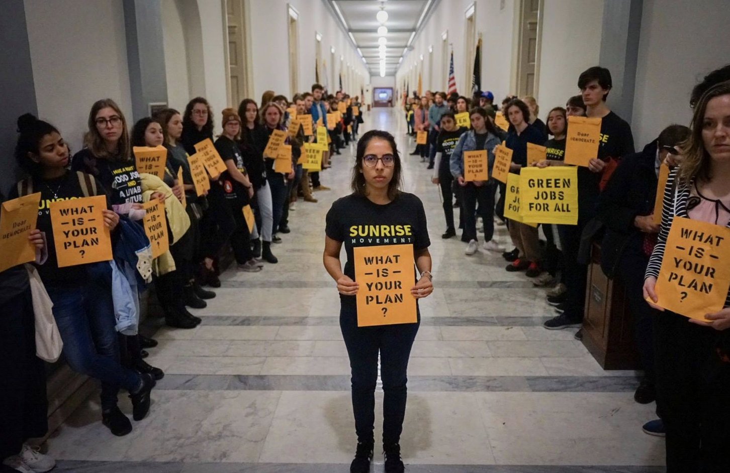
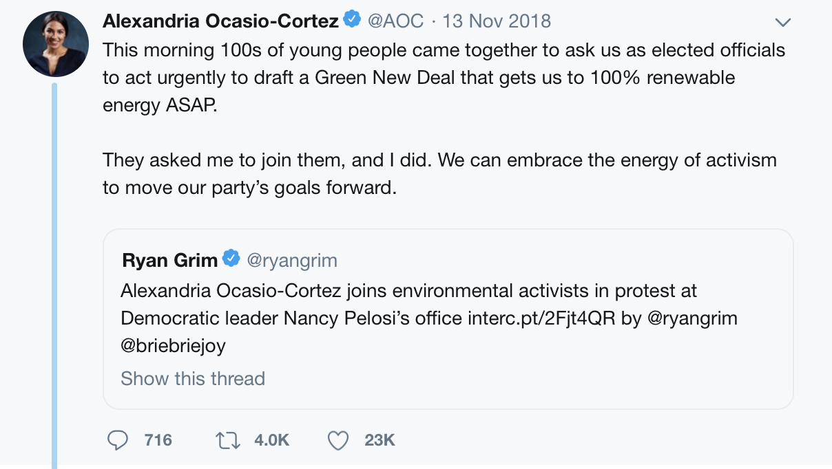
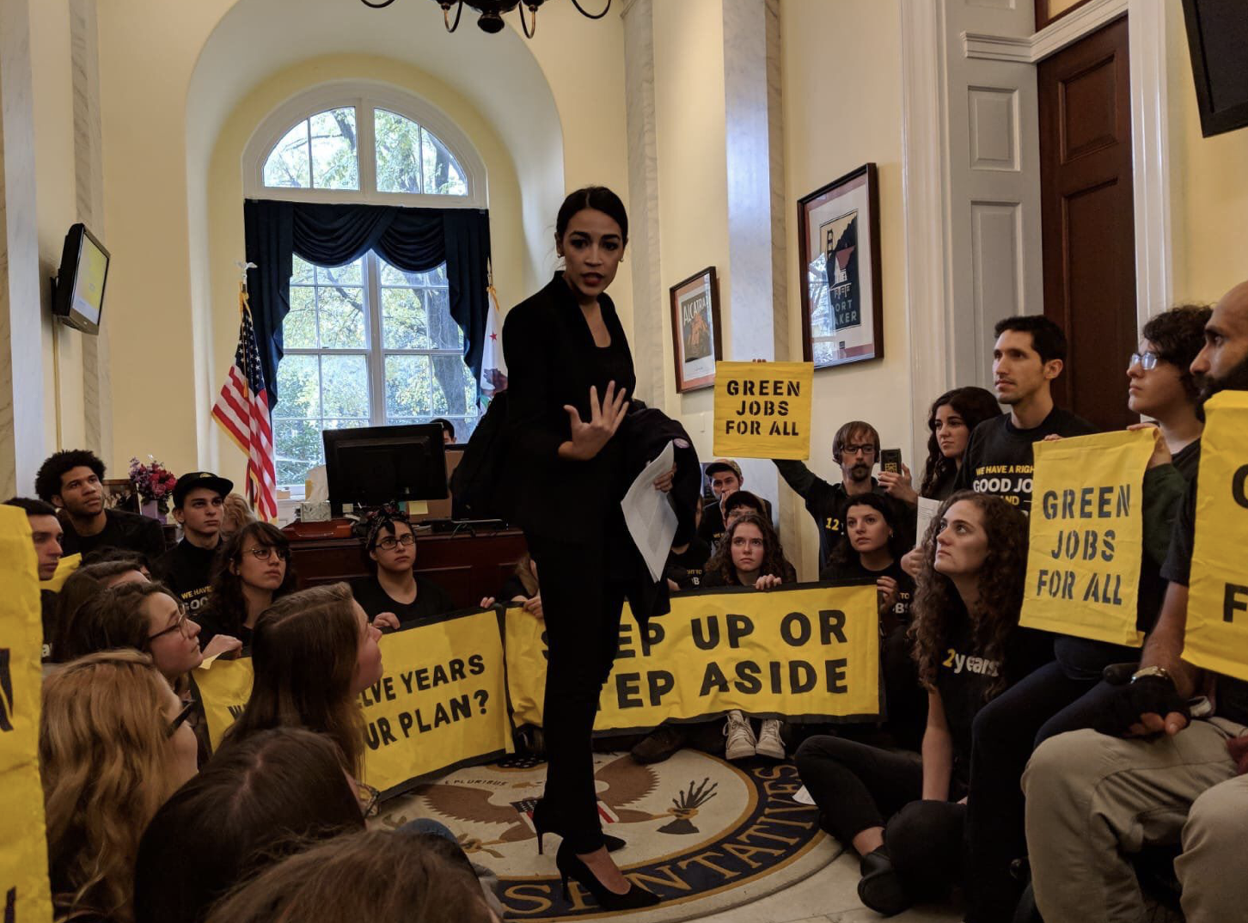
Climate Action: GND
Roots of the Green New Deal
Nov 13th, 2018 protest
AOC rallying behind the Sunrise Movement
This twitter thread:
Notes:
sunrise movement protest of Nov 13th, youth-led climate activism, AOC rallied behind the protestors and tweeted at Nancy Pelosi, bringing the term “Green New Deal” into a major spotlight for the first time.

Slide 7
Creating a Movement
Draws attention to issues and educates people
Puts a name to what’s happening that people can rally behind
#BLM
#GreenNewDeal or #GND
Creates a sense of community
#MeToo
Notes:
Shows that you are not alone in concern over the issues that are impacting you, and that you care about a particular issue.

Slide 8
Twitter
With Twitter, you only get 280 characters, so being concise is key! Only focus on super important details.
Tips:
Can link article for interested followers to learn more
Create threads!
Use hashtags
#CoalCommunityTransition
#BeyondCoal
Twitter Intro:
How to Tweet:
Notes:
It’s important to keep in mind for the campaign I’m working on, #BeyondCoal isn’t just a hashtag for Maryland. It’s a campaign that Sierra Club and activists are running around the country. If you go to Twitter, and search #BeyondCoal, you’ll see these tweets.

Slide 9
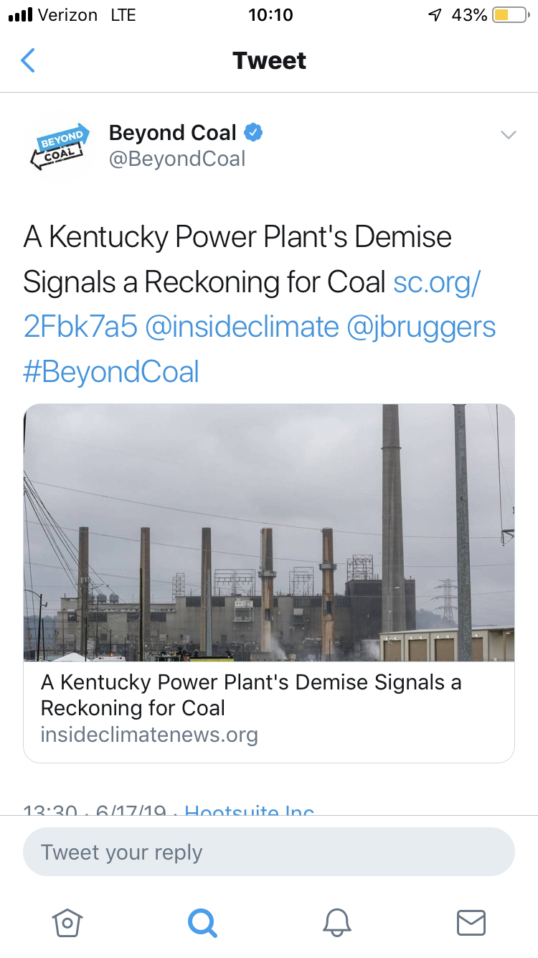
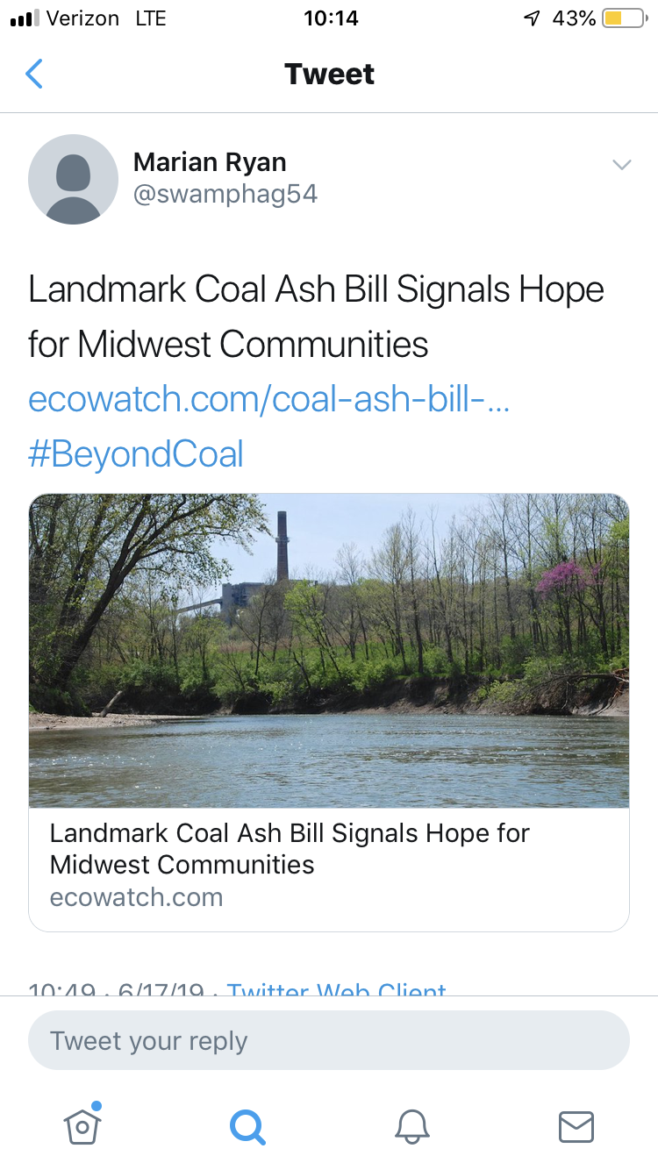
How to Tweet Effectively
Informative Tweet
Very clear, short message
Link to article
Hashtag
Tag (@)
Use bit.ly links
How to tweet an article:
Notes:
Using @ and someone’s username for twitter (or other social media platforms) alerts that person that you are “tagging them”. They will likely see your tweet, and can respond or re-share what you posted to their followers. Hashtags and tagging others are critical for getting noticed.

Slide 10
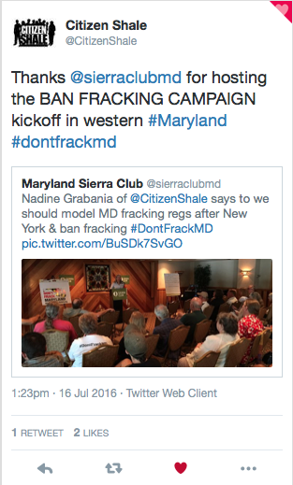
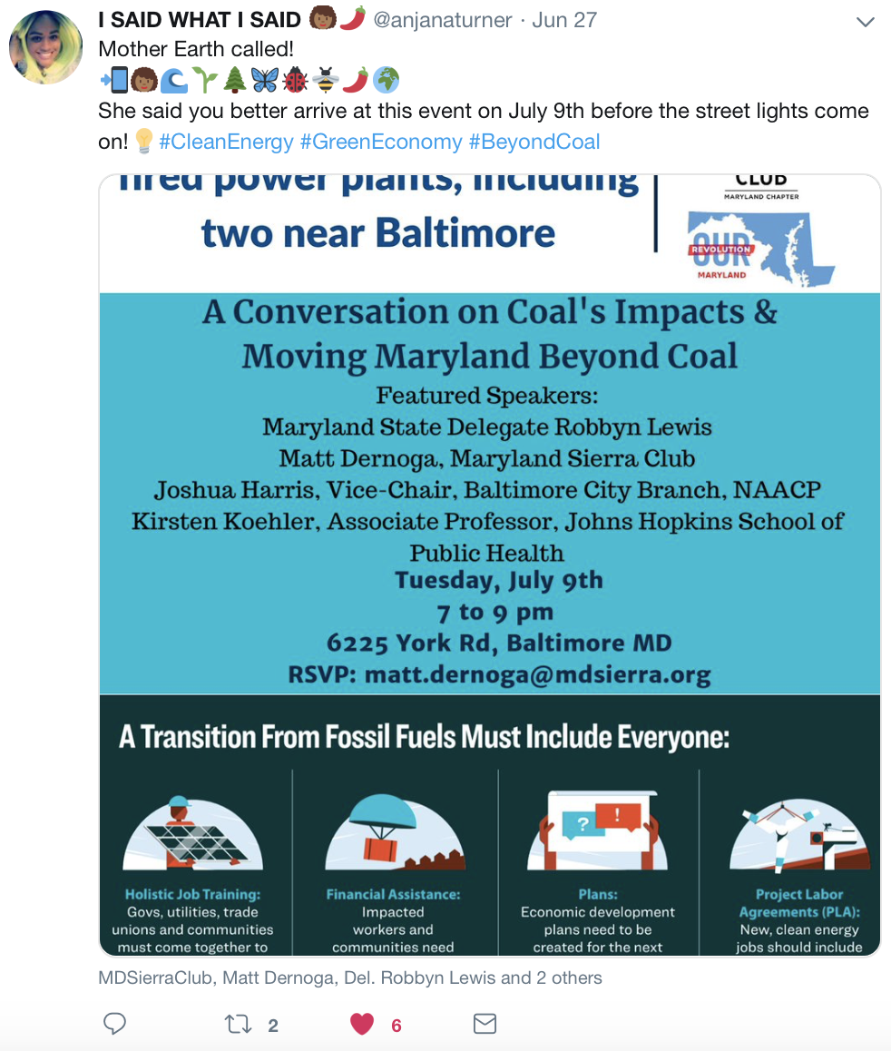
Twitter in Action for Maryland Sierra Club
Notes:
Example of tweet on Baltimore Coal Forum, both the initial tweet and the re-like

Slide 11
Retweet and Reply!
With twitter you can simply…
reply to tweets
retweet (it will show up on your profile and show your followers that you shared it)
Retweet with comment
Create a thread of your own
*Remember* hashtags, tags (people), and location tags are super important!

Slide 12
Instagram
All about **PHOTOS**
Still has hashtags, location tags, and tagging accounts
2 ways to share: story, or post!
Story disappears after 24 hrs
Post stays on your profile
- Can connect to Facebook and
Twitter accounts
- Must use smartphone

Slide 13
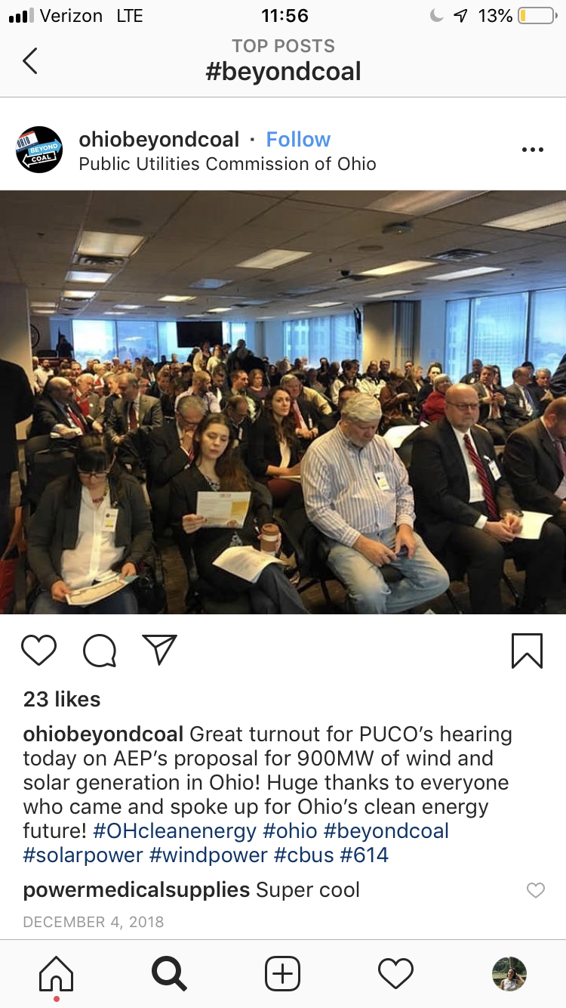
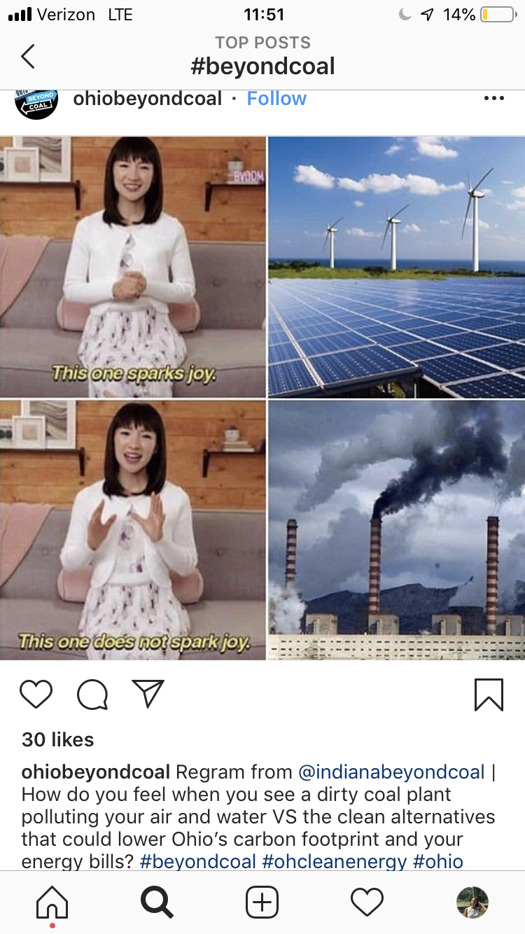
Example posts
Informative caption
Hashtags
location
What they got right...
Funny meme as photo
Hashtags
“Regram”
How to improve
Not much info in the caption
No location!
Notes:
“Regram from” is a way to credit who made the initial post

Slide 14
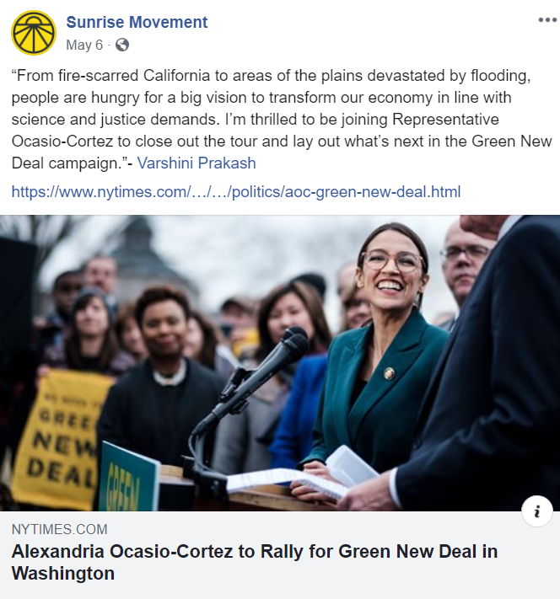
Facebook
You can have longer writing and explanations on your posts.
But keep it interesting.
Visually appealing.

Slide 15
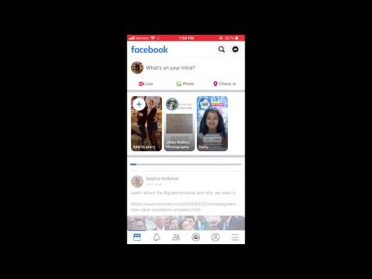
Facebook
You can share links/ news stories with your friends.
Post upcoming events.
Create private or public groups people can join.
Livestream events
Notes:
One thing I want to emphasize here is the benefit to events or actions you are putting together. If you have a couple hundred Facebook “friends” following your account, and you create an event that is a town hall, a forum, or even a call to action for everyone to contact their legislator on a piece of legislation, this can really broaden your reach and increase turnout.

Slide 16
Summary of How to Post Effectively
Short and clear
Attention grabbing / catchy
Inspiring message
Use hashtags
Tag elected officials and other influential users
Images with limited text are usually most effective. Content with relevant images gets 94% more views than content without relevant images.

Slide 17
Use Social Media to Talk to Elected Officials
Like writing letters and calling elected officials, making posts directed at them is another way of immediate contact.
Others can like or share your post to spread the message.
Another way to hold elected officials accountable.
Important Twitter Tip: you can create a list of local and state elected officials to follow. Go to this list, and you’ll see only their tweets and updates. Use this to engage directly with them over the issues they are or aren’t talking about.
Notes:
Reasons why this is important

Slide 18
Example:

Slide 19
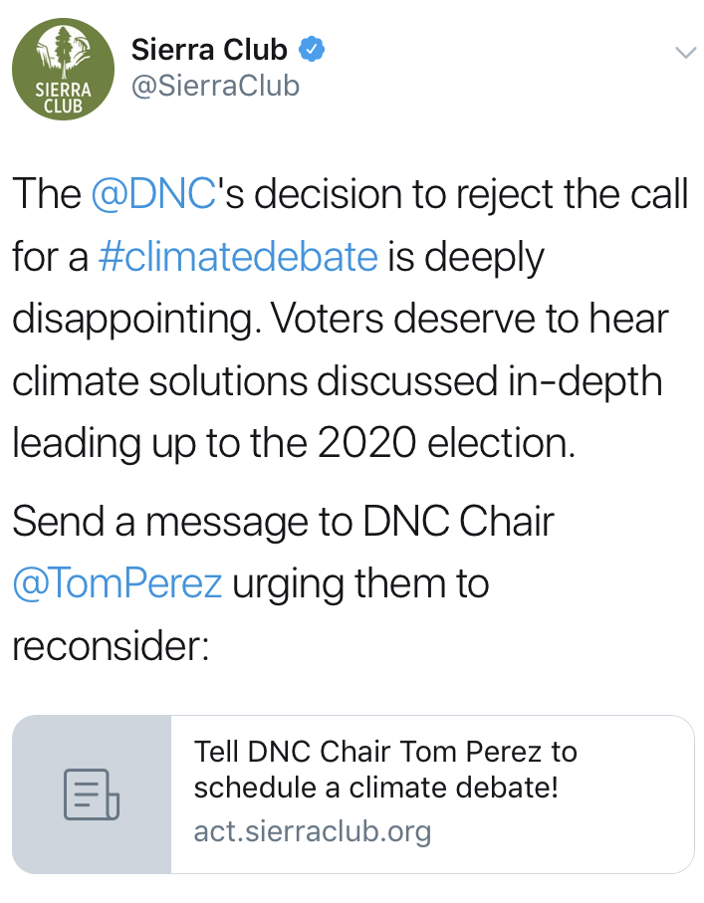
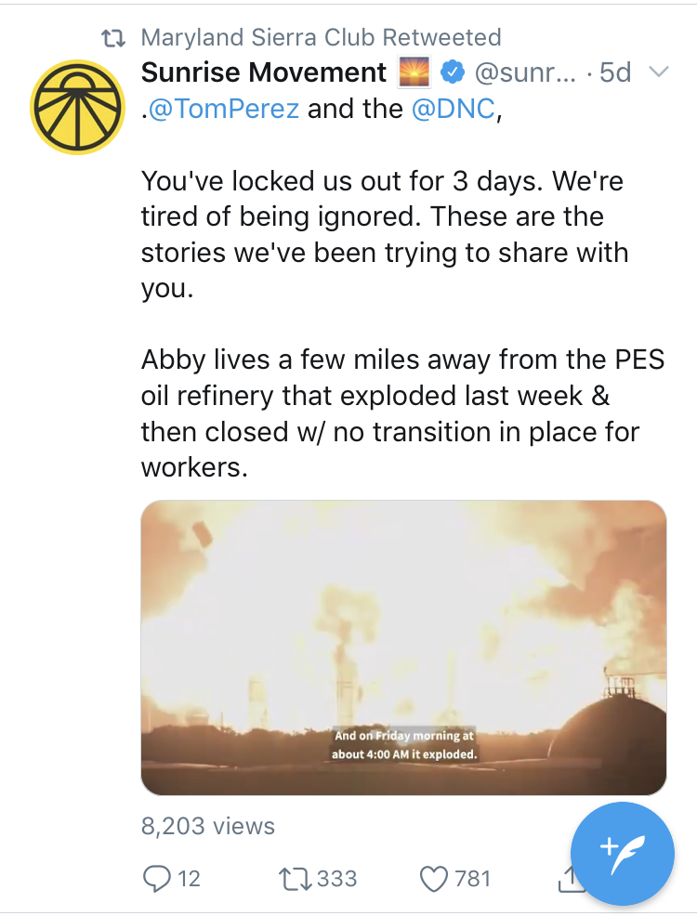
Examples:
Notes:
Tweeting at tom perez and DNC with direct call to actions

Slide 20
Your Turn
Search up our facebook page by typing “Sierra Club Maryland Chapter”
Like the page
Follow the page to receive notifications
Share our most recent post, and add relevant commentary (hashtag)
Notes:
Go to MD Sierra Club Facebook Page, and “like it” to follow it, share our most recent post (add relevant commentary such as a hashtag).

Slide 21
Your turn...
If you have twitter…
Go to the MD Sierra Club Twitter page by searching @sierraclubmd
Follow us!
“Favorite” the most recent post by clicking the heart button
Reply to the post using a hashtag
Notes:
Using twitter (if you have twitter), go to Maryland Sierra Club twitter page, “favorite” the most recent post, and reply to it using a hashtag

Slide 22
Join the Beyond Coal Social Media Team
Our burgeoning coal community transition campaign is working hard to call attention to the impact of coal in Maryland, and the need for a just transition off coal to clean energy.
We need more active social media users to amplify our message, and hold elected officials accountable in Maryland.
15 minute bi-weekly commitment, we prepare the posts for you to share
Write Energy.Intern@mdsierra.org to join.

Slide 23
Recap
Posts should be concise, direct, and clear
Use hashtags, location tags, and make sure to tag people (your elected officials!). This is critical to getting your post seen.
Copy + paste links to articles
Engage with other users by liking or sharing their posts!
Can use social media to create a community, elevate or amplify an issue, and to contact elected officials.
Follow us! :)

