Slide 1
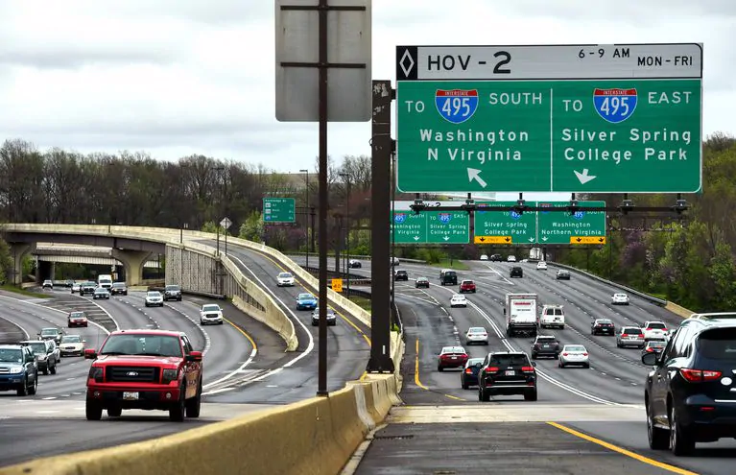
Stop highway expansion!

Slide 2
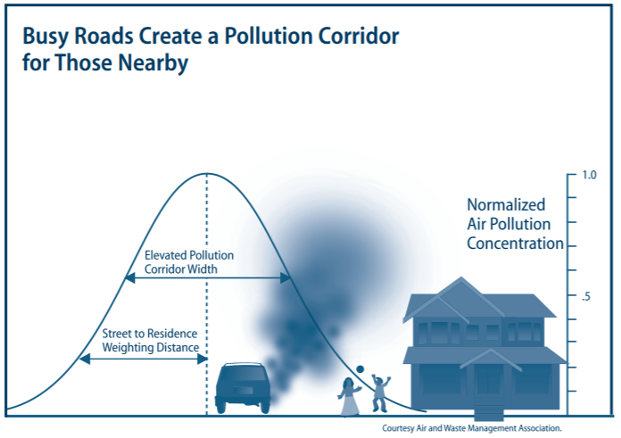
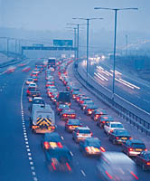
Impacts of Highway Expansion

Slide 3
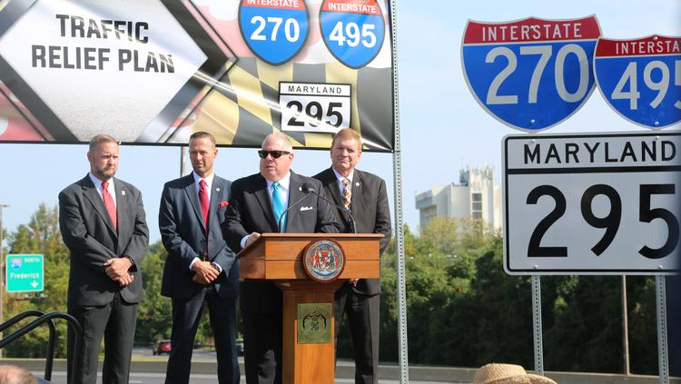

Slide 4
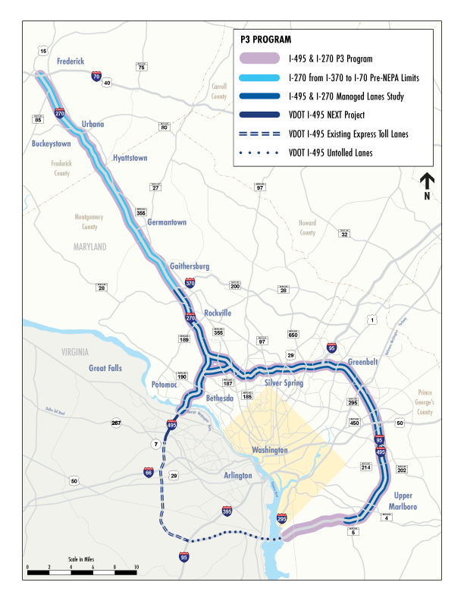
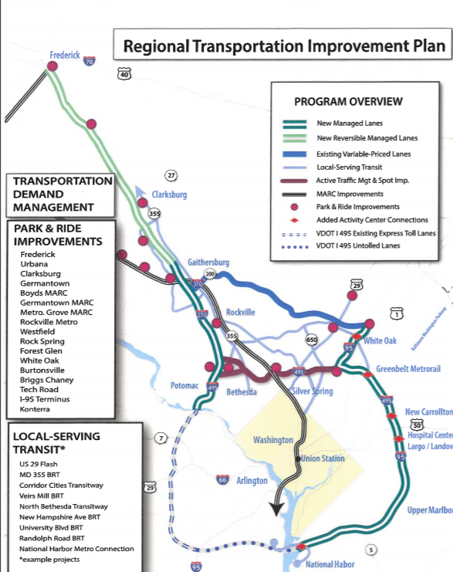

Slide 5
What has happened so far?
April 8 -- HB1091 dies in Senate
April 29 -- Transurban says it won’t bid on 495 project due to political opposition
May 5 –- Councilmember Tom Hucker holds Silver Spring Sunday morning rally with activists (800+ turnout, tweet from Gov. Hogan)
June 3 –- Councilmember Hucker holds Silver Spring press conference on toll free transportation alternatives
June 5 BPW designates tollway project a public-private partnership, 2-1
June 12 -- MNCPPC issues non-concurrence letter, triggers mediation with SHA.

Slide 6
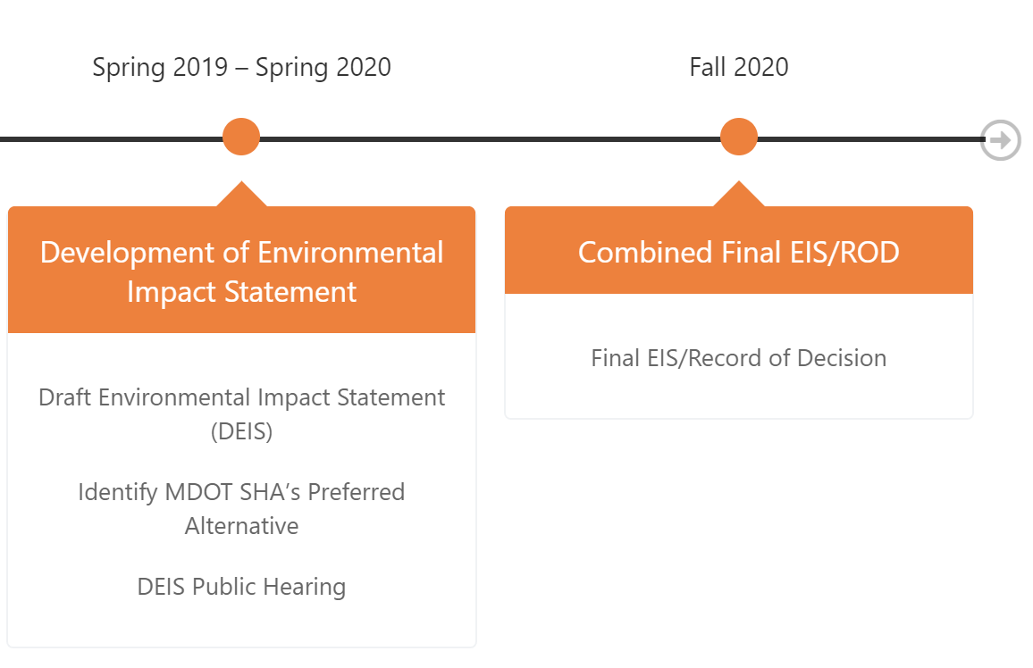
What is next? (NEPA)

Slide 7
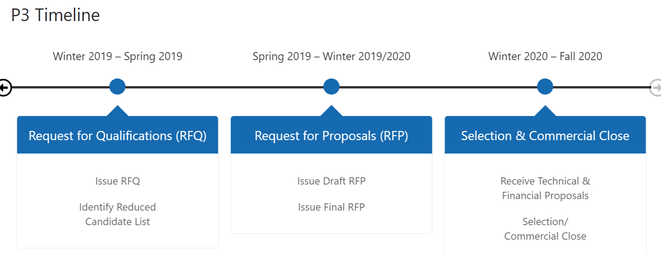
What is next (P3)

Slide 8
How to get involved?
Get Involved! Join our Transportation Committee!
Participate in our monthly Transportation Committee meetings and participate in planning campaign strategy
Organize and participate in townhalls, panel discussions, and webinars
Lobby and contact your elected officials and testify at hearings
Write letters to the editor, op-eds, and blogs
Road Show October 30th (Fredrick), November 4th (Moco),
Email transportation@mdsierra.org to get involved

Slide 9
Fall Road Show
Fredrick: Wed October 30, 7:00 p.m. Winchester Hall, First Floor Hearing Room, 12 East Church Street, Frederick
Prince George’s: Friday, November 1, 10:00 a.m. County Admin. Bldg., Room 2027, 14741 Gov. Oden Bowie Drive, Upper Marlboro
Anne Arundel: Monday, November 4th: Anne Arundel 3:00 p.m. Council Hearing Room, The Arundel Center, 44 Calvert Street, Annapolis
Monday, November 4th: Montgomery 7:00 p.m. County Office Building, Third Floor Hearing Room, 100 Maryland Avenue, Rockville MD 20850

