Slide 1
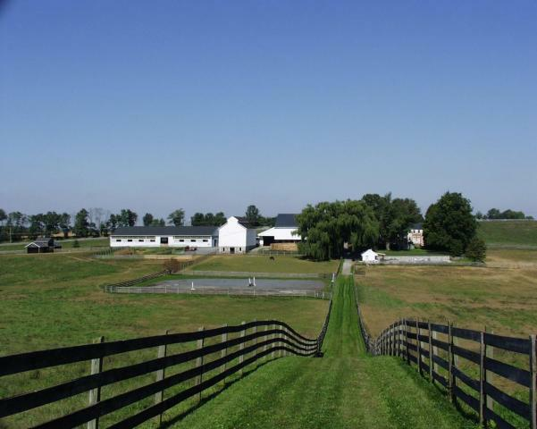

Slide 2
Welcome
Our Purpose
Today’s Agenda

Slide 3
Agenda 5:30-7:30pm
Introductions and expectations
100% Vision – local resolutions and targets
Our current energy profile (DVRPC)
Bright spots
Opportunities and options for collaboration
Next Steps

Slide 4
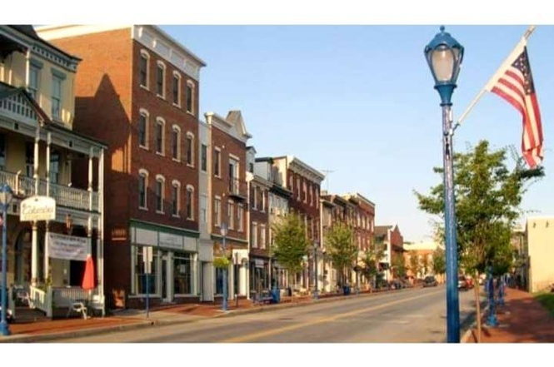
Your Name
Community and your role
What like to get out of this meeting?

Slide 5
100% Resolutions

Slide 6
Phoenixville & WC Resolutions
Goals
100% Renewable Electricity by 2035
100% Renewable Heat and Transportation by 2050
Creating a Plan
(P) direct staff to create milestones & strategy in 2018
(WC) commission a committee or contractor to draft an energy transition plan by Apr 2019
Annual progress reports (bi-annual for WC)
(WC) quarterly reports on progress of energy plan
Renewable Energy Defined
carbon-free and pollution-free energy generated sustainably from renewable sources such as wind, solar, small hydro, tidal, geothermal, and fuel cells (WC)
Prioritize locally generated renewable energy
Engaging with Stakeholders
(WC) all borough stakeholders will have a chance to participate in the planning and implementation of this energy transition

Slide 7
Components of a Good RF100 Resolution
Must
A full transition of at least the electricity sector to clean, renewable energy;
By 2035:​ A target year for when this commitment will be achieved no later than 2035 for electricity and 2050 for all energy sectors;
Equity, Affordability, and Access:​ A commitment to access for all members of the community
Clean and Renewable Resources Only;
Transparent and Inclusive Process: for planning and implementation, ensuring that all members of the community have an opportunity to participate, especially ensuring those who negatively impacted by current energy systems
Suggest
All Energy Sectors;
Goal for Local Generation;
Timeline:​ A detailed timeline for planning and/or implementation;
Commitment to Collaboration:​ work with surrounding communities in achieving aligned clean energy and equity goals;
Commitment to Advocate:​ for policies or regulations at the state, regional and/or federal level that aid the city in their transition
Guideline Doc

Slide 8
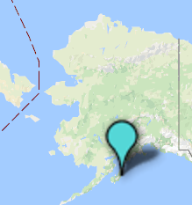
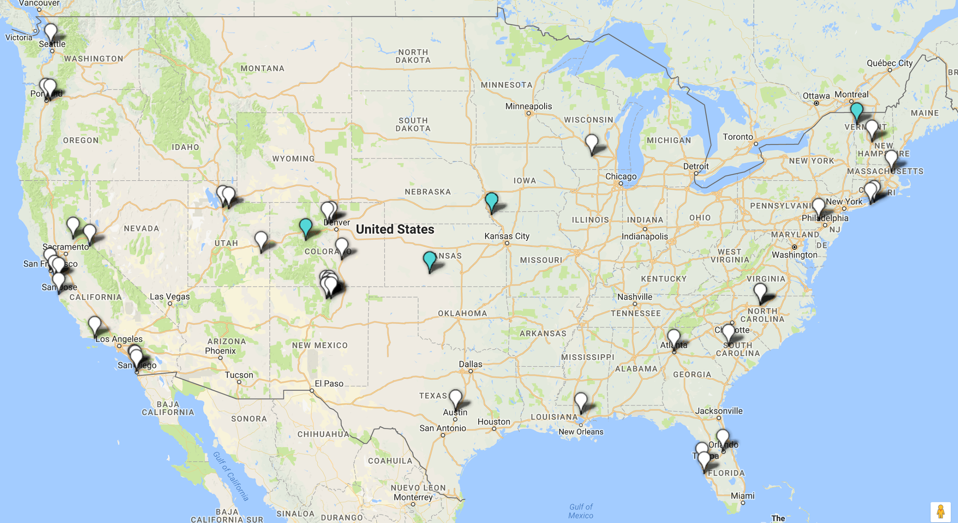
100% Renewable Electricity Cities: 45 Commitments, 5 Have Achieved

Slide 9
Achieved: 100% Renewable Energy
Aspen, CO - a mix of 50% wind, 45% hydropower, 5% from solar and landfill gas. More
Burlington, VT - utility scale wood pellet burning steam generators. more
Greensburg, KS - most LEED buildings per capita in US. 100% local wind. Rebuilt from devastation of tornado. more
Kodiak Island, AK - combination of wind and hydro-electric. saved the local residents $22 million compared to diesel costs. More
Rock Port, MO - 2008 - first city in US to produce more electricity than they use from local wind turbines. Excess is sold to MO utility. More
Committed: 45 cities have passed resolutions 44. Phoenixville, PA 45. West Chester, PA
In the Works: Hundreds have organized initiatives to make a commitment
In Pennsylvania: Philadelphia, Pittsburgh, Reading, Bristol
Minneapolis, MN
Chicago, IL
Arlington, VA
Columbus, OH
Madison, WI
Tulsa and Norman, OK

Slide 10
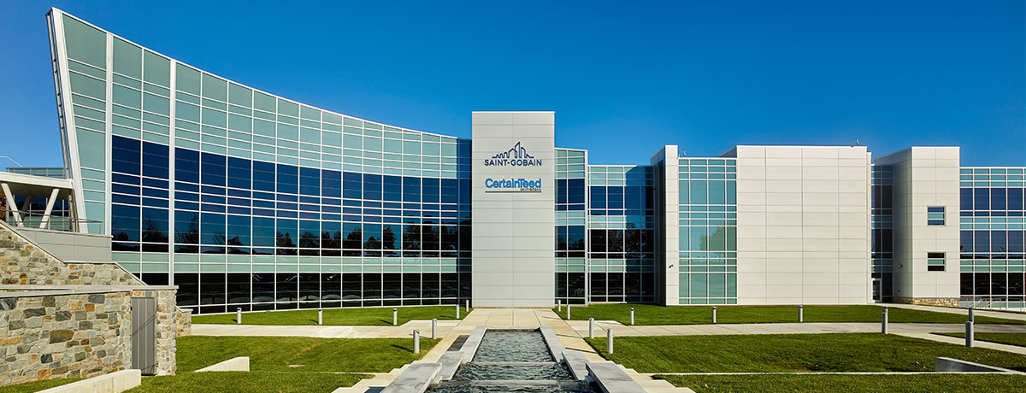
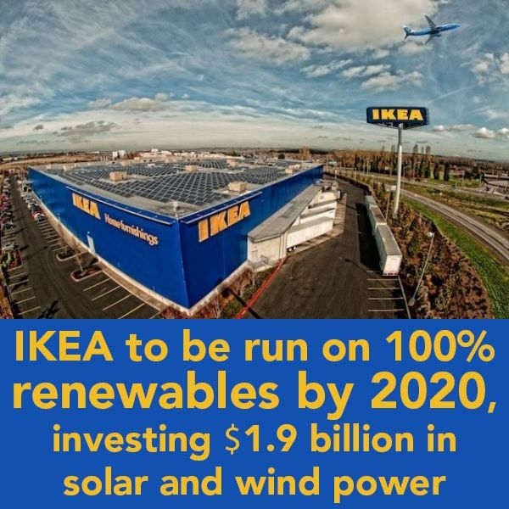
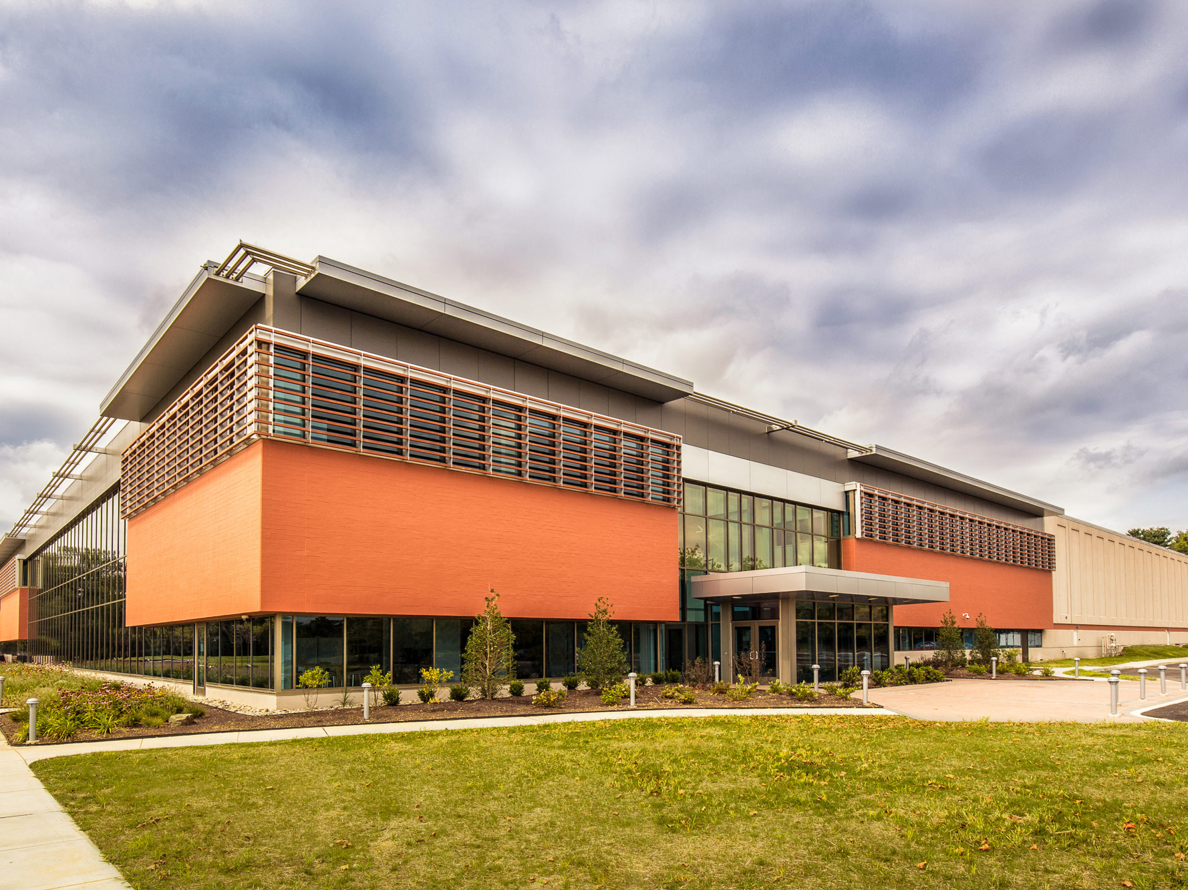

Slide 11
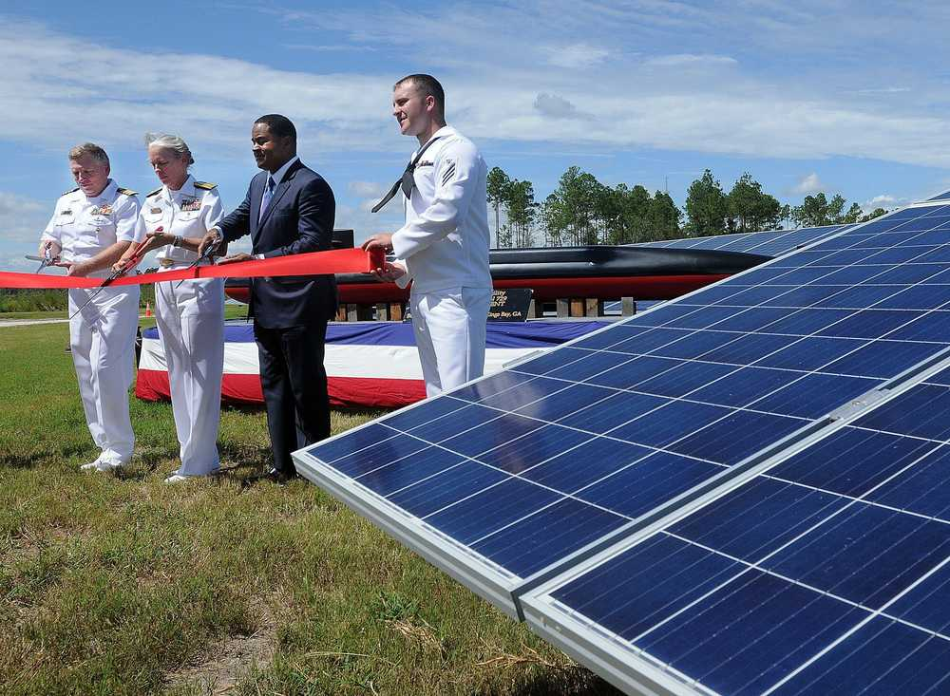

Slide 12
Notes:
Surge or local responses

Slide 13
Carbon Neutral Cities
Play
https://www.youtube.com/watch?v=vAK7qAGeeVw
https://www.youtube.com/watch?v=TDANRkes6Q4&spfreload=10
Notes:
Let’s listen to some examples.

Slide 14
Symbolic Statement
Mayors For Clean Energy Endorsement
Start the conversation - get people’s attention
Clean Energy Resolution
Goal Setting Shows Political Commitment
Moving the resolution through committees gets more leaders involved, incorporates various interests
Comp Plan Updates
Puts the energy transition in context with other sustainability initiatives
Comp Plan is the place for far-sighted goals
Energy Transition Plan
(or Climate Action Plan)
A roadmap for achieving the goals of the resolution
Options, prioritize actions, cost estimates, progress metrics, equity assessments, reference models
Stakeholder Engagement
Serious meetings with community, business, institutions, institutions, etc
Before, during and after the roll-out of the transition plan
Energy Action
Efficiency incentives, grid options, local generation, energy storage, demand reduction, collective bargaining, micro-grids, matching buyers with sellers
Don’t leave people behind - keep this transition fair and inclusive

Slide 15
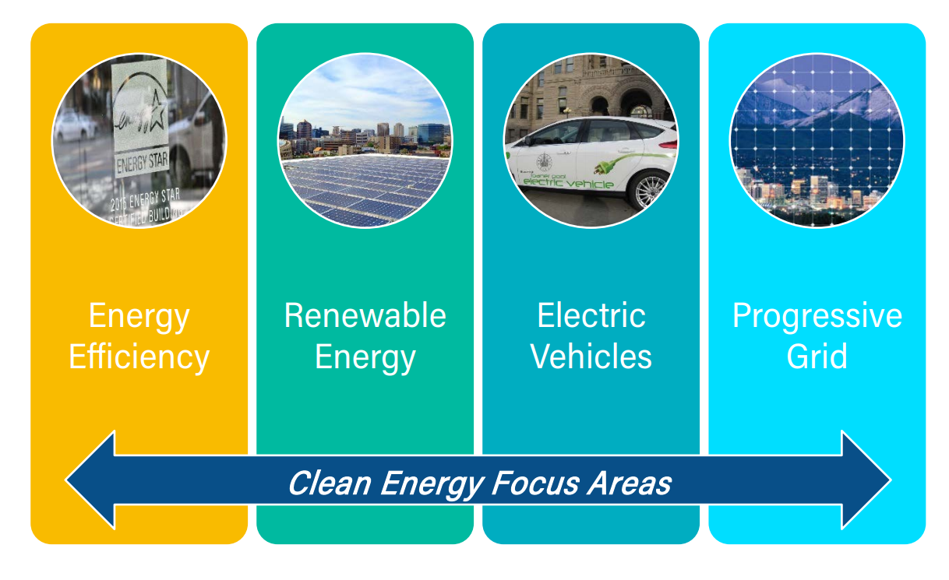
Community-Wide Plans
Corvallis, OR Action Plan &
Cost Estimates
Salt Lake City Implementation Plan

Slide 16
What will work best for us locally?
Where does collaboration make sense?
What information and expertise do we need to move forward?
Who needs to be involved, who are our potential partners?
How best to involve them?

Slide 17
Possible working groups
Steering/Leadership Group
Strategy Group
Partnership development group
Stakeholder input and feedback
Energy solutions
Others?
Roles
Timeline
Next steps
Facilitation

Slide 18
Upcoming Options
Presentation by DVRPC on energy
Request potential renewable energy production assessment
RFP process
Other?
Begin stakeholder dialog
December 9th on local responses to extreme weather at West Chester University
Other?

Slide 19
“A HUNDRED YEARS from now, looking back, the only question that will appear important about the historical moment in which we now live is the question of whether or not we did anything to arrest climate change.”
THE ECONOMIST December 2011

